Slide 1
Travel Orders and Request Form
California cadet corps

Slide 2
The process
Travel Request Form
Travel resources
Travel Vouchers
Logon problems
Special Circumstances
Installing Calaters
Cacadets.org
Point of contact

Slide 3
Travel Request Form

Slide 4
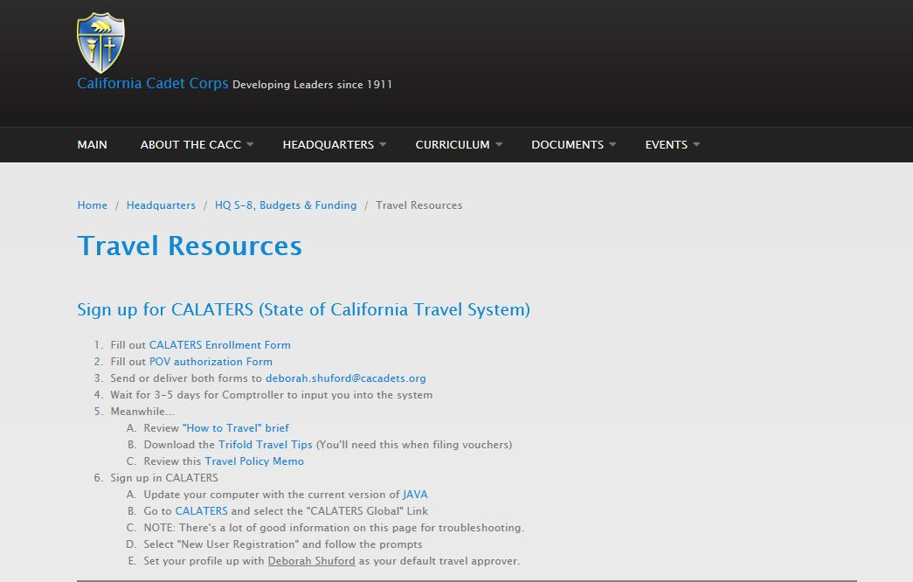
Travel Resources (calaters)

Slide 5
Travel Resources (Travel vouchers)

Slide 6
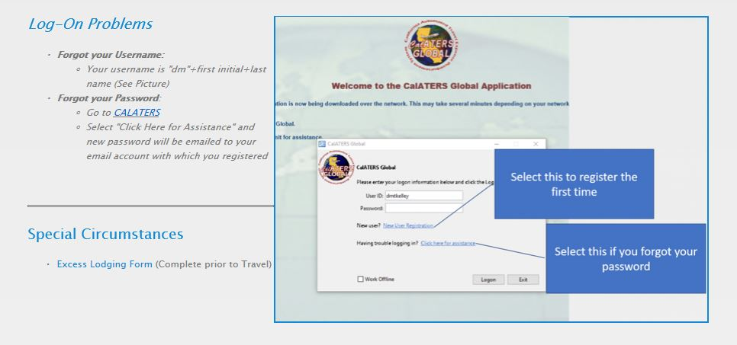
Travel Resources (logon problems)

Slide 7
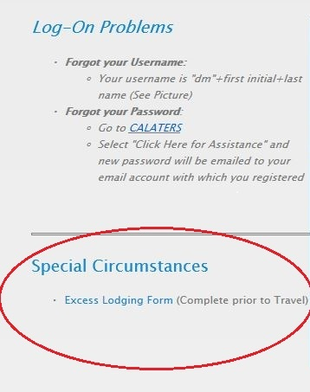
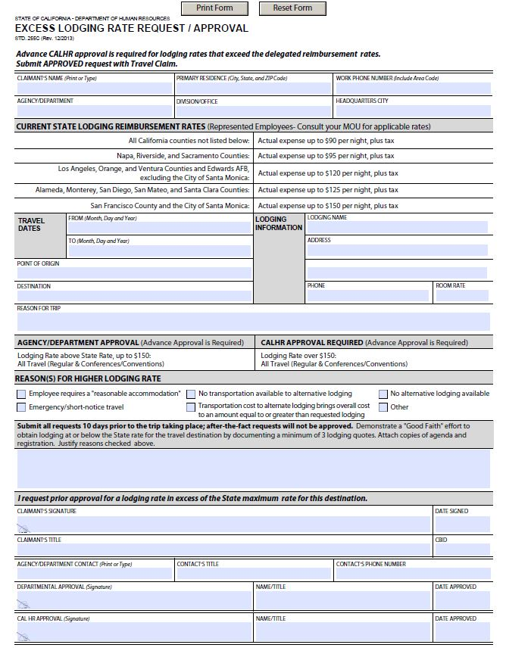
Travel Resources (Special circumstances)

Slide 8
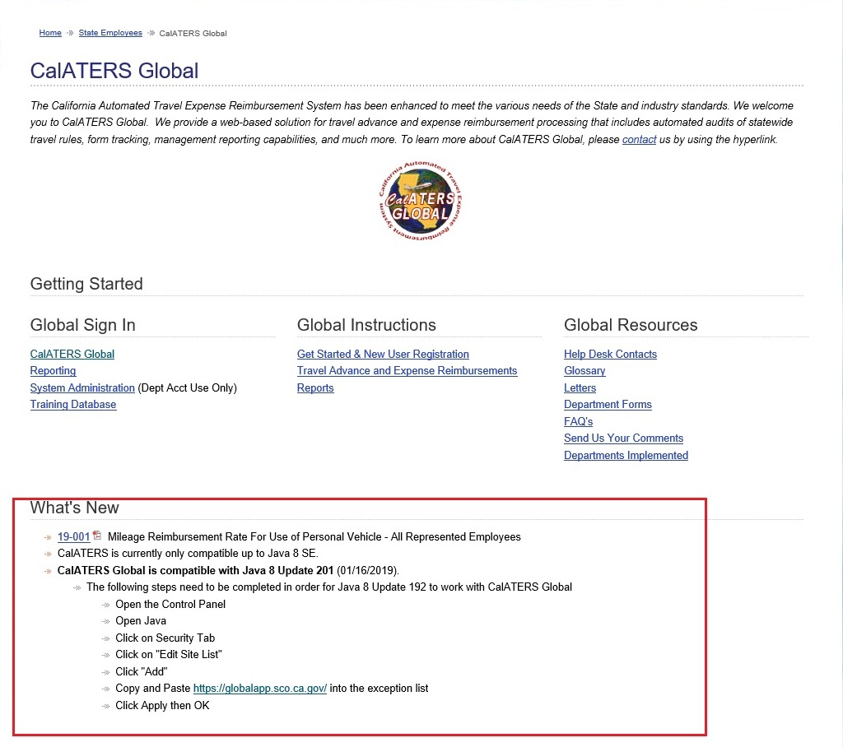
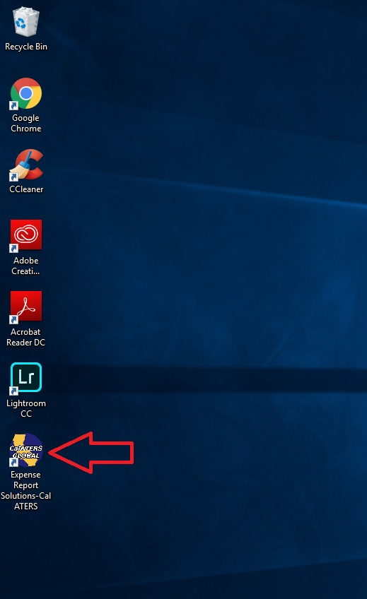
INSTALLING CALATERS GLOBAL
Java Installation:
1: Go to Java Website and install a new version or update current version.
2: Once Java is up to date, then you can proceed to adding the website to the exception list(directions can be found on this page) which will give you the ability to install Calaters Global software and the desktop icon.
3: This process can take place before signing up with Calaters Global to avoid complication later.
This is what the
desktop icon
looks like.

Slide 9
Point of contact
Associate Governmental program Analyst – Financial Resources
Email: Deborah.Shuford@cacadets.org
Phone: 805-782-6749

Slide 10
Thank you!

