Slide 1
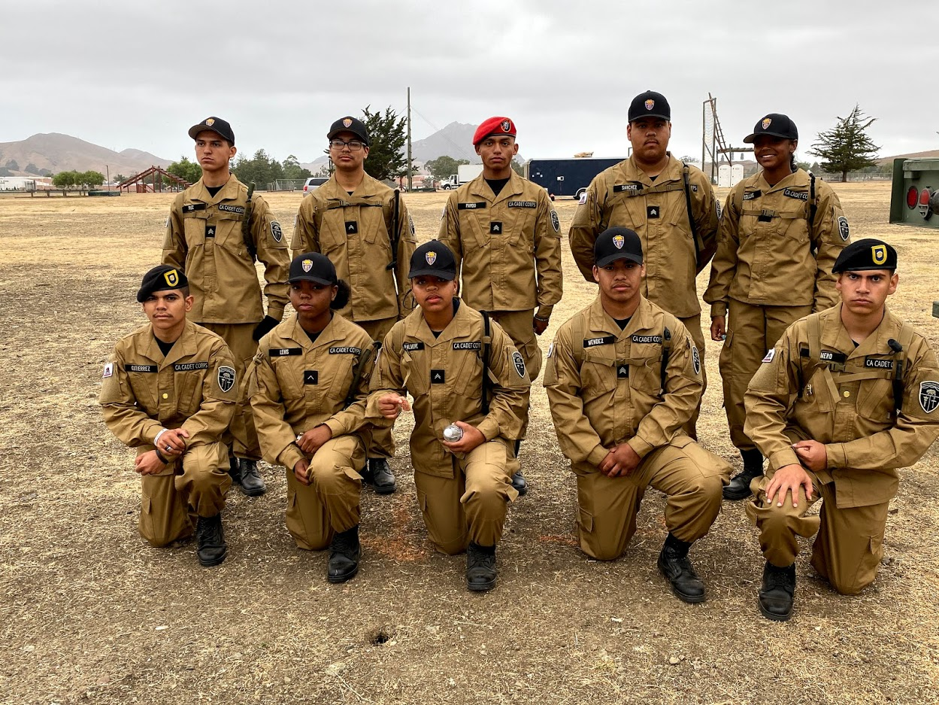
California Cadet Corps
Curriculum on Military Knowledge
“Look Sharp. Feel Sharp. Be Sharp!”
M2B: Class C Uniform

Slide 2
Class C Uniform Agenda
B1. Coyote Brown Class C Uniform
B2. Khaki Class C Uniform

Slide 3
Coyote Brown Class C uniform
B1. Wear the Coyote Brown Class C Uniform to standard.

Slide 4
Coyote brown Class C Uniform
OBJECTIVES
DESIRED OUTCOME (Followership)
90% of Cadets will understand when the Class C Uniform is appropriate for wear, will be able to wear it properly, and describe the standards for each of the parts of the uniform.
Plan of Action:
Wear the Coyote Brown Class C Uniform to standard.
Wear the Khaki Class C Uniform to standard
Essential Question: What are the standards for wearing the Class C Uniform properly? What are all the parts to it?

Slide 5
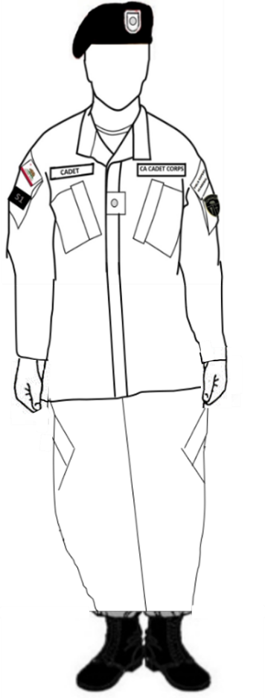
Class C Uniforms
Coyote Brown Class C Uniform
Khaki Class C Uniform

Slide 6
Coyote Brown Class C Uniform

Slide 7
Headgear
A cap must be worn with this uniform. The basic cap is the CACC baseball-style cap. If you have completed training and received orders authorizing the red or black beret or the drill instructor hat, you may wear those as well.
CACC baseball-style cap
Black Cadet Leadership Beret
Red Survival Beret
Cadets who have been authorized permanent wear of the Drill Instructor Hat may wear it
Cadets who have graduated the Cadet Drill Instructor Course and are engaged in drill-related training may wear the Drill Instructor Hat during that training

Slide 8
Headgear
Rank insignia is centered. All caps are worn so that no hair is visible on the forehead beneath the cap.
The Beret is worn with the headband straight across forehead, 1” above eyebrows. Flash is positioned over left eye. The right side of the beret is draped toward the right ear. Rank insignia is centered on flash.

Slide 9
T-Shirt
Wear a plain black crew neck T-Shirt with no marking on it (CACC PT shirt may be worn).
Tuck in your T-Shirt.
Fasten ALL buttons and Velcro on pants and blouse.

Slide 10
Patches - Coyote Brown Class C
Nametape is brown on black, worn on Velcro above the right pocket, with the cadet’s last name.
The California Patch is worn on the wearer’s top right sleeve pocket, centered on the Velcro.
A Duty Patch or a brigade or unit patch may be worn on the bottom part of the pocket.
CA Cadet Corps nametape is worn on Velcro above the left pocket.
Achievement tabs (up to 3) may be worn on the top left pocket Velcro.
The CACC Patch (subdued) is worn on the bottom left pocket Velcro.

Slide 11
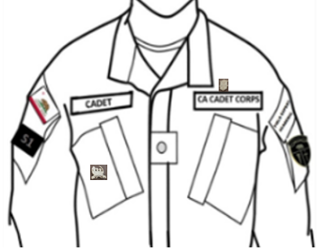
Badges – Coyote Brown Class C
The Drill Instructor Badge may be worn on the right pocket, parallel to the ground.
The Medic Badge may be worn above the CACC nametape.

Slide 12
Rank Insignia
Rank insignia affixed to Velcro between the two pockets.

Slide 13
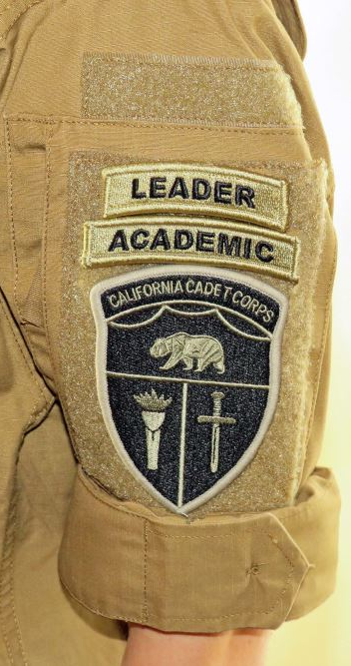
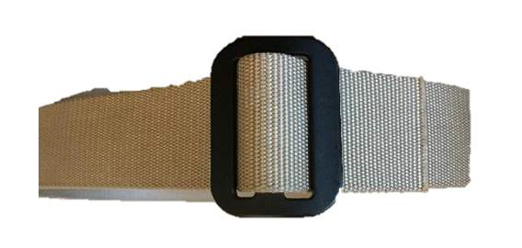
Belt & Sleeves
If sleeves are rolled, roll them so that the outside of the cuff remains out, and no more than 3 inches above the elbow.
Start by turning the sleeve inside out, with the cuff by the shoulder seam. Fold up the bottom twice, as smoothly as possible. Then turn the cuff down on top of the folded material. Practice the spacing so it works for your arms.
A tan or coyote brown belt is worn, with the end pointing to the left.

Slide 14
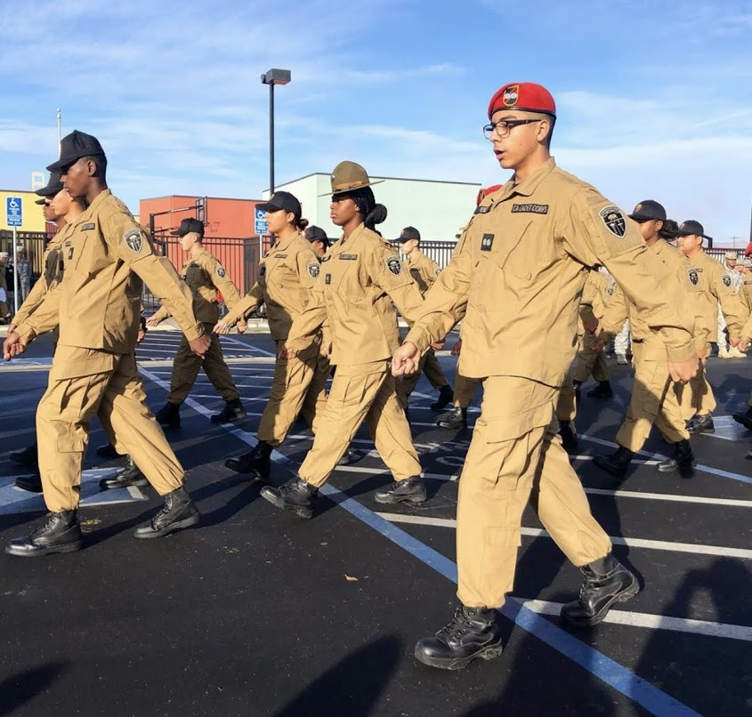
Pants & Boots
Pants are bloused by tucking pants into boots or around a blousing band. Pants should not be bloused down around ankles if a blousing band is used – they should sit right above the boot.
Black or tan boots may be worn. Black boots should be shined.
The blouse is worn outside of the pants, with T-Shirt tucked in.
The uniform is designed to fit loosely; do not alter it to fit snugly.

Slide 15
Blousing Your Boots
Pants are bloused using blousing bands of any type. Without blousing bands, they may be tucked into the boots, but should not present a ‘pegleg’ appearance by being tightly wrapped around the leg.
When bloused, pants should sit on top of the boot – not around the ankles.
Tuck in all loose shoestrings so they don’t hang down.
Socks, if they show, must be a dark color – black is preferred. They should be boot socks or athletic socks that provide cushioning for the feet and must extend above the top of the boot top (ideally by 4-6 inches). Skin should not show between the boot top and pants.

Slide 16
Check on Learning
What is the basic cap worn with the Coyote Brown Class C Uniform?
Which arms are the CACC patch and California patch worn on?
Which two badges may be worn on the Class C Uniform?
Name two ways to blouse your boots that are NOT authorized.

Slide 17
Khaki Class C uniform
B1. Wear the Khaki Class C Uniform to standard.

Slide 18
Khaki Class C Uniform
OBJECTIVES
DESIRED OUTCOME (Followership)
90% of Cadets will understand when the Class C Uniform is appropriate for wear, will be able to wear it properly, and describe the standards for each of the parts of the uniform.
Plan of Action:
Wear the Coyote Brown Class C Uniform to standard.
Wear the Khaki Class C Uniform to standard
Essential Question: What are the standards for wearing the Class C Uniform properly? What are all the parts to it?

Slide 19
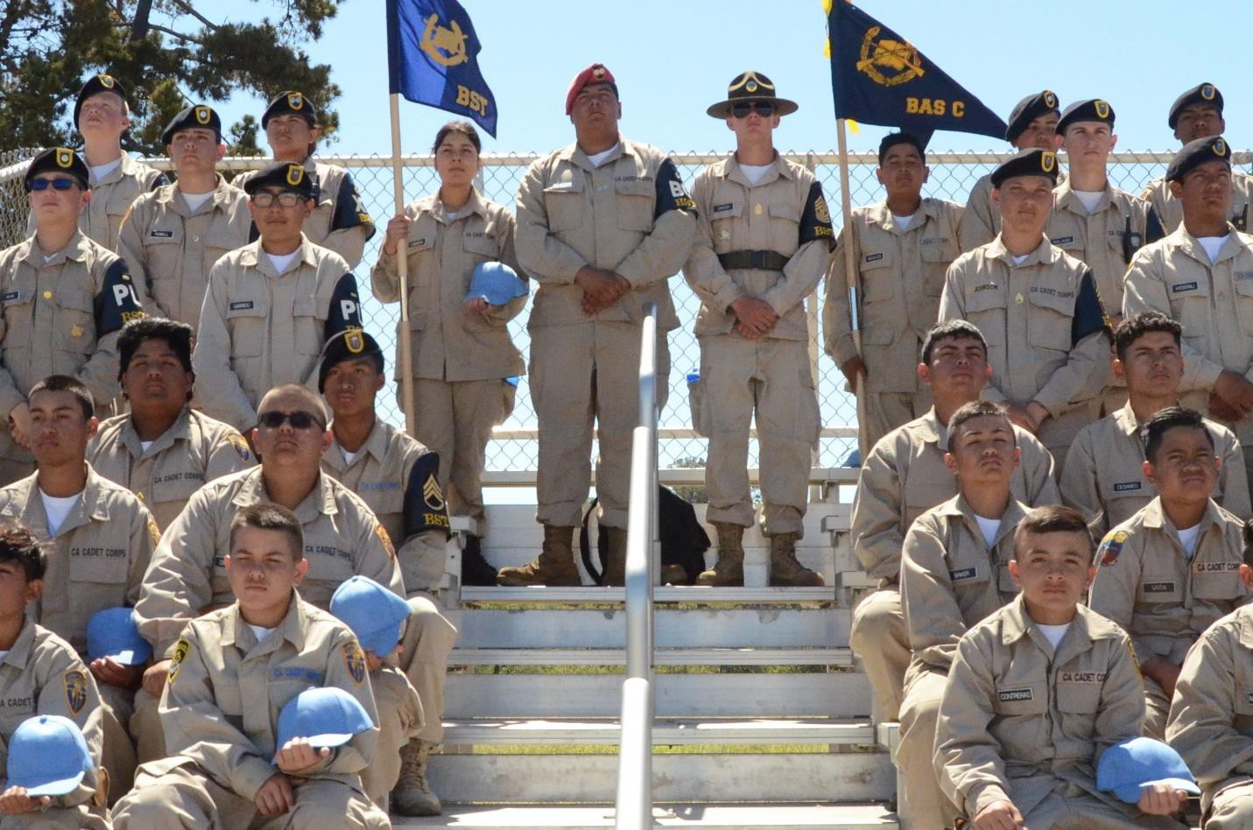
Khaki Class C Uniform

Slide 20
Headgear
A cap must be worn with this uniform. The basic cap is the CACC utility cap, also called a patrol cap. The CACC baseball-style cap may also be worn by all cadets. If you have completed training and received orders authorizing the red or black beret or the drill instructor hat, you may wear those as well.
CACC baseball-style cap
Black Cadet Leadership Beret
Red Survival Beret
Cadets who have been authorized permanent wear of the Drill Instructor Hat may wear it
Cadets who have graduated the Cadet Drill Instructor Course and are engaged in drill-related training may wear the Drill Instructor Hat during that training

Slide 21
Headgear
Rank insignia is centered. All caps are worn so that no hair is visible on the forehead beneath the cap.
The Beret is worn with the headband straight across forehead, 1” above eyebrows. Flash is positioned over left eye. The right side of the beret is draped toward or over the right ear. Rank insignia is centered on flash.

Slide 22
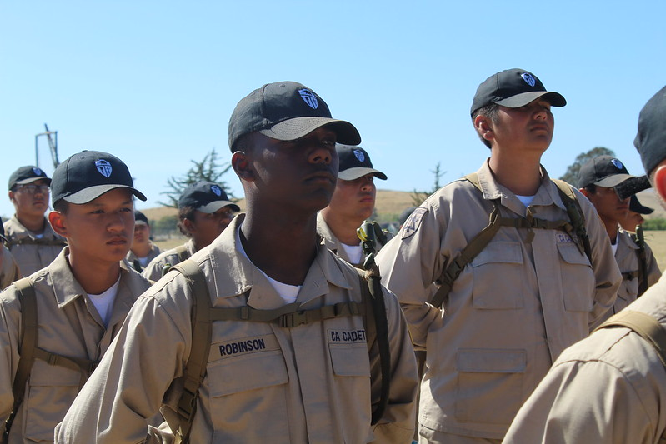
T-Shirt
Plain black or white crew neck T-Shirt with no marking on it (CACC PT shirt may be worn).
Tuck in your T-Shirt.
ALL buttons buttoned on pants and blouse; all Velcro closed.

Slide 23
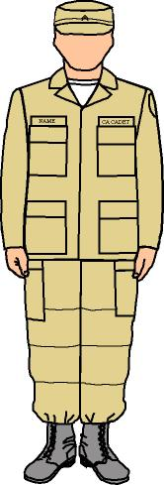
Patches & Nametapes
Khaki Class C
Brigade or unit patch, if worn, is worn on the wearer’s right, 1/2 inch from the seam, centered. No crease on patch.
Cadet Corps patch is worn on the wearer’s left, 1/2 inch from the seam and centered. No crease on patch.
Embroidered blue on tan nametape above the right pocket, or black nameplate centered on the pocket. Cadet’s last name only.
Embroidered CA CADET CORPS blue on tan tape above the left pocket. Note that no ribbons are ever worn on this uniform

Slide 24
Rank Insignia & Badges
Cadet Medic Badge worn 1/8-inch above the Cadet Corps nametape
Top of rank insignia centered between and aligned with the tops of the pockets
Cadet Drill Instructor Badge worn centered on the right pocket.

Slide 25
Pants & Boots
Pants are bloused by tucking pants into boots or around a blousing band. Pants should not be bloused down around ankles if a blousing band is used – they should sit right above the boot.
Black or tan boots may be worn. Black boots should be shined.
The blouse is worn outside of the pants, with T-Shirt tucked in.
The uniform is designed to fit loosely; do not alter it to fit snugly.

Slide 26
Blousing Your Boots
Pants are bloused using blousing bands of any type. Without blousing bands, they may be tucked into the boots, but should not present a ‘pegleg’ appearance by being tightly wrapped around the leg.
When bloused, pants should sit on top of the boot – not around the ankles.
Tuck in all loose shoestrings so they don’t hang down.
Socks, if they show, must be a dark color – black is preferred. They should be boot socks or athletic socks that provide cushioning for the feet and must extend above the top of the boot top (ideally by 4-6 inches). Skin should not show between the boot top and pants.

Slide 27
Check on Learning
Describe where the headband of all the caps worn with the Class C uniform is worn.
What color T-Shirt do you wear with the Khaki Class C Uniform?
Do you wear a California Patch on the Khaki Class C Uniform?
What do you do with shoestrings when wearing the Class C Uniform?

