Slide 1
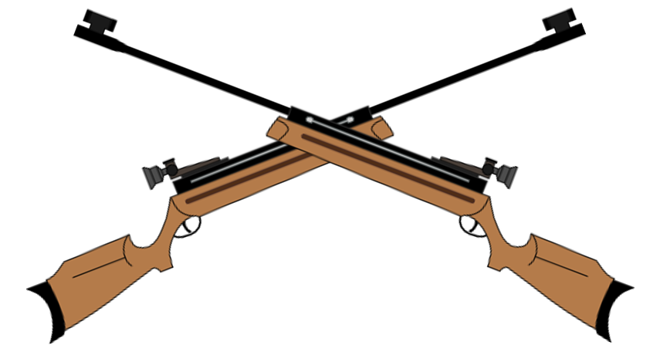
California Cadet Corps Curriculum on Military Knowledge
“On Target!”
M13/C: Competitive Marksmanship

Slide 2
Agenda
C1. Why Competitive Marksmanship?
C2. How to Compete
C3. Rifle Matches
C4. State Championship Rifle Matches

Slide 3
WHY COMPETITIVE MARKSMANSHIP
C1. Cadets are able to safely participate in a rifle marksmanship competition as part of a rifle team.

Slide 4
Why Competitive Marksmanship
OBJECTIVES
Cadets are able to safely participate in a rifle marksmanship competition as part of a rifle team.
Plan of Action
Explain the benefits of marksmanship competition
Essential Question: What benefits are there to cadets who participate in the sport of rifle marksmanship?

Slide 5
Competitive Marksmanship
Marksmanship is a sport
Provides an athletic option for cadets
Competition is the ultimate goal, providing motivation to improve
Competitions available from local to international level

Slide 6
Marksmanship as a Sport
Builds marksmanship skills
Develops self-discipline
Develops focus
Develops precision & attention to detail
Offers continuous challenge
Offers a venue with male/female equality
Clubs available outside the school as well

Slide 7
Check on Learning
1. Name two positive personal attributes marksmanship can help you improve.
2. TRUE or FALSE:
Males and females compete separately in most marksmanship competitions.

Slide 8
HOW TO COMPETE
C2. Explain how a cadet is able to compete as a member of a rifle team.

Slide 9
Firearms Safety Rules
OBJECTIVES
Cadets are able to safely participate in a rifle marksmanship competition as part of a rifle team.
Plan of Action
2. Explain how a cadet is able to compete as a member of a rifle team.
Essential Question: How does a cadet compete in the sport of rifle marksmanship?

Slide 10
Rifle Team
If your school or Cadet Corps unit already has a rifle team, you just need to build your skills and talk to the coach about joining the team
If your school doesn’t have a rifle team, this is an excellent leadership opportunity – YOU can find others who want to shoot and build a team at your school!
Some schools and districts do not allow shooting sports. Find out what policies affect you before you start.

Slide 11
Simple or Complex
You may just start with a Cadet Corps Rifle Team.
Get 5-10 cadets together, schedule marksmanship training and shooting practice, and sign up for the State Marksmanship Championships held in February each year.
Work with your local NRA or CMP club to use equipment and facilities

Slide 12
Cadet Corps Competition
Senior Division – high school cadets
9th grade and higher
Junior Division – middle school cadets
8th grade and below

Slide 13
Simple or Complex
Form a school rifle team
Compete in NRA or CMP matches
Compete in state championships
Send a team to national championships
All this is possible if you’re motivated to do it!

Slide 14
Competition
Awards at State Championships
Governor Goodwin J. Knight Marksmanship Award
3 Sr Div cadets firing highest individual scores
Brigadier General Carter C. Speed Marksmanship Award
3 Jr Div cadets firing highest individual scores
Dion O’Sullivan Marksmanship Award
3 teams cadets firing highest team aggregate scores

Slide 15
Check on Learning
1. When is the annual state rifle marksmanship championship held most years?
2. What organizations exist that will help provide opportunities to shoot locally?
3. TRUE or FALSE:
It only takes about five interested cadets to form a Rifle Team.
4. TRUE or FALSE:
A 9th grader in a military institute fires in Senior Division.

Slide 16
RIFLE MATCHES
C3. Identify the rules that govern rifle matches.
C4. Explain the California Cadet Corps State Rifle Championship Match program.

Slide 17
Rifle Match Rules
OBJECTIVES
Cadets are able to safely participate in a rifle marksmanship competition as part of a rifle team.
Plan of Action
3. Identify the rules that govern rifle matches.
4. Explain the California Cadet Corps State Rifle Championship Match program.
Essential Question: How do California Cadet Corps rifle matches work?

Slide 18
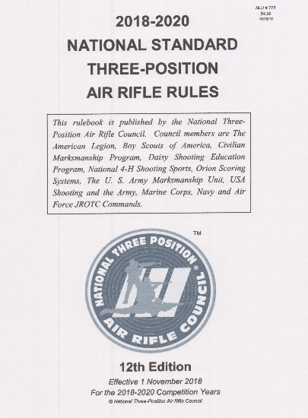
Rifle Matches
Air Rifle competition: Civilian Marksmanship Program (CMP) Rules
Smallbore (.22 cal) Rifle competition: National Rifle Association (NRA) Rules

Slide 19
Alternative
Cadet Corps Competition
May use rules that meet CR 3-17 requirements
Generally follow same standards as NRA/CMP
Supervising Adult does not need to be certified by NRA or CMP
Simpler to put on a competition
Can use CACC awards instead of NRA/CMP
Won’t count toward NRA/CMP requirements

Slide 20
Timing
NRA and CMP Rules
1 minute per shot for prone & kneeling
90 seconds per shot for standing
NRA Set-up time allows 5 minutes for position and target change between positions
CMP uses 8 minutes preparation & sighting, 5 minutes for position change, 5 minutes for sighting
NRA Smallbore Range Fire: 45 minutes
CMP Air Rifle Range Fire: 63 minutes

Slide 21
Special Rules
Only metallic sights used
Only standard velocity ammunition used
State-provided targets
Individuals who don’t have a team can request to compete
Participating cadets must have earned at least a Marksman qualification badge to be eligible to compete at state matches

Slide 22
State Matches
Senior Division Fires 3 x 10 course of fire
Prone
Standing
Kneeling
Junior Division – 30 shots in Prone Unsupported

Slide 23
State Matches
Ties decided by:
Highest ranking score in Standing, then
Highest ranking score in Kneeling, then
Highest ranking score in Prone, then
Greatest total number of Center shots, then
Refiring Standing (or Prone for Jr Div)

Slide 24
Postal Matches
Teams agree to follow established match rules and conditions
Teams fire at their home location
Submit their targets or scores to a match supervisor who adjudicates the match remotely
Multiple postal matches can be used with aggregate scores for a state postal championship

Slide 25
Check on Learning
1. TRUE or FALSE:
Postal matches give the opportunity for competition without travel.
2. Smallbore Rifle competition follows which rules?
NRA
CMP
3. TRUE or FALSE:
California Cadet Corps rifle competitions do not always follow all the rules established for NRA or CMP competitions.

