Slide 1
Curriculum On College & Careers
Unlocking a door to the future
“Military Careers”

Slide 2
Military Careers Agenda
B1. Careers in the Military
B2. Joining the Military
B3. Applying to US Military Academies
B4. ROTC
B5. National Guard and Reserves

Slide 3
CAREERS IN THE MILITARY
B1. Discuss the career opportunities offered by the military and know where to find career information.

Slide 4
“Exploring Careers in the Military” (24:57)
“Military Careers” (1:00)
Double Click on the picture or the link for video

Slide 5
24 Career Fields
Accounting, Budget & Finance | Arts, Communications, Media & Design | Aviation
Business Administration & Operations | Combat Operations | Communications Equipment Technicians
Construction, Building & Extraction | Counseling, Social Work & Human Services | Cyber
Education & Training | Engineering & Scientific Research | Environmental Health & Safety
Health Care Practitioners | Human Resources Management & Services | Information Technology, Computer Science & Mathematics
Intelligence | International Relations, Linguistics & Other Social Sciences | Law Enforcement, Security, & Protective Services
Legal Professions & Support Services | Mechanic & Repair Technicians | Medical & Clinical Technicians
Naval & Maritime Operations | Personal & Culinary Services | Transportation, Supply & Logistics

Slide 6
Career Types
Officer
Warrant Officer (Army only)
Enlisted
18%
82%

Slide 7
Career Types
Many civilian jobs represented
Military jobs give you skills:
Leadership
Dependability
Reliability
Good work ethic
Employers consider these very important

Slide 8
Military Career Sites
Explore your military career options:
ARMY: https://www.goarmy.com/careers-and-jobs/help-choosing-a-career-job/army-career-explorer.html
NAVY: https://www.navy.com/careers.html
AIR FORCE: https://www.airforce.com/careers
MARINE CORPS: http://www.militaryspot.com/marines/marine-corps-jobs
COAST GUARD: https://www.gocoastguard.com/Careers

Slide 9
Bigger Services = More Job Choices
37% of active duty service members are in the Army
23% each are in the Air Force and Navy
14% are Marines
3% are in the Coast Guard
Larger services have many more job choices
Statistically likely to end up in the Army if you enlist
Look around, talk to people, take aptitude tests, figure out WHAT kind of job you want
Where is the job you want? Is it available? Is it in one branch, or all?

Slide 10
Check on Learning
1. Name three career fields available in the military.
T/F – There are more career fields in the larger branches of the military.
T/F – Employers value the skills gained from military service.
Where can you find more information about career fields available in the military?

Slide 11
JOINING THE MILITARY
B2. Discuss how to join the military and list the major requirements an enlistee will have to meet.
Understand the realities of dealing with a military recruiter.

Slide 12
How do I join the Military?
Do research - Set goals and priorities
Know what you want
Find a recruiter you trust
Qualify: Paperwork, ASVAB, Physical Exam
Swear in!

Slide 13
Research
The most important step in your journey to Soldier, Sailor, Airman, Marine, or Coastie
Have an idea of what they offer before seeing a recruiter
Ask yourself:
What are your life goals
How will you get there
Is the military a stepping stone or a destination
Join the Reserves or go active duty
Find your dream job – clarify your priorities and determine what you want to do

Slide 14
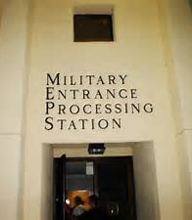
Meeting the Requirements
Citizenship Status
Medical Fitness, including weight
Take the Armed Services Vocational Aptitude Battery (ASVAB)
Background Check or Security Clearance
Tattoos
Parental Status
Educational Status
A recruiter will walk you through these step by step. Do you meet the requirements to be in the military? If not, can you change something or are you disqualified?

Slide 15
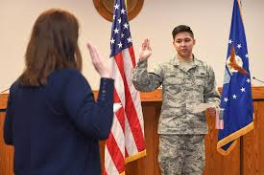
Citizenship Status & Age
US Citizen, green card, or permanent residence
17-34 years old
If 17, parental consent required

Slide 16
Medical Fitness
Pass a physical exam at the Military Entrance Processing Station (MEPS)
Some conditions will disqualify you, but can be changed (e.g., overweight or high blood pressure)
Weight standards for all branches of the military are published in Army Regulation 40-501, Chapter 2

Slide 17
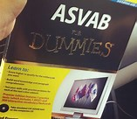
ASVAB
Armed Services Vocational Aptitude Battery
Tests your ability to do certain job functions, NOT your knowledge
Get help on line or from your recruiter
ASVAB results determine what jobs you qualify for
Take a sample ASVAB https://www.military.com/join-armed-forces/asvab

Slide 18
Your Background
Some things may disqualify you for military service:
Felony convictions
Domestic abuse
DUI (depends on timing)
Bankruptcy
Drug use
You may be able to get a waiver to join. You may qualify for a job that does not require a security clearance. Be honest and forthcoming about the situation with your recruiter.

Slide 19
Tattoos
May look great, but could cause problems with the military
Rules change depending how desperately the services need recruits
No tattoos visible above the T-Shirt neckline or on hands or wrists
Nothing racist, hate-related, sexist, or gang-related
May be limited to a certain number of tattoos
No body mutilation (scarification, forked tongue, ear gauging > 1.6 mm)

Slide 20
Parental & Educational Status
Single parents with custody rights may have a problem enlisting
Depends on the service
The rules change
Have a formal plan - who takes care of your kids if called to duty
Anything less than a high school diploma (even a GED) puts you in a lesser status
Few recruits are accepted at this level
GRADUATE FROM HIGH SCHOOL!

Slide 21
Find a Recruiter
Go to a recruiting office
Go on line & input your info – they will call you
Talk to a friend or someone you trust
Talk to more than one branch of service
Avoid going at end of the month or in September
Recruiters trying to meet quota
May talk you into what is available, NOT what is best for you!

Slide 22
20 Questions to Ask a Recruiter
How long do I have to enlist for? What's the minimum commitment?
Am I eligible for any special enlistment programs or bonuses?
What do I have to score on the Armed Services Vocational Aptitude Battery (ASVAB) test to qualify?
What are the major differences in pay, benefits and job opportunities between services?
Do you have films or literature about military life and particular jobs
How long is basic training? Where is it? What is it like?
What physical fitness requirements must I meet to enter the military and succeed in basic training?
What jobs are available?
What are the possibilities for remote or overseas duty stations?
What are the training and advancement opportunities for jobs that I am eligible for?

Slide 23
20 Questions to Ask a Recruiter
What would pay be like?
Do I get paid while in training?
How much money can I get for college?
Can I take college courses or other training programs while in the military?
Are there any upcoming military events in the area, such as airshows, fleet weeks, etc.?
Can a friend and I go to basic training together?
What are the haircut or other appearance standards that will apply to me?
What's the delayed entry program?
What are the next steps?
How can I get more information?
https://www.military.com/join-armed-forces/military-recruiter-twenty-questions.html

Slide 24
Wait if Necessary
Be willing to wait to get exactly what you want
This is true for military recruiters or buying a car
If the job you want is not available, tell the recruiter to call you when it is. Then walk away!

Slide 25
Check on Learning
Name at least four requirements you have to meet before joining the military.
What can disqualify you from joining?
What does the ASVAB test: your knowledge or abilities?
Do recruiters have your best interest in mind?
What are some questions you should ask a recruiter?

Slide 26
APPLYING TO US MILITARY ACADEMIES
B3. List the five US military academies and discuss the process of applying for admission.

Slide 27
US Military Academies
The US Military Academy, West Point, NY (Army)
The US Naval Academy, Annapolis, MD
The US Air Force Academy, Colorado Springs, CO
The US Coast Guard Academy, New London, CT
The US Merchant Marine Academy, Kings Point, NY

Slide 28
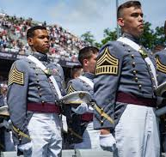
Benefits
Top notch education & degree
Essentially free – avoid student loan debt
Full regular commission & high status in military service
Support of classmates throughout your life
Awesome training opportunities, especially in the summers
Great student life in athletics, clubs, etc.
Fully prepares you to be an officer: Lieutenant or Ensign
West Point Military Academy Graduates

Slide 29
Admission Requirements
Medical Fitness
Physical Fitness
High academic standing – excellent grades in high school
High scores on SAT/ACT
Extracurricular activities, leadership roles
Excellent character & positive personality traits
Between 17 & 23 years old
Not married, pregnant or legally obligated to support children
Coast Guard Cadet Richard Salinas

Slide 30
Admission Requirements
Requirements for high school classes:
4 years of English with composition, grammar, literature and speech
4 years of math including algebra, geometry, & trigonometry
2 years foreign language
2 years of lab science
1 year of US history
Calculus or at least pre-calculus and computing also recommended

Slide 31
Physical Aptitude Exam
Pull ups for men or Flexed Arm Hang for women
Basketball throw from kneeling position
Standing long jump
300 yard shuttle run
Two minutes of push ups
You can only take the test once
Be prepared to pass

Slide 32
Nomination
Required for all academies except Coast Guard
From your senator, congressman, or the Vice-President
10 applicants vying for every nomination
Application process is your opportunity to sell yourself
As a well-rounded student
Will succeed at an academy
Naval Academy Midshipman March

Slide 33
Nomination
What to do:
Apply for every nomination for which you are eligible
2 Senators
Your Congressman
Vice-President
Merchant Marines
Begin seeking nominations in the Spring of your junior year
Don’t delay!
There are deadlines – if you miss it, you missed it!

Slide 34
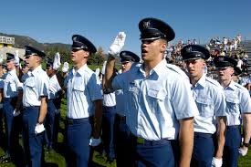
Acceptance Rates
Getting into an academy is difficult.
All your competitors are well qualified, just like you
Acceptance rates:
West Point – 9%
Annapolis – 9%
Air Force – 15%
Coast Guard – 20%
Merchant Marine – 20%
Air Force Academy Cadets

Slide 35
Assistance
Liaison officers at the military academies
Staffers at congressional offices
Academy savvy folks are happy to assist
Parent groups of current cadets
Academy grad

Slide 36
Prep Schools
If grades or scores do not meet standards
Some academies run their own prep school
Others have programs in military schools
New Mexico Military Institute
Marion Military Institute

Slide 37
Prep Schools
Provide the needed classes and training
Their military program promotes success at the academy
Will still need to go through nomination & appointment process
Will have more of an “in” from the Prep Schools

Slide 38
Check on Learning
List the five U.S. Military Academies
What are some of the required high school classes?
Who do you write to for a nomination?
When should you write to them?
T/F – It’s easy to get a nomination into an academy

Slide 39
ROTC
B4. Discuss ROTC as a commissioning option for an active or reserve military career and how the ROTC programs work in the timing of your college degree.
Know where to find ROTC information.

Slide 40
Reserve Officer Training Corps ROTC
Commission at colleges and universities throughout the nation
Cross-enrollment agreements with thousands more schools
2-4 year program, one class, one lab each semester
Stipend for contracted cadets
Air Force ROTC Logo
Army ROTC Logo

Slide 41
ROTC
Access to Simultaneous Membership Program with National Guard
Be in both, get paid, get training & experience
ROTC Scholarships available
‘Normal’ college experience
Summer training requirement
No obligation the first two years
Last two years focus on commissioning and signing a military contract
Army, Air Force, Navy/Marine Corps
Navy / Marine Corps ROTC Unit

Slide 42
ROTC
Go on-line to find ROTC programs in your area.
Check the branch of service websites and local colleges an universities.
Same general requirement apply for ROTC as other commissions:
Pass a physical exam
Be of high moral character
Meet the age requirements
Meet weight standards
Be enrolled in college while
in the ROTC

Slide 43
Check on Learning
ROTC graduates receive what type of commission?
What rank can you earn while in the ROTC?
What is the main difference between your first two years of ROTC at college and the last two years?
Where to you find information about joining the ROTC?

Slide 44
NATIONAL GUARD AND RESERVES
B5. Discuss the option of a reserve component military career.
List the benefits and drawbacks of the reserves.
B6. Discuss how to enlist or attain a commission in the reserves.

Slide 45
Reserve Components
Army National Guard
Army Reserve
Air Force National Guard
Air Force Reserve
Navy Reserve
Marine Corps Reserve

Slide 46
Reserve Components
Reserve is a federal program under each branch of services
The National Guard is a state program falling under the Governor.
Federally recognized members of the US military
Works for the Governor in peacetime
Works for the President in times of war
Federal government pays about 95% of costs

Slide 47
Reserve Service
After joining, assigned to a unit
Active duty training to complete initial entry training
Once trained, return to your unit
Unit meets one weekend a month
2-week training event once a year
May be at a local training area
May be in support of an exercise somewhere
May be further individual training at a military base
Initial 8-year commitment, 2 years of which may be inactive
Great way to be in the military but still have a ‘normal’ life

Slide 48
Reserve Training
Initial reservist training is exactly the same as active duty training
Officer or enlisted, you are just as qualified as every other soldier/ airman / sailor / marine coming out of initial entry training
Train up to 24 days on weekends and 15 days annually
Attend only weeks of higher level training
Active officers and NCOs attend months of higher level training

Slide 49
Reserve Training
If mobilized for a real world mission, your unit is given more time to prepare for combat
Reserve units may have different equipment from active units, but will receive everything needed if sent to combat

Slide 50
How to Join
See a Reserve or National Guard Recruiter
Requirements are the same as active duty recruits
Options are less, depending where you are willing to go for your monthly training
Most people join units near their residence
Positions and skills are limited to what type of unit is near you
If you live in the desert and want to join the Navy Reserve, there may be a unit, but not a ship
Air units generally are on active or reserve bases
Army and Marine units are dispersed in communities
Remember – You attend an initial entry training that takes you away from family, job and school for months.

Slide 51
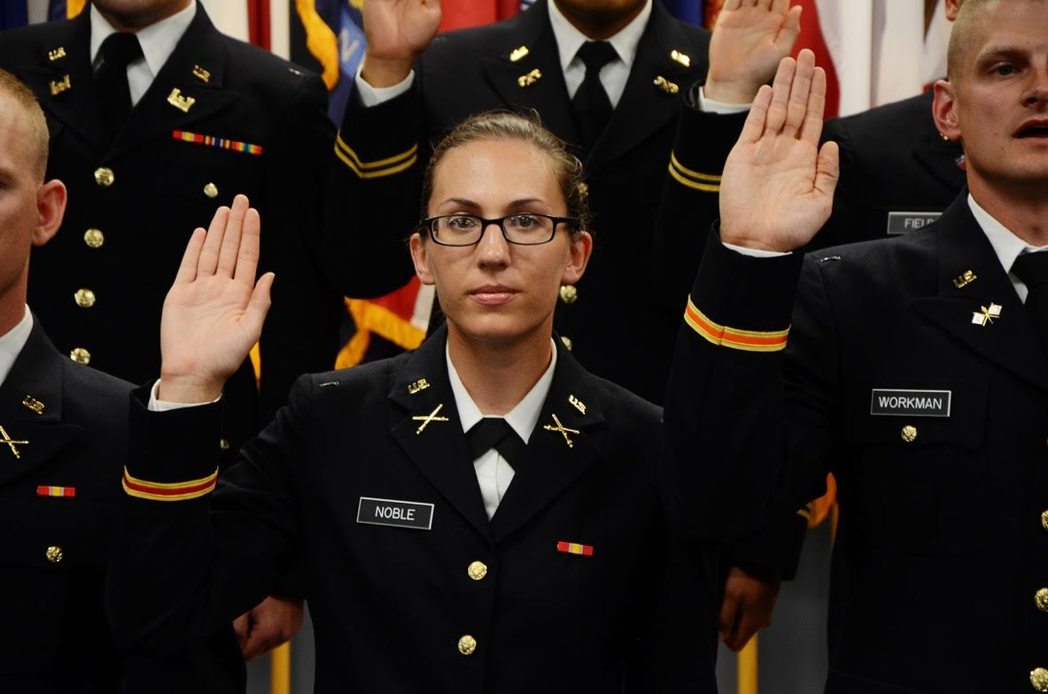
Reserve Commissions
To be an officer in the Reserves/National Guard:
Requirements are similar to active officer commissioning
Age range is generally more lenient (you can be older)
ROTC can commission reserve officers
There are guaranteed reserve assignments – get it in writing!
Not always available
National Guard OCS requires a BA/BS or currently enlisted
National Guard OCS Candidates Receive their Commission

Slide 52
Check on Learning
Is the National Guard or Reserves a good option if you want a “normal” life?
How often do Guardsman and Reservists train?
T/F – National Guard or Reserve training is not as good as active duty training.
How do you join the National Guard or Reserves?
T/F – Officer Candidate School is not an option for Guardsman or Reservists.

