Slide 1
California Cadet Corps Curriculum on Citizenship
C4/A: Understanding Diversity

Slide 2
Agenda
A1. Types of Diversity
A2. Gender & Sexual Diversity
A3. Age Diversity
A4. Race, Ethnicity, Culture, & Language Diversity
A5. Diversity in Philosophy and Politics
A6. Personality (True Colors)

Slide 3
TYPES OF DIVERSITY
A1. Define ‘diversity’ and discuss the difference between Identity Diversity, Value Diversity, Cognitive Diversity, and Behavioral Diversity.

Slide 4
Diversity
OBJECTIVES
Cadets understand and support diversity within their Cadet Corps unit, school, and friendships.
Plan of Action
Define ‘diversity’ and discuss the difference between Identity Diversity, Value Diversity, Cognitive Diversity, and Behavioral Diversity.
Essential Question: What are the types of diversity and how do they interrelate?

Slide 5
Diversity Defined
diversity
[di·​ver·​si·​ty | \ də-ˈvər-sə-tē]
NOUN
1 : the condition of having or being composed of differing elements : variety especially : the inclusion of different types of people (such as people of different races or cultures) in a group or organization programs intended to promote diversity in schools
2 : an instance of being composed of differing elements or qualities : an instance of being diverse a diversity of opinion
Merriam-Webster

Slide 6
Types of Diversity
Identity / Social Category / Demographic
Value
Cognitive / Informational
Behavioral

Slide 7
Identity / Social Category / Demographic Diversity
Related to a person’s social-physical categories, like race, gender, ethnicity, sexual orientation, physical ability.
Refers to who we are, in our bodies
Often there’s a long history of discrimination being legitimized in law and customs
Often immediately visible, obvious, and “objective” – hard for a person to avoid
Can’t be changed by individuals themselves

Slide 8
Value Diversity
Related to diversity in belief systems, value preferences, assumptions about what is better or right, beliefs about how the world is organized.
Refers to what we believe. Includes religion & politics.

Slide 9
Cognitive / Informational Diversity
Related to what you know and how you know it, including work experience, learning styles, intelligence, differences in mental processes of perception, judgment, categorization, and so on.
Refers to what we know.

Slide 10
Behavioral Diversity
related to personality styles, action orientation, how we interact with others, working style.
Refers to how we act.

Slide 11
Types of Diversity Related
These four types of diversity are related, in that a person’s social category will influence his or her life experience, and thus influence his or her values, cognitive preferences, and behavioral preferences.
These types are not independent, and at the same time the relationships between them are not hard-wired.

Slide 12
Diversity & Inclusion
focuses mostly on oppressed groups – race, sex, ethnicity, gender identity, etc. – what their experience has been, and how to remedy that so all peoples’ experience is equitable.
Embrace differences
Everyone contributes to the group’s ability to accomplish the mission. Diverse ideas increase the likelihood of mission accomplishment

Slide 13
Oppression Olympics
A term used within social justice circles
Refers to arguments in which inequalities faced by a group are dismissed for being considered less important than those faced by another group
i.e. In feminist circles, some people push race related grievances, asserting their situation is worse than that for white women

Slide 14
CACC Core Value: Respect
Each of us, as human beings, deserve respect
If we can respect each other, we can work together to accomplish our common goals
Decreases conflict

Slide 15
Check on Learning
1. Match the type of diversity to
a. Identity 1. How we act
b. Value 2. What we know
c. Cognitive / Informational 3. Who we are
d. Behavioral 4. What we believe
2. Racial diversity is an example of what type of diversity?
Identity
Value
Cognitive/Informational
Behavioral
3. Religious diversity is an example of what type of diversity?
Identity
Value
Cognitive/Informational
Behavioral

Slide 16
GENDER AND SEXUAL DIVERSITY
A2. Discuss an aspect of gender diversity that might affect you or your fellow cadets in the California Cadet Corps.
A3. List the categories of sexual diversity covered in this lesson, and give a brief definition of each.

Slide 17
Gender Diversity
Based on the ratio of male to female (and sometimes non-binary genders)
Usually refers to situations where there isn’t equality between the sexes
May refer to overall numbers, numbers within the leadership of an organization, representation on boards, etc.

Slide 18
Gender Diversity in CACC Sample Issues
Does the absence of many female commandants, or units that are mostly male, drive off potential female cadets?
How does the lack of gender diversity affect a unit?
Are leadership positions distributed evenly among male & female cadets

Slide 19
Practical Exercise
Collect information on your unit:
# of male cadets, # of female cadets in each rank
breakdown of M/F in leadership positions
look at types of positions by gender (i.e. are females assigned staff roles more predominantly than line leadership roles?
Determine the percentages
Assess the diversity of your unit, ID issues
Discuss ways to even the playing field

Slide 20
Sample Gender Diversity Issues
Unequal pay for the same work
Glass ceilings – equal opportunity
Positional bias
Terminations
School sports teams
Number of teams, funding, importance in school

Slide 21
Sample Gender Diversity Issues
Interview questions
Task/role expectations
Dress codes
Office temperature settings
Cheer squads

Slide 22
Gender Diversity
Studies show that companies with greater gender diversity more successful than those dominated by one gender
More success in production, financial responsibility, worker satisfaction, reputation, revenues, profits.
Similar success in gender diverse schools, military units, clubs

Slide 23
Sexual Diversity
The diversities of sex characteristics, sexual orientation, & gender identities
Physical Sex: based on an individual’s genitals
Assigned Sex: Declared at birth
Gender Identity: A person’s internal under-standing of their own true gender

Slide 24
Sexual Diversity
Gender Role: Society’s belief of appropriate roles for males and females
Dress, behavior, activities
Which restroom to use
Gender Presentation: the way people express their gender/role outwardly, including:
Clothing, jewelry
Mannerisms
Hairstyle
Interests
Speech

Slide 25
Sexual Diversity
Perceived Gender: How someone appears to others. Think about how you ‘know’ someone is female or male
i.e. At first glance, many people see someone with short hair wearing a military uniform as male. This may have happened to cadets you know.

Slide 26
Sexual Diversity
What does this mean
Consider the distinctions between physical sex, assigned sex, gender identity, gender role, gender presentation, & perceived gender
How do you learn what’s considered appropriate for girls & boys?
How does someone else’s gender identity affect you?

Slide 27
Check on Learning
Johnny Smith makes more money than Peggy Jones. Is this gender inequality in pay?
Is a dress code gender biased? Why or why not?
What is the difference between physical sex and assigned sex?

Slide 28
Age diversity
A4. List four ways Gen Z are different from Millennials

Slide 29
Age Diversity
Affects how you interact with others
Discussed in terms of ‘generations’
May form cliques or social circles
May disagree on how things should be done
Open communication smoothes over differences

Slide 30
Advantages to Diversity
Age diversity has advantages:
Multiple ways of looking at issues
Problem solving
Creativity
Social awareness
And disadvantages
Tension between generations

Slide 31
Generation
“A group of people born around the same time and raised around the same place.”
Generations exhibit similar characteristics because their experiences are similar
Communication, shopping, motivation preferences
Useful knowledge to people trying to reach, inform, or persuade a large cross-section of a population

Slide 32
Generations
Generation | Birth Dates
Traditionalists or Silent Generation | Born 1945 and before
Baby Boomers | Born 1946-1964
Generation X | Born 1965-1976
Millennials or Generation Y | Born 1977-1995
Generation Z, (also known as iGen, or Centennials) | Born 1996-(2010-2015)

Slide 33
From Millennials to Gen Z
For Millennials, 9-11 was significant in their lives. For Gen Z, it wasn’t (they were too young)
Millennials show significant differences from their predecessors – Gen X
Different attitudes toward employment, sales, & marketing

Slide 34
Gen Z (iGen, Centennials)
The current ‘new’ generation
Different from predecessors in parenting, education, employment, entrepreneurship, sales, marketing, politics, religion and more
Your generation
You’ve never known life without the Internet

Slide 35
Millennials vs Gen Z
Millennials | Generation Z
Raised by Baby Boomers | Raised by Gen Xers
Grew up during an economic boom | Grew up during a recession
Tend to be idealistic | Tend to be pragmatic
Focused on having experiences | Focused on saving money
Mobile pioneers | Mobile natives
Prefer brands that share their values | Prefer brands that feel authentic
Prefer Facebook and Instagram | Prefer Snapchat and Instagram

Slide 36
‘True Gen’
Baby Boomers (1946-1964) – post World War II, consumption
Gen Xers (1965-1976) – status
Millennials (1977-1995) – experiences
Gen Z (1996-2015) – search for truth
There’s not only one way to be
Greater freedom of expression, openness to understanding different kinds of people

Slide 37
Gen Z
Individuals shape their identities over time
Radical inclusiveness – connecting through different truths
Friends online & in real world are all friends
Technology friendly
Fewer confrontations – more dialogue
Flexible about differences of opinion within the institutions they connect with
Embrace diversity & inclusion

Slide 38
Check on Learning
Name three generations within our society today.
Someone born in 2010 is in which generation?
Match the generation to what defines them:
Baby Boomers 1. Search for Truth
Millennials 2. Love of consumption
Gen Z 3. Search for experiences

Slide 39
Race, ethnicity, culture, & language diversity
A5. Contrast the culture you fall into with another culture that is present in your school.

Slide 40
Races Listed in Census
White
Black or African American
American Indian or Alaska Native
Asian Indian
Chinese
Filipino
Other Asian — (i.e. Hmong, Laotian, Thai, Pakistani, Cambodian, etc.)
Japanese
Korean
Vietnamese
Native Hawaiian
Guamanian or Chamorro
Samoan
Other Pacific Islander — (i.e. Fijian, Tongan, etc.)

Slide 41
5 Categories of Race
RACE | PERCENTAGE IN US (2010 Census)
White | 79.96%
Black or African American | 12.85%
American Indian/Alaska Native | 0.97%
Asian | 4.43%
Hawaiian Native & Pacific Islander | 0.18%

Slide 42
Hispanic/Latino
An ethnicity, not a race
Ethnicity is defined as belonging to a group that has a common language, culture, and body of traditions.
Hispanic/Latino is the only ethnicity tracked by the US Census

Slide 43
Culture
The way people live at a particular time and place.
Defined by customs, art, social institutions, beliefs, and way of life
In California education, you study 4 cultures: Asian, African, Hispanic/Latino, & Middle Eastern

Slide 44
Why Study Cultures
The more you know about a culture to respect its characteristics, it helps you hate less, understand more, appreciate what they offer (foods, traditions, clothes, architecture, etc.) and acknowledge that they have valid input in the issues you share.
A Cadet Corps core value is Respect. Learning about others helps you respect them.

Slide 45
Diversity in Language
Impacts in workplace, schools, etc.
We tend to exclude people from our circle if they don’t speak our language
Lack of common language can separate you from those around you
If languages are a part of your culture (in your school, neighborhood, etc.), learn what you can so you can communicate with everyone

Slide 46
Race, Ethnicity, Culture, Language
These categories of diversity & inclusion are important because they’re obvious, and you can’t escape them (or cover them up)
They establish, to some extent, your ‘identity’ and social category
They offer an opportunity to blend different strengths into the best possible solution
They offer the problem of separating you from others who are different, breaking up teams, & causing discrimination

Slide 47
Check on Learning
Name 4 of the 5 US Census categories of race.
What is ethnicity? What is the only ethnicity tracked by the US Census?
What Cadet Corps core value relates to culture and diversity?

Slide 48
diversity in Philosophy & politics
A6. Select a religion or political belief, and contrast it with another religion or political belief. List or discuss some differences and similarities.

Slide 49
Philosophy & Politics
Diversity in cultural, spiritual, and political beliefs can sometimes pose a challenge in a diverse organization
Respect: Don’t impose your beliefs on others
Keep your personal beliefs independent of your organizational responsibilities & duties
Don’t talk religion or politics with people you don’t know well

Slide 50
Get to Know Others
It’s great to expose yourself to a wide range of beliefs & experiences that are different from yours
That’s why we study other cultures
It brings you closer to people who are different from you
It opens your mind to new ways of thinking and experiencing life

Slide 51
Check on Learning
Diversity teaches you to __________ other cultures and ways of thinking
What two categories should you avoid talking about with people you don’t know well?
Name something about your culture you could share with someone from outside it

Slide 52
personality diversity (True Colors)
A7. Discover which personality group in True Colors you best fit, and describe your color type (per Lowry) and how you fit in the general population.

Slide 53
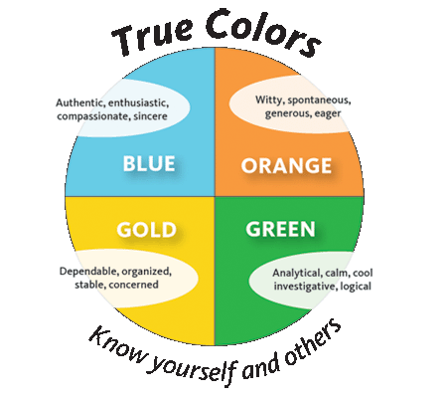
True Colors
A personality profiling system
Similar to the Myers-Briggs Type Indicator (MBTI)(Strand L4, B7)
A model for understanding yourself and others based on your personality temperament (biologically based aspect of personality).
It uses four colors to categorize personality types into temperaments.
It was developed by Don Lowry in 1978.

Slide 54
Four Colors
Lowry’s system divides personality types into four colors:
Green: Independent Thinkers
Gold: Pragmatic Planners
Orange: Action-oriented
Blue: People-oriented

Slide 55
Take an Assessment
In the True Colors process, you prioritize pictures and descriptions of characteristics based on what you know about yourself, how you react to different situations, and how you approach others. A free version of this test is in our text. Take the test by prioritizing the concepts represented in each line, then add up the boxes representing each color as listed at the bottom.

Slide 56
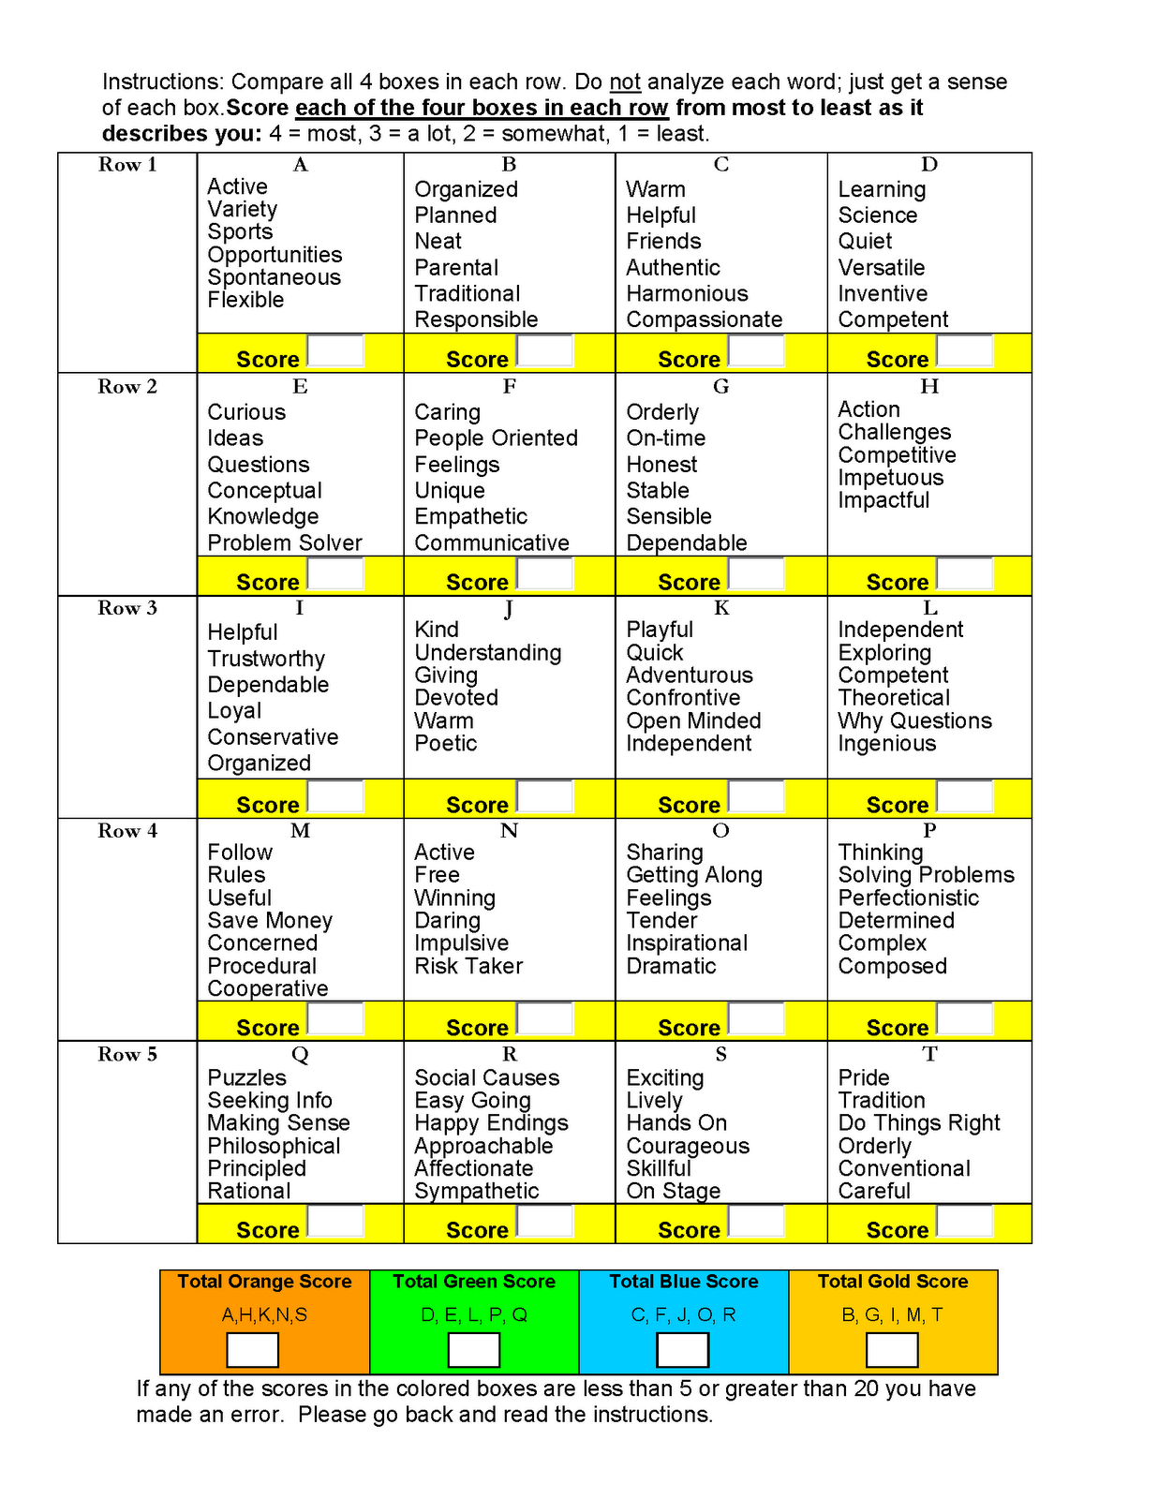

Slide 57
Understanding Personality
Knowing someone’s personality traits helps you connect with them, figure out what’s important to them, what motivates them, & how they’ll react to different situations
It helps you as a leader, or as a boss, or as a coworker, or as an employee or subordinate

Slide 58
Four Types
Different in fundamental ways:
They want different things
They have different motives, needs, drives
They analyze, conceptualize, understand, and learn differently

Slide 59
Gold
I am conventional. I am the pillar of strength and have high respect for authority. I like to establish and maintain policies, procedures, and schedules. I have a strong sense of right and wrong. I am naturally parental and dutiful. I do things that require organization, dependability, management, and detail. I need to be useful and to belong. I am the sensible, stable backbone of any group. I believe that work comes before play. I value home, family, status, security, and tradition. I seek relationships that help me ensure a predictable life. I am caring, concerned, and loyal. I show concern through the practical things I do.

Slide 60
Orange
I am courageous. I act on a moment's notice. I see life as a roll of the dice, a game of chance. I need stimulation, freedom, and excitement. I am a natural leader, troubleshooter, and performer. I like to do things that require variety, results, and participation. I often enjoy using tools. I am competitive and bounce back quickly from defeat. I value action, resourcefulness, and courage. I am generous, charming, and impulsive. I show affection through physical contact.

Slide 61
Blue
I am compassionate. I am always encouraging and supporting. I am a peacemaker, sensitive to the needs of others. I am a natural romantic. I like to do things that require caring, counseling, nurturing, and harmonizing. I have a strong desire to contribute and to help others lead more significant lives. I am poetic and often enjoy the arts. I value integrity and unity in relationships. I am enthusiastic, idealistic, communicative, and sympathetic. I express my feelings easily.

Slide 62
Green
I am conceptual. I have an investigative mind, intrigued by questions like, "Which came first, the chicken or the egg?" I am an independent thinker, a natural nonconformist, and live life by my own standards. I like to do things that require vision, problem solving, strategy, ingenuity, design, and change. Once I have perfected an idea, I refer to move on to a new challenge. I value knowledge, intelligence, insight, and justice. I enjoy relationships with shared interests. I prefer to let my head rule my heart. I am cool, calm, and collected. I do not express my emotions easily.

Slide 63
Class Exercise
Separate into groups by true color
Hand out poster paper, markers, pencils, & some pieces of masking tape
As a group, design an amusement park in 15-20 minutes, tape it on the wall, and be ready to explain it to the group

Slide 64
How Groups Think
Is this what happened with your groups? Generally:
The Gold’s are very detail orientated including parking lots.
The Greens usually only use a pencil and use mostly text.
The Oranges like to draw and use lots of color and are the most unrealistic of the groups.
The Blues always remember comfort details like bathrooms, first aid, handicap parking and diaper changing areas.

Slide 65
Notes About Gold
This personality accounts for 38% of the population. This group turns the lights on at work, makes the coffee, makes sure budget is intact – basically they get things done. Golds are the worker bees. Without golds, everything stops! They learn best by instruction and are the ones most likely to raise their hand even in college. Most church workers and community workers are golds. 80% of all elementary school teachers are also gold. However, this personality is a rotten risk taker; they like security. Golds often make lists and enjoy highlighters. They entrust schools, prefer laws (most police & judges are gold) and like structure within a family. They are the most family orientated of the four groups. Golds also make more money “totally” than any other group. Golds are the group most likely to organize their sock drawer. They like things to be neat and in order.

Slide 66
Notes About Orange
This personality accounts for 36% of the population. Oranges do things quickly, but they usually turn out pretty well. The difference from a gold is that oranges always do it their own way. They are not known for following rules or established systems. Oranges are also very celebrative – they are the “party” group. When they set their minds to accomplish something, they really like doing it. This personality is also very hands-on physical. They like activity. They are experiential and generally prefer no restraints. Oranges are mostly in creative arts and due to the activity attribute, most physical education teachers are orange. Oranges are very competitive, spontaneous, risk takers, adventurous, happy and have a great sense of humor; they sincerely like to make people laugh. This group, like blues, are very giving, but are not looking for something in return or desiring a lasting relationship as a result of “giving” -- however, in life, they do want to see results. Oranges are especially considered an organized mess. Their desks are piles and seem senseless, yet they know where everything is.

Slide 67
Notes About Blue
This personality accounts for 12-14% of the population; 70% are woman. This personality is often referred to as the “Hallmarks” as these people are most likely to send a card to someone. They write cards and also appreciate getting cards. They are flexible, love people, focus well and like to serve. They give the most “strokes” and also need to receive the most strokes. Their goal is to be with people. They are very introspective and ask questions like “Who am I – Who am I really.” This group buys into the True Colors testing results the most. Blues are the “catapults” – they see potential and motivate others. They can often be misunderstood for being nosey because they always want to know how a person is doing. They ask about a person’s family and they really want to know – it is not just chit-chat to them. They learn best by pleasing others. This personality lends itself to never having a lot of money because blues are always spending it on others. Blues usually need to go shopping with other blues. They want to connect.

Slide 68
Notes About Green
This personality accounts for12-14% of the population. They love knowledge, research, solving problems, data, philosophy, solutions and blue prints. To this personality, there never is enough time or data; they always want more information. Members of this personality usually include: scientists, mid level to top management execs, and CEO’s; 80% of all professors are greens. A green professor loves when students argue or disagree with him. They love debate. They are, however, bored easily. Greens are good planners but not the best implementers; instead, greens like to develop the solutions or blue prints and allow others to complete the work; they set the vision. Greens often question everything; always asking: “why?” They desire the best answers and are not easily satisfied with a solution. They find it hard to put closure on things. They will continue to prove it is the best one. This personality can multi-task well, but a green will be the personality most likely to lose the car keys or where they parked the car at the mall. Greens are highly introverted and only take calculated risks. They do not share their feelings or emotions easily with others.

Slide 69
True Colors
Shows us how to approach, communicate, educate and even discipline someone more effectively within their natural framework.
For example:
A student who is gold will respond better to guidelines than an orange.
A blue will respond better to an emotional plea while a green will expect rational and reasoning.

Slide 70
Check on Learning
True Colors differentiates people into types based on
Rank c) Personality
Favorite color d) Leadership style
Try matching color types to staff roles, and indicate your thought process. Some may be in a couple places, some may need a couple colors!
S1:
S2:
S3:
S4:

