Slide 1
California Cadet Corps Curriculum on Wellness
“Don’t Steal from Your Future”
W1/B: Critical Consumer

Slide 2
Agenda
B1. Consumer Awareness
B2. Bargain Shopping
B3. Buying a Car
B4. Paying for College

Slide 3
Critical Consumer
OBJECTIVES
Enable Cadets to make wise, planned purchases and understand their options when paying for college.
Plan of Action
Understand basic marketing and advertising tactics
Recognize the value of bargain shopping
Understand the impact of car payments versus the freedom of paying cash for a car
Identify the steps in preparing to purchase a car
Know your options to pay for college

Slide 4
B1. CONSUMER AWARENESS

Slide 5
Critical Consumer
OBJECTIVES
Enable Cadets to make wise, planned purchases and understand their options when paying for college.
Plan of Action
1. Understand basic marketing and sales tactics
Essential Question:
What are the basic marketing and sales tactics used to get you to buy things?

Slide 6
Consumer Awareness
Purpose:
Be aware of marketing and sales tactics
Resist temptation to make impulsive/emotional purchases
Be a wise consumer who plans ahead
Car purchase
Electronics
College
Be Smart with Your Money!

Slide 7
Consumer Awareness
As a class, take the Consumer Awareness Online Formative Assessment:
Consumer Awareness Online Formative Assessment
(approx. 30 minutes)

Slide 8
Consumer Awareness
Marketing
Targeted by advertisers and marketers before you could read
Be aware of marketing strategies
Resist their message
Stick to your budget
Achieve YOUR dreams, not the advertisers

Slide 9
Consumer Awareness
https://www.youtube.com/watch?v=8YqWoXeGEt0

Slide 10
Consumer Awareness
Advertisers pay to promote their products
Television
Roadside billboards
Internet
Digital Music
Video Streaming
All aimed at the consumer – YOU!

Slide 11
Consumer Awareness
“In simplest terms, marketing is the act of driving profitable customer action. It spans the full scope of strategies and tactics organizations use to position products and services in the marketplace and motivate target audiences to make a purchase.” (Sailer, 2019)
Marketers needed in all industries
Develop & promote products
Brand recognition
Stay competitive
Increase profits
They need you to buy what they are selling!

Slide 12
Consumer Awareness
It’s not your fault you can’t resist…
https://www.youtube.com/watch?v=TLf2gOrL1iM

Slide 13
Consumer Awareness
Many 4-yr colleges offer a degree in Business Marketing
Teaches the basics of marketing: “4 P’s”
Product
Price
Promotion
Place
https://www.youtube.com/watch?v=cFdCzN7RYbw

Slide 14
Consumer Awareness
Be aware of sales tactics used to influence your buying decision
Purpose is to influence you to buy their product
Be aware – may not align with your priorities
Be extremely critical of all advertisements

Slide 15
Consumer Awareness
10 ways advertisers are tricking you every day…
https://www.youtube.com/watch?v=MlSyk27fHSw

Slide 16
Consumer Awareness
Advertisements (“ads”) and Salespeople:
Ads designed and salespeople trained to answer resistance from the buyer
Want to gain your trust
Want to make you feel you
NEED their product
Want to make a sale!

Slide 17
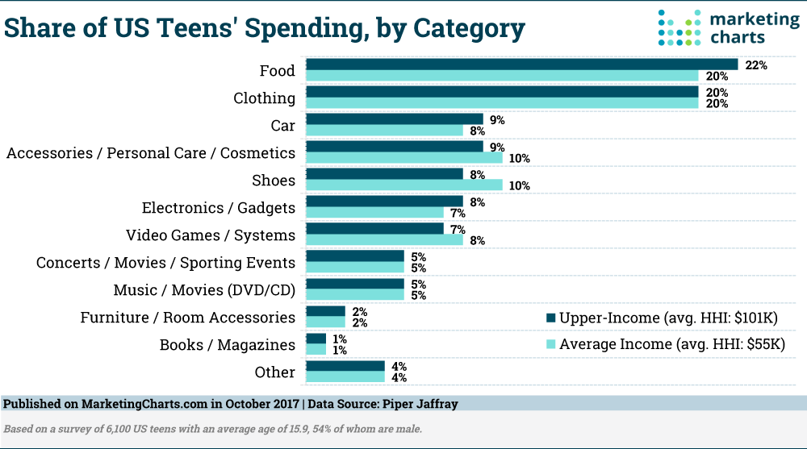
Consumer Awareness
How U.S. Teens spend their money:

Slide 18
Consumer Awareness
We want to empower you to:
Resist unneeded purchases
Make informed and wise decisions
Recognize the difference between needs and wants

Slide 19
Consumer Awareness
Practical Exercise
Cadets, think about and share in the classroom the answers to the following:
How do you feel when you want to buy something you are focused on?
Have you ever bought something on impulse, then wished you had not?

Slide 20
Consumer Awareness
Top factors that influence our buying:
Need the item
Friends have it, so I want it too
Instant gratification (impulse buying)
Want to impress others (cars, electronics, etc.)
Ads or salespeople “emotionally” sell it to us

Slide 21
Consumer Awareness
Practical Exercise (for outside the classroom)
Listen and/or watch the free versions of YouTube, Spotify, or Pandora for at least 30 minutes.
Count the number of advertisements broadcast during the time you are watching or listening
Write down the ways you think the advertiser are trying to influence you to buy their product:
You need it
“Everyone’s got one”
It’ll make you feel or look good
???

Slide 22
Consumer Awareness
Before buying a “big ticket” item – WAIT OVERNIGHT
Even electronics, cell phones
Still NEED or WANT it the next day?
Do research!
Avoid impulse purchases

Slide 23
Check on Learning
What is the purpose of advertising?
Give some examples of how advertisers try to influence you to buy their stuff.
Is it a good idea to wait overnight before buying a “big ticket” item? Why or why not?

Slide 24
B2. BARGAIN SHOPPING

Slide 25
Critical Consumer
OBJECTIVES
Enable Cadets to make wise, planned purchases and understand their options when paying for college.
Plan of Action
1. Recognize the value of bargain shopping
Essential Question:
How can you save money while shopping and still purchase quality items?

Slide 26
Bargain Shopping
Goal is to NOT pay full retail price
Research where to buy
Spend the least amount of money

Slide 27
Bargain Shopping
Tips for Bargain Shopping
Never buy new when used will do
Pay with cash
Buy off-brands
Buy off-season
Buy generics
Shop sales
Shop wisely at “brick and mortar” stores
Shop online
Consider quality - how long will you use it

Slide 28
Bargain Shopping
Never buy new when used will do
Can save 20% to 90%
Examples where to buy:
eBay
Craigslist
CarMax
Thrift stores
Consignment stores

Slide 29
Bargain Shopping
Practical Exercise (for outside the classroom)
Bargain Tip: "Never buy new when used will do"
Your 27" computer monitor broke and you need to replace it. You have $400 in your savings account, but you were saving it for something else. You want to spend as little as possible on a replacement.
Which of these websites will get you the BEST deal on a monitor?
Amazon
Best Buy
Tiger Direct
eBay/Craig’s List
Research these and see what you find.

Slide 30
Bargain Shopping
Pay with Cash
You will be less susceptible to an upsell
Less likely to waste money on things you don’t need
Bring ONLY the cash you need
Practice budgeting
Spend only what you intend to spend
Puts YOU in control of your money
Leave access to your account at home instead of in your wallet
You FEEL IT when cash leaves your hand

Slide 31
Bargain Shopping
https://www.youtube.com/watch?v=d7X3YXHf2fE

Slide 32
Bargain Shopping
Buy off-brands
Save between 20-90%
e.g., A.P.C. jeans = $220; Uniqlo jeans = $40
Learn to identify quality markers
Double stitches
Material weight
Fastener ruggedness
Will find many brands are marketing hype

Slide 33
Bargain Shopping
Buy off-season
Save between 20-90%
Need a winter jacket?
Wait until end of winter when spring clothes come out
Same jacket will be 50% off or more
Check the sale racks in the back of the store

Slide 34
Bargain Shopping
Buy generics
e.g., Medicines, staple food items, gasoline are all regulated products
Generics just as good as the name brands
Compare labels for ingredients and nutrition

Slide 35
Bargain Shopping
https://www.youtube.com/watch?v=dkyvlS9k4k4

Slide 36
Bargain Shopping
Shop Sales
Find clearance items, usually at the back of the store
Shop sales events
BEWARE of the upsell: “Buy One Get One 50% off”

Slide 37
Bargain Shopping
Shop wisely at “Brick and Mortar” stores
At actual buildings
Compare store prices
Shop discount, factory, and dollar stores
Use coupons or promo codes
Shop Tuesday nights – most common night for store sales

Slide 38
Bargain Shopping
Shop wisely at “Brick and Mortar” stores
Shop when in a good mood
Time constraints and stress lead to impulse buying
Shop alone
Unless shopping buddy is a bargain shopper
Make a shopping list – STICK TO IT!
Ask for discounts, haggle, ask if they match lower price of other store

Slide 39
Bargain Shopping
Shop online
Often 10% - 25% cheaper
More information or specifications published
Read consumer reviews before you buy!

Slide 40
Bargain Shopping
Consider quality
If quality jeans cost 20% more, but last 50% longer, might be a good deal
Name brands do not always equal quality
Manufacturer warranties often good indicator of quality
If one item has a one-year warranty and another a lifetime warranty, then the item with the lifetime warranty would be higher quality

Slide 41
Bargain Shopping
Negotiating Price
In many parts of the world it’s “haggling”
Not done much in the U.S. except for buying a house or car
Many cringe at the thought of doing it
But some major retailers do, including Best Buy

Slide 42
Bargain Shopping
Negotiating Price – How to Haggle
Shop at the end of the month
Managers have monthly sales goals to meet
More open to negotiating
Carry cash
Store does not pay credit card transaction fees
Ask for a cash discount
Check out other haggling techniques at:
https://www.wisebread.com/11-retailers-where-you-can-negotiate-a-lower-price

Slide 43
Check on Learning
Why is it good to shop with cash?
2. T/F – Generic brands are never as good as name brands.
3. How much can you save buying off-brands, or shopping off-season?

Slide 44
B3. BUYING A CAR

Slide 45
Critical Consumer
OBJECTIVES
Enable Cadets to make wise, planned purchases and understand their options when paying for college.
Plan of Action
Understand the impact of car payments versus the freedom of paying cash for a car
Identify the steps in preparing to purchase a car
Essential Question:
What are the benefits of purchasing a car with cash, and how do you purchase a quality used car?

Slide 46
Buying a Car
Cars are not “assets” because they depreciate (decrease in value)
Wisest way to pay for a car:
Save your money
Pay cash
Buy used
Loans or leases
are fiscally foolish

Slide 47
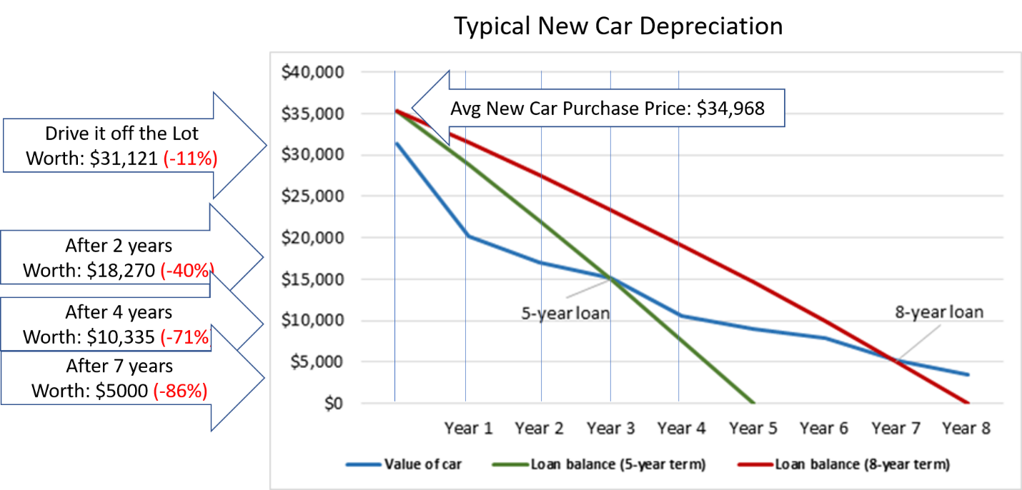
Buying a Car

Slide 48
Buying a Car: Tale of Two Cadets
Two Cadets ride their bicycle to the same Starbucks where they work. They both would like more hours at work but have decided they need a car to get to and from their homes more often.
They both gross $1,000 (before taxes) per month and net $800 (after taxes). This equates to an annual take-home pay of $9,600.
They both have $1,000 in their savings account. They are both good students, good drivers, and will own their cars for 5 years before selling and getting something else.

Slide 49
Buying a Car: Tale of Two Cadets
Cadet Frivolous –
Cadet Frivolous feels he
deserves a new car
He buys an average new car at
for $34,968 with an 8-year
(96 month) loan at 4% interest
Mother co-signs the loan
Down payment = $1,000
He decides (smartly) not to
take the extended warranty

Slide 50
Buying a Car: Tale of Two Cadets
Cadet Frivolous –
Insurance is $1,800 annually with:
A very high $2,500 deductible
Good Student Discount
Annual 12,000 miles
Annual vehicle registration cost of this car is $508 (California Department of Motor Vehicles)
Car gets 32 mpg, he will be driving 12,000 miles per year and, gas costs are $3.09 per gallon
He will pay $35/month in maintenance

Slide 51
Buying a Car: Tale of Two Cadets
Cadet Wise –
Cadet Wise decides to save his money until he has $5,000 to purchase a good used car.
He saves every bit of his paycheck and after 5 months he has saved $5,000 cash.
He finds a 7-year-old version of the same average new car that Cadet Frivolous purchased advertised on Craig’s List for $6,500.
Because he has cash, he can haggle with the seller and convinces the seller to part company with his car for $5,000.

Slide 52
Buying a Car: Tale of Two Cadets
Cadet Wise –
Buys a car for $5,000 cash
Insurance is $850 annually with:
A $1,000 deductible
Good Student Discount
Annual 12,000 miles
Annual vehicle registration cost of this care is $211 (California Department of Motor Vehicles)
Car gets 32 mpg, he will be driving 12,000 miles per year and, gas costs are $3.09 per gallon
Because the car is older, he will pay $100/month in maintenance

Slide 53
Buying a Car: Tale of Two Cadets
Total Cost of Ownership for Both Cadets –
Determine total cost of any car ownership using the cost calculator at FinancialMentor.com (https://financialmentor.com/calculator/car-cost-calculator)
Cadet Frivolous’ annual cost = $10,824.32
Cadet Wise’s annual cost = $3,573.25

Slide 54
Buying a Car: Tale of Two Cadets
Results of Frivolous Decisions –
Heavy monthly cost burdens take away your freedom. Cadet Frivolous could not travel to Europe with his friends after his graduation because he had no money left over after his car expenses.

Slide 55
Buying a Car: Tale of Two Cadets
Results of Frivolous Decisions –
Having debt removes your choices. Cadet Frivolous had to increase his hours at work just to pay for his car expenses. Since he owed the car payment each month, which he would for 8 years, he had no choice
but to work more hours.

Slide 56
Buying a Car: Tale of Two Cadets
Results of Frivolous Decisions –
Getting a loan beyond your means is extremely risky. Cadet Frivolous needed his mom to co-sign for him. Unfortunately for them both, when Cadet Frivolous was late with his payment just two times, both their credit ratings took a hit. As a result, mom was not able qualify for a home loan that would have enabled them to move into a nicer house.

Slide 57
Buying a Car: Tale of Two Cadets
Results of Frivolous Decisions –
Being “upside down” or having “negative equity” is common for car loans and can be devastating financially
After two years of owning the car, Cadet Frivolous was in an auto accident and his insurance company declared the car a totaled loss.
The car was worth $18,270. Hi insurance company paid only $15,770! (Did you forget the $2,500 deductible?)

Slide 58
Buying a Car: Tale of Two Cadets
Results of Frivolous Decisions –
He (and his mom) still owed $27,800 on the car loan after two years of payments. So they still owed $12,030 to the bank for a totaled, unusable, and worthless car!
Without a car and saddled with a $12,030 debt (plus interest), Cadet Frivolous had to resume riding his bicycle, reduce his hours at work, and work for another year and a half just to pay off his debt.
There are consequences for bad financial decisions.

Slide 59
Buying a Car: Tale of Two Cadets
Results of WISE Decisions –
Low monthly expenses permit a lifestyle that puts YOU in control of your life – NOT the bank.
With a monthly budget and low expenses, Cadet Wise was able to save for his future, buy new clothes, have a social life, and not stress about making the next car payment. He even saved enough money for a post-graduation trip to Europe with his friends.

Slide 60
Buying a Car: Tale of Two Cadets
Results of WISE Decisions –
Being debt-free provides freedom. Cadet Wise was accepted to a 3-month internship with a big company in the area. The internship was something he always wanted because it meant that if he did well, he could land a high-paying professional job with the company. But the internship, like many others, paid nothing. Because he had no car payment, and a little money saved, he took the internship then accepted a job that paid twice what he was making at Starbucks.

Slide 61
Buying a Car: Tale of Two Cadets
Results of WISE Decisions –
Being debt-free allows you help others. Cadet Wise was able to reduce his hours at work and stay home more to help is family for a couple of months when his mother was sick. He could not have done that, and kept his car, if he had a monthly loan repayment to make.

Slide 62
Buying a Car: Tale of Two Cadets
Results of WISE Decisions –
Being debt-free allows you to weather the inevitable storms.
After two years, Cade Wise was in a car wreck and his insurance company declared the car a total loss.
The car was worth $5,000. The insurance company sent a check for $4,000 ($1,000 deductible).

Slide 63
Buying a Car: Tale of Two Cadets
Results of WISE Decisions –
Without a car payment, Cadet Wise had saved $1,500 in his emergency savings. With a $5,500 budget Cadet Wise found a replacement car that was $500 nicer and 2 years newer than his old car.
Good financial decisions have good consequences.

Slide 64
Buying a Car: Tale of Two Cadets
Practical Exercise
For class discussion. Think about Cadet Wise and Cadet Frivolous.
Which would you rather be? Why?
If you find yourself in Cadet Frivolous’ shoes, how do you can get out this financial mess?

Slide 65
Buying a Car: How to buy a car
Step 1: Set a Budget
Use the total car cost calculator at https://financialmentor.com/calculator/car-cost-calculator
Determine total costs
Budget how much to spend

Slide 66
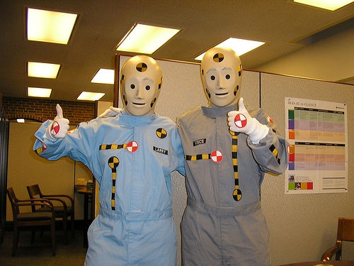
Buying a Car: How to buy a car
Step 2: Research
Research cars BEFORE going to the dealership
Know what features you want
Know what you can afford to pay

Slide 67
Buying a Car: How to buy a car
Step 2: Research
On-line research sites:
Cars.com Advanced Search: Search cars near you by body type, transmission type, engine power, and more to make sure you get the performance you need
Edmunds Car Finder: Search by an extensive range of features like keyless ignition and navigation systems, as well as by price and fuel efficiency
Consumer Reports: Get safety and reliability information from the national leader in product analysis and information
Kelley Blue Book: This trusted resource highlights reviews and recommendations for every class of car and offers more tools to help you research your options

Slide 68
Buying a Car: How to buy a car
Step 2: Research
On-line research sites (cont’d):
J.D. Power: Famous for its industry awards, learn more about the best options among the cars
Yahoo! Autos: For a wide range of car news, reviews, and buying guides
Insurance Institute of Highway Safety: How the cars performed during rigorous crash tests
fueleconomy.gov: Research fuel efficiency ratings with this official government site
The Balance: Research and compare insurance costs. Factors of insurance costs including sale price and type of car, your driving history, how much you drive, and much more

Slide 69
Buying a Car: How to buy a car
Step 3: Go Shopping – Preferably with and experienced car buyer
Be prepared to negotiate the price
The salesperson wants the higher price to boost their commission
You want the lower price to save money!

Slide 70
Buying a Car: How to buy a car
Step 3: Go Shopping – Preferably with and experienced car buyer
Take the car for a test drive
Does the steering wheel jiggle
Does it pull to one side
Does it rattle and shake
Trust your intuition

Slide 71
Buying a Car: How to buy a car
Step 3: Go Shopping – Preferably with and experienced car buyer
Take a checklist like the one from Popular Mechanics
Used Car Checklist from Popular Mechanics
Can help you decide if you have a lemon or a diamond in the rough

Slide 72
Buying a Car: How to buy a car
Step 3: Go Shopping – Preferably with and experienced car buyer
https://www.youtube.com/watch?time_continue=18&v=drbhNLvYxGQ

Slide 73
Buying a Car: How to buy a car
Step 4: Check out the vehicle
Get a Carfax report at https://www.carfax.com/
Check for a clean title
Not involved in an accident
Minimize chance of being scammed on the mileage
Check your insurance rates for the specific car with your insurance company
Take the prospective car to an independent mechanic for a full inspection (usually under $100)

Slide 74
Buying a Car: How to buy a car
Step 4: Check out the vehicle
If the title says “SALVAGED” – Run!
The cost of repairing the car was too high compared to the value of the car
The insurance company declared car a total loss
Usually the result of a bad accident or flooding

Slide 75
Buying a Car: How to buy a car
Step 5: Negotiate the Deal
Steer clear (pun intended) of expensive additions like extended warranties and car loans
Determine how much you are willing to spend
Factor in the needed repairs
Start with an offer below your spending limit
Negotiate back and forth respectfully
Stick to your limit
If other party will not come down – walk away

Slide 76
Buying a Car: How to buy a car
Practical Exercise
For outside of classroom.
Look online for at least two USED cars you think you might want to purchase for CASH
Use the Total Car Cost Calculator at https://financialmentor.com/calculator/car-cost-calculator
Determine what the total cost of each car would be if you kept the car for 5 years
Consider: Based on your income and how much you currently have saved, can you afford either of these cars?

Slide 77
Check on Learning
T/F – It’s cheaper to pay cash for a car than get a car loan
Is it a good idea to test drive a car before buying? Why or why not?

Slide 78
B4. PAYING FOR COLLEGE

Slide 79
Critical Consumer
OBJECTIVES
Enable Cadets to make wise, planned purchases and understand their options when paying for college.
Plan of Action
Know your options to pay for college
Essential Question:
What are your options to attend college without incurring student loan debt?

Slide 80
Paying for College
https://www.youtube.com/watch?v=CfoGLH7kQLs

Slide 81
Paying for College
Post-secondary education has become very expensive, especially four-year colleges
Do you want to attend college or a vocational or technical school?
How will you pay for tuition, fees, books, room and board and living expenses?
Will you live at home while at college?
Considering financial aid (a loan) to pay for school?
Paying off student loan debt is a HUGE burden

Slide 82
Paying for College
Have you saved money to attend college or vocational or technical school?
Can you go to school while you work?
Can you get grants and scholarships?
Are you considering tuition-free schools, such as the service academies?
Are you planning to enlist in the military and use the GI Bill to pay for college?

Slide 83
Paying for College
Working while attending college can be a challenge
May mean it will take longer to complete
A great option to avoid student loan debt

Slide 84
Paying for College
Grants and Scholarships require you to do some research
Need to complete an application
Great option – free!! No repayment
US Dept of Education website has great information:
https://studentaid.gov/understand-aid/types/scholarships

Slide 85
Paying for College
The U.S. Department of Labor has a free scholarship search tool
More than 8,000 scholarships, fellowships and grants
For levels of study ranging from Associate Degrees to Graduate Degrees
https://www.careeronestop.org/toolkit/training/find-scholarships.aspx

Slide 86
Paying for College
For federal scholarships, complete the Free Application For Federal Student Aid, or FAFSA.
Beware! This is the same application used for student loans.
Can be very tempting to take the student loan and think “just pay it off later”
Suddenly you have a $100,000 debt or more
Even if you don’t graduate, you still must pay all that back – and it can take up to 20 years!
Always consider free money first – grants, scholarships, working part-time

Slide 87
Paying for College
Practical Exercise
For outside the classroom. Research scholarship options.
Discuss your scholarship options with your Financial Aid office at your high school and/or the college you plan to attend
Go to https://www.careeronestop.org/toolkit/training/find-scholarships.aspx and identify at least three scholarships for the field you want to study

Slide 88
Paying for College
U.S. Military Options –
The U.S. Service Academies are free:
United States Military Academy
United States Naval Academy
United States Air Force Academy
United States Coast Guard Academy

Slide 89
Paying for College
U.S. Military Options –
Service academies give you the military environment and a first-class education
Tuition, books, room and board, medical and dental care are all fully funded
Earn your Bachelors of Science degree and receive an officer’s commission
After graduations, serve your country for a minimum of five years.

Slide 90
Paying for College
U.S. Military Options –
Competition for acceptance to these academies are fierce.
Admission criteria include:
High school academic performance
Standardized test scores (SAT or ACT)
Athletic and extracurricular activities
Leadership experience and community involvement
A congressional letter of recommendation

Slide 91
Paying for College
U.S. Military Options –
Senior Military Colleges
Like service academies
Among the most prestigious and famous education institutions in the world
Every senior military college cadet must participate in the Reserve Officer Training Corps (ROTC) program
Only those students who receive an ROTC scholarship are required to enter military service after graduation

Slide 92
Paying for College
U.S. Military Options –
Maritime Academies
The Unites States Merchant Marine is a fleet of civilian-owned merchant ships that carry cargo and passengers on behalf of the Unites States
After graduation you become a shipboard officer, but a continued service commitment is not required

Slide 93
Paying for College
U.S. Military Options –
For a list of Service Academies, Senior Military Colleges, and Maritime Academies and contact phone numbers, visit:
https://www.todaysmilitary.com

Slide 94
Paying for College
U.S. Military Options –
Military Tuition Assistance
Available in all four branches and the US Coast Guard
Up to $44,000 for
Vocational/technical programs
Associates, Bachelors and Masters Degrees
Independent Study and Distance Learning Programs
$250 per semester credit-hour for tuition
Available only while actively serving in the military

Slide 95
Paying for College
U.S. Military Options –
Military Tuition Assistance
Can use the Montgomery GI Bill or Post 9/11 GI bill to supplement fees and books
Contact the school’s Office of Military and Veteran Services
Many schools lower their fees to match the TA limits
Contact your service branch’s education center for requirements and approval

Slide 96
Paying for College
U.S. Military Options –
https://www.youtube.com/watch?v=bGGlkqEgXF4

Slide 97
Paying for College
U.S. Military Options –
Montgomery GI Bill and Post 9/11 GI Bill
Offered through the U.S. Dept of Veteran’s Affairs
Montgomery GI Bill given to those entering active service after 1977
Post 9/11 GI Bill given to those entering active service after September 10, 2001
You might qualify for both, but can only use one

Slide 98
Paying for College
U.S. Military Options –
Montgomery GI Bill and Post 9/11 GI Bill
Benefits for both include
Tuition and fees
Books and supplies
Money for monthly housing costs
Money to help move from a rural area to go to school

Slide 99
Paying for College
U.S. Military Options –
Montgomery GI Bill benefits expire after 10 years
Selected Reserve benefits expire after 3 years
Available only while still in the Reserves
Post 9/11 GI Bill benefits never expire
Can be use for spouse’s education
Can be used for children’s education

Slide 100
Paying for College
U.S. Military Options –
ROTC (Reserve Officer Training Corps) Scholarships
ROTC scholarships require you serve as an Officer for 3-5 years after graduation
Pays for tuition, fees, books
College life just like other college students
Take additional required courses, and may require intensive summer program
Talk to an ROTC Advisor or high school advisor

Slide 101
Paying for College
U.S. Military Options –
For more information about these GI Bills, visit the U.S. Department of Veteran’s Affairs website:
https://www.va.gov/education/about-gi-bill-benefits/

Slide 102
Check on Learning
T/F – It is possible to attend college without incurring student loan debt.
Where might you find information about scholarships?
What options does the Military have to offer for free education?

