Slide 1
Wellness 4A: Nutrition for the Student
Nutrition of the student
Caloric Requirments
Healthy eating
Vegetables
Fruits
Grains
Dairy
Protiens
Oils
Added Sugars
Saturated Fats
Sodum
Alcohol
Caffeine
Healthy Brain Food
Optimal vs Typical

Slide 2
NUTRITION FOR THE STUDENT
A1. Caloric Requirements For A Student
A2. Healthy eating patterns for a student
A3. Vegetables
A4. Fruits
A5. Grains
A6. Dairy
A7. Proteins
A8. Oils
A9. Added Sugars
A10. Saturated Fats
A11. Sodium
A12. Alcohol
A13. Caffeine
A14. Healthy Brain Food for Test Day
A15. Optimal Vs. Typical Sample Menus

Slide 3
Nutrition FOR the Student: Unit Objectives
The desired outcome of this unit is for students to learn various nutritional facts, proper diets of nutrition, and planning for specific activities in a student cadet's life.
Plan of Action:
Understand caloric requirements for sustainment
Define and apply estimated energy requirements (EER).
Define Basal Metabolic Rate (BMR)
Compare and contrast and apply macronutrients and micronutrients.
Define carbohydrates, simple and complex carbohydrates.
Apply Recommended Dietary Allowance (RDA)
Understand empty calories and apply steps to avoid them
Understand and apply the FIT nutrition model, and its role in “meal prepping”
Compare the difference between a portion and a serving size
Define and give examples of the 6 sub-categories of vegetables.

Slide 4
Nutrition of the Student: Unit Objectives
Express reasons why vegetables are difficult for an individual to have in their daily diet.
Define nutrient-dense foods
Apply the difference between hypokalemia and hypokalemia.
Understand the chemical grains become in the digestion process
Understand and define the key vitamins/minerals grains contain
List the similarities and differences of whole grains, refined grains, and enriched refined grains
Understands dairy products chemical contents
Define probiotics and prebiotics give examples of where to find each.
Understand vitamins/minerals found in dairy products
Understand proteins roles in body functions/body chemistry

Slide 5
Nutrition of the Student: Unit Objectives
Explain nonessential amino acids, essential amino acids, and amino acids role/functions in the body
Express where to find proteins in various foods.
Understand various nutrients found in oils
Define and understand the roles of sugars, glucose, isomers, cellulose, disaccharides, polysaccharides, and glycogen
Understand and explain in relative terms type 1 diabetes, type 2 diabetes, hyperglycemic, and hypoglycemic.
Compare and contrast saturated and unsaturated fats.
Identify two types( subtypes) of trans fats
Relate sodium’s role to hypertension
Understand sodium’s overall role in body chemistry
Understand and apply blood pressure classification levels to their identifications.

Slide 6
Nutrition of the Student: Unit Objectives
Define alcohol
Explain why alcohol is a psychoactive drug.
Explain and relate the Brain Blood Barriers (BBB) roles with alcohol
Evaluate the outcome information on alcohol abuse, alcoholism, fetal alcohol syndrome, and cirrhosis.
Explain the combination of energy drinks and alcohol
List issues and prospective positives caused by caffeine use
List and explain various brain foods for large concentration days or events
Explain with reason why aspartame is possibly dangerous
Define adenosines triphosphate (ATP)
Discuss and reason optimal vs typical health perspectives or dietary intakes.

Slide 7
Nutrition of the Student : Caloric Requirements For A Student
Objectives: Cadets will be able to
Understand caloric requirements for sustainment
Define and apply estimated energy requirements (EER).
Define Basal Metabolic Rate (BMR)
Compare and contrast and apply macronutrients and micronutrients.
Define carbohydrates, simple and complex carbohydrates.
Essential Question:
How do we use scientific systems of caloric intake?

Slide 8
Caloric Requirements For A Student
Estimated Energy Requirements (EER) are equations that are used to predict energy maintenance factoring in height, weight, age, and sex.
Basal metabolic rate (BMR) is the rate of the energy expenditure (calories burned) of a person after they have slept for 8 hours and fasted for 12 hours in the supine (laying down) position in a hospital or laboratory setting, essentially it’s the “do nothing” but breathe for 16 hours metabolic rate.
Resting Metabolic rate (RMR) is a test that is the same test except it does not require the patient to stay at the hospital because the values were identical
Macronutrients are types of food that provides the energy that is required in our diet. The three basic categories of macronutrients are fats, carbohydrates, and proteins.

Slide 9
Caloric Requirements For A Student

Slide 10
Check On Understanding
What does EER stand for?
According to the table, moderate exercising females and males at 16 have the same caloric need (T/F)
Basal metabolic Rate and Resting Metabolic Rate are not the same test; what makes them different?

Slide 11
Nutrition of the Student: Healthy eating patterns for a student
Objectives:
Cadets will be able to
Define carbohydrates, simple and complex carbohydrates.
Apply Recommended Dietary Allowance (RDA)
Understand empty calories and apply steps to avoid them
Understand and apply the FIT nutrition model, and its role in “meal prepping”
Compare the difference between a portion and a serving size
Essential Question:
How do intake amounts (caloric, and physical amounts) have precise outcomes?

Slide 12
Healthy eating patterns for a student
Carbohydrates are the body’s main source of energy
there are two types simple and complex.
Simple carbohydrates are sugars, including basic table sugar, fructose sugar from fruit, and sucrose, mostly found in soft drinks, they are the quick fuel.
Complex carbohydrates are carbohydrates that take longer to digest because their chemical structure is harder to break down, such as bread, beans, and vegetables.
Micronutrients are items that the body needs smaller amounts of such as vitamins and minerals.

Slide 13
Healthy eating patterns for a student
Dietary Reference Intake (DRI) designates the recommended amounts of micronutrients needed to be consumed.
Recommended Dietary Allowance (RDA) tells us the minimum amount of nutrients to maintain and meet the health needs of most people.
Adequate Intake (AI) is commonly used when the RDA of a micronutrient is not sufficient.
Tolerable Upper Intake Level (UL) is the maximum number of a vitamin or mineral that can be consumed without causing a health risk

Slide 14
Healthy eating patterns for a student
empty calories are foods that are full of simple carbohydrates like candy, pastries, and sugary soft drinks

Slide 15
Healthy eating patterns for a student
FIT formula for nutrition.
Frequency, eating three meals a day with planned snacks.
Intensity the calories are measured to its relative amount and balancing the 5 food groupings.
Time matching the intervals of a regular schedule in spacing them out morning, noon, and evening.

Slide 16
Healthy eating patterns for a student
A portion is the amount of food on the plate. It can be under or over the recommended serving.
A serving is what is recommended for each component of food as shown in

Slide 17
Check On Understanding
Define the FIT Formula as it relates to nutrition.
What is the academic word for quick fuel?
____________ are found in pastries and soft drinks.

Slide 18
Nutrition of the Student: Vegetables
Objectives:
Cadets will be able to
Define and give examples of the 6 categories of vegetables.
Express reasons why vegetables are difficult for an individual to have in their daily diet.
Essential Question:
How are vegetables crucial to human body chemistry and overall health?

Slide 19
Vegetables
There are 6 categories of Vegetable:
Dark green vegetables are veggies such as broccoli, spinach, and kale
Orange vegetables are items like carrots, butternut squash, pumpkin, and tomatoes
Dried peas are the various peas such as black-eyed peas, chickpeas, and green peas
Beans are a type of protein but are still a vegetable, some examples of those are, black beans, pinto beans, and kidney beans
Starchy vegetables are potatoes, corn, yams, and sweet potatoes
The other category for vegetables is a compilation of various veggies, such as onions, artichokes, celery, cucumbers, and many others

Slide 20
Vegetables Eating Vegetables are difficult
Taste/texture: some people simply dislike the taste or texture of certain vegetables
Economics: accessing fresh veggies is hard due to stores not carrying quality produce, or the money it costs to buy fresh veggies
Food experiences: individuals may have had a negative interaction with some or all veggies as a younger child
Habits: people will not eat veggies because it’s not part of their daily routine
Culture: can play a part in the type or amount of vegetables in someone’s diet

Slide 21
Vegetables Eating Vegetables are difficult (cont.)
Geography: where the person may live, there are no fresh vegetables
Advertising: the media does not promote healthy eating
Social factors: the individual has not enjoyed that particular item because of how someone else prepared them
Health concerns: food allergies and digestive impacts
Emotions: stress may affect the overall eating habits
Green food/sustainability: even though it is a vegetarian diet base, the cruelty-free element makes some vegetables inaccessible for those who follow that ideal, due to them being grown using animal products

Slide 22
Check On Understanding
List 3 reasons why choosing vegetables may be difficult?
All vegetables are carbohydrates? (T/F)
Which category of vegetables has more varieties?

Slide 23
Nutrition of the Student: fruits
Objectives:
Cadets will be able to
Define nutrient-dense foods
Apply the difference between hypokalemia and hypokalemia.
Essential Question:
How is body chemistry dependent on elements found in fruits?

Slide 24
Fruits
Nutrient-dense foods are considered the opposite of empty calorie foods, meaning they are full of vitamins and minerals. Fruits in diet have been found to be a factor in brain health, improving cognitive function.
Some fruits are high in water content, sometimes containing between 80%-99% of water. Examples are watermelons, cantaloupes, strawberries, apples, grapes, oranges, pears, and pineapples

Slide 25
Fruits Potassium & Body Chemistry
Potassium is an element which is needed for the human body to function, impacting the body systems that involve the kidneys, blood plasma, and intracellular fluid. An imbalance of potassium can cause issues such as muscle weakness, cramps, breathing issues, and constipation.
Hypokalemia is an insufficient amount of potassium in the body. Too little or too much potassium can cause the heart to abnormally contract, leading to death.
Hyperkalemia is high levels of potassium in the blood, usually disrupting the electrical impulses and signals and mostly a result of a kidney dysfunction.
Potassium can be found in fruits like bananas, apples, and apricots

Slide 26
Check On Understanding
What is the difference between Hyperkalemia and Hypokalemia?
Nutrient-dense is the opposite of empty-calorie (T/F)
What is the largest component of fruits like watermelons, apples, and pears?

Slide 27
Nutrition of the Student: Grains
Objectives:
Cadets will be able to
Understand the chemical grains become in the digestion process
Understand and define the key vitamins/minerals grains contain
List the similarities and differences of whole grains, refined grains, and enriched refined grains
Essential Question:
How are different types of grains needed for overall health and what are the benefits of each?

Slide 28
Grains
Grains are the most well-known carbohydrate
Whole grains are considered a nutrient-dense type of food
Whole grains are usually high in potassium
Grains are full of starch molecules, turning into glucose in the body.
The starches turn into chains and there two different chains
amylose contains hundreds of glucose units
amylopectin contains thousands of glucose units

Slide 29
Grains Vitamins and Minerals
The following minerals and vitamins are laid out by function:
Zinc’s major functions include protein along with DNA production, healing wounds, boosting the immune system, and assisting in growth.
Iron is carries oxygen and supports in energy production
Magnesium produces protein, aiding in muscle contraction and nerve transmissions.
Niacin is a vitamin that assists in energy metabolism

Slide 30
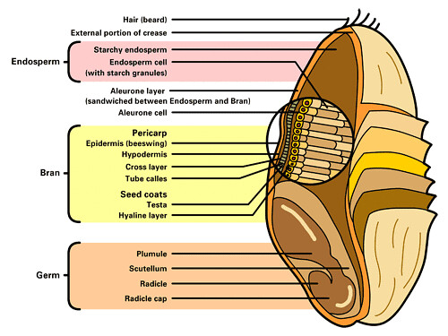
Grains Anatomy of Grains
Whole grains are comprised of grains with whole kernels.
Anatomy of grain is defined by the
bran (outside/shell)
the germ( the innermost segment),
the endosperm (the largest inside portion)
These are items like oatmeal, buckwheat, whole cornmeal, quinoa, and brown rice.

Slide 31
Check On Understanding
What are the three structures in the grain anatomy?
Which are healthier, refined grains or enriched refined grains?
Grains turn into ____________ in the body to be used as fuel.

Slide 32
Nutrition of the Student: Dairy
Objectives:
Cadets will be able to
Understand dairy products’ chemical contents
Define probiotics and prebiotics and give examples of where to find each
Understand vitamins/minerals found in dairy products
Essential Question:
How are dairy products in various forms essential to intake of elements that are connected to the body's functioning?

Slide 33
Dairy
Dairy is an important component of maintaining overall health and body chemistry
All dairy contains lipids, which are fatty acids
There are three types of lipids:
triglycerides make up 95% of lipids ingested, found in fried food, cheeses, whole milk, and vegetable oil
phospholipids only makes up 2% of lipids found in foods, and their job is to enclose fat cells while in transport through the bloodstream
sterols are the least common but the most known lipid because their full name is cholesterol and their major function is producing sex hormones (testosterone, estrogen, etc.), vitamin D, and bile salts.

Slide 34
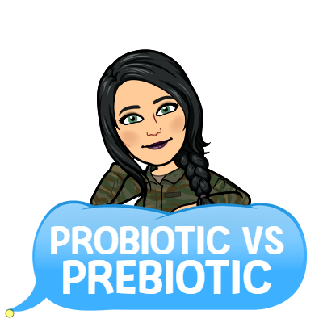
Dairy
Some dairy products have things called probiotics and prebiotics
Both are considered good/friendly bacteria that aid digestion
Probiotics are lactic acid bacteria, also known as lactobacilli. They are added as a live culture bacteria to food items that go through a fermentation process, such as yogurt and Kefir
Prebiotics are soluble fibers that fuel the growth of select bacteria to grow in the large intestinal tract

Slide 35
Dairy
Dairy is full of vitamins and minerals the body needs to maintain function.
Calcium the chemical element that builds and maintains bones, aids in blood clotting, and aids in muscular and nerve functions.
Phosphorous aids in the maintenance of teeth and bones, and supports the release of energy from nutrients.
Vitamin B₂ also known as riboflavin, breaks down proteins and carbohydrates.
Vitamin B₁₂ chemical name cobalamin, is the element that supports in the formation of nucleic and amino acids.
Vitamin D helps the body absorb calcium and phosphorous

Slide 36
Dairy
Dairy comes in four categories:
Milk including skim milk, flavored milks, lactose-free, 2%, and whole milk. Also includes substances like frozen yogurt, ice cream, puddings, sherbets, and smoothies.
Non-dairy calcium such as soymilk and rice milk
Cheese is any of the three different types of cheeses, including naturally hard cheeses such as cheddar, mozzarella, Swiss, and many more, and soft cheeses like brie, cottage cheese, feta, and ricotta, as well as processed cheeses like cheese spreads and America cheese.
The yogurt category includes all yogurts and soymilk yogurts

Slide 37
Check On Understanding
______________ makes up 95% of all lipids?
My common name is cholesterol, but my scientific name is___________?
In order for the body to be able to absorb calcium milk also provides what vitamin?

Slide 38
Nutrition of the Student: Proteins
Objectives:
Cadets will be able to
Understand protein’s roles in body functions/body chemistry
Explain nonessential amino acids, essential amino acids, and amino acids role/functions in the body
Express where to find proteins in various foods.
Essential Question:
How do proteins and elements within proteins impact the body and what foods are they are found in?

Slide 39
Proteins
Proteins are a class of nitrogen-containing biomolecule composed of amino acids.
Proteins are the main component of the cell, used to grow, repair and maintain muscles and connective tissues, assist in the production of hemoglobin, enzymes, and hormones, control acid to base balance, maintain osmotic pressure in the blood, support the formation of antibodies/disease protection and produce energy.
Amino acids are components of proteins that the body needs to either self-create or acquire from a diet source. They are considered the building blocks because of the connection to growing and building muscles and other body tissues
Nonessential amino acids are produced by the body, but the body does not rely on them.
Essential Amino acids are the 8-9 (adults/children) amino acids that the body cannot self-create/synthesize and must be part of daily food intake.

Slide 40
Proteins
Meats consist of beef, ham, lamb, bison, rabbit, venison, and pork
Poultry includes chicken, duck, goose, and turkey
Beans and peas are lentils, pinto beans, black beans, kidney beans, and edamame, among others
Soy products include tempeh, tofu, and veggie burgers
Eggs include chicken eggs and duck eggs
Nuts and Seeds include almonds, peanuts, pecans, pumpkin seeds, sunflower seeds, and walnuts
Seafood is a misleading name, as not all items in the category come from the ocean. It has its three subcategories:
finfish like catfish, cod, seas bass, snapper, trout, and tuna
shellfish such as clams, crab, lobster, oysters, shrimp, mussels, squid, and octopus
canned fish are items like anchovies, sardines, and tuna

Slide 41
Check On Understanding
Check on Understanding:
______________ is a self-created or synthesized amino acid that is not vital.
Protein has no shared elements/items in any other food group (T/F)
Name at least 2 functions of proteins in the body.

Slide 42
Nutrition of the Student: Oils
Objectives:
Cadets will be able to
Understand various nutrients found in oils
Essential Question:
What are oils in nutrition and what is their role in human health?

Slide 43
Oils
Oils are a type of lipid and are primarily fat in liquid form
Oils are not its own food group but does provide significant nutrients
Since oils are fat the intake of them must be limited.
Omega -3 fatty acid is an oil mostly found in fish and is a healthy portion of the daily diet.

Slide 44
Oils
Polyunsaturated fatty acids (PUFA) are things like corn oil, olive oil, and canola oil.
Some oils are primarily used in a manner to flavor food such as walnut oil and sesame seed oil. Some foods naturally have oils in them such as various nuts, certain fish, and avocadoes. Condiments like mayonnaise, salad dressings, and squeeze margarine are mostly made up of oils
Monounsaturated fatty acids (MUFA) are oils found in plant-based items, vegetables, and fruits.
Poly and monounsaturated fats do not elevate the bad (LDL) cholesterol levels in the blood supply.
Most oils contain vitamin E that is important to vision, reproduction, and the health of your blood, brain and skin. It is an antioxidant, protecting cells and the body against cancer and other diseases.

Slide 45
Check On Understanding
______________ is fat in liquid form.
What oil is mostly found in fish?
What does MUFA stand for?

Slide 46
Nutrition of the Student: Added Sugars
Objectives:
Cadets will be able to
Define and understand the roles of sugars, glucose, isomers, cellulose, disaccharides, polysaccharides, and glycogen
Understand and explain in relative terms type 1 diabetes, type 2 diabetes, hyperglycemic, and hypoglycemic.
Essential Question:
What is sugar’s role in body functions, and how does it impact overall health?

Slide 47
Sugars
Sugar is an organic compound that the body uses as fuel or energy to complete work.
The everyday name for monosaccharide is simple sugar or glucose
Glucose is a simple sugar with the molecular formula C₆H₁₂O₆.
Fructose is fruit sugar, often bonded to glucose to form sucrose
Disaccharide is comprised of two or more monosaccharides. An example of a disaccharide is sucrose.
Polysaccharide is a carbohydrate (e.g. starch, cellulose, or glycogen) whose molecules consist of a number of sugar molecules bonded together

Slide 48
Sugars
Cellulose is a structural component some plants have and is a polysaccharide that the human body cannot digest. A common example of this is celery. Celery chemically and biomedically is famous for burning more calories to chew it than a human can gain from eating it.
Glycogen is a polysaccharide that is deposited in muscle cells and is stored for it to be used as energy in the form of glucose

Slide 49
Sugars in the Body
Sugar is needed for the body to function. It is involved in the circulation of the blood, and in order to enter that circulation, sugars are ingested, digested by the body, and sent to the intestinal cells to the capillaries to the blood vessels.
The simple way to imagine how the process goes is that the blood vessels are a highway and blood is the vehicle on the highway. The converted sugars are the engine in the vehicle. The brain's key fuel to function comes from sugar, but it’s not an excuse to overdo it on sugary sodas. Both too much sugar and not enough sugar in the body are bad for organs and the brain

Slide 50
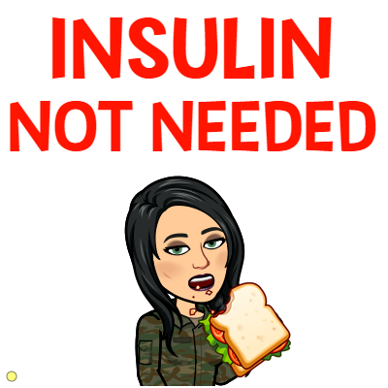
Diabetes
Diabetes mellitus is commonly named simple diabetes and is characterized by the blood glucose levels being high, also known as hyperglycemia.
Hyperglycemia results in insufficient production of insulin due to a malfunction in the pancreas. This is known as Type 2 diabetes.
Type 2 diabetes, also referred to as non-insulin-dependent diabetes mellitus (NIDDM), simply put does not produce enough insulin or is insulin resistant.
Insulin resistance is a condition where the body does not respond to insulin. This causes hyperglycemia.
Type 2 diabetes is also a health problem associated with being obese or overweight

Slide 51
Diabetes
Type I diabetes is due to the inability to produce insulin as needed sufficiently, due to failure of the β-Cells (beta-cells) inside the pancreas. This type is also known as Insulin-dependent diabetes mellitus (IDDM). Simply put, the pancreas produces little to no insulin.
Hypoglycemia is a low blood sugar level. It mostly happens with Type I diabetes but can happen to anyone if there is not enough glucose in the body to support work or energy. Exercise can improve glycemic control resulting in fewer hypoglycemic episodes

Slide 52
Check On Understanding
Check on Understanding:
______________ means the blood sugar in too high.
Chemical equation or name for glucose is C___H___O___
What type of diabetes is due to the inability to produce insulin?

Slide 53
Nutrition of the Student: Saturated AND UNSATURATED Fats
Objectives:
Cadets will be able to
Compare and contrast saturated and unsaturated fats.
Identify two types( subtypes) of trans fats
Essential Question:
What are the types of fats and what is their connection to cardiovascular health?

Slide 54
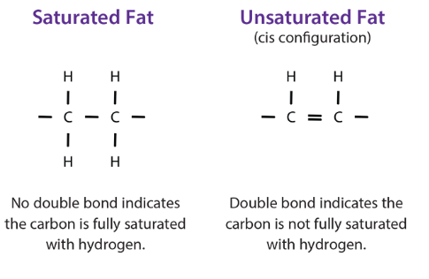
Saturated and Unsaturated Fats
Fatty acids are long chains of carbon with hydrogen atoms combined.
Saturated fat is an acid where each carbon atom has 4 single bonds.
Saturated fats are normally solids at room temperature. They are found in food like beef, lamb, pork, lard, cream butter, and cheese.
Unsaturated fat has one or more double bonds making it easier to metabolize/absorb
Unsaturated fats (mono or poly) are oils and liquid at room temperature.

Slide 55
Saturated and Unsaturated Fats
Trans-fat are unsaturated fats, naturally occurring and artificial
Naturally occurring trans-fat occurs in the gut of animals and food made from various animals’ meat and milk.
Artificial trans-fat occurs in the process of adding hydrogen to vegetable oils in order to solidify them more, such as foods like doughnuts, cakes, margarine, crackers, frozen pizzas, and cookies. These fats are called hydrogenated.

Slide 56
Fat and Cardiovascular Disease
Researchers have not been able to prove that saturated fats are bad for you. They have generally been connected with heart disease, but studies have not proven this.
Trans-fats are bad for you!
Unsaturated fats may help lower your risk for heart disease.
Polyunsaturated fats (Omega-3 and Omega-6 fatty acids) are healthy and needed by the body

Slide 57
Check On Understanding
______________ has 4 single bonds to each carbon atom.
All trans-fat is good for you T/F?
Of the types of fat, which is the best for your health?

Slide 58
Nutrition of the Student: Sodium
Objectives:
Cadets will be able to
Relate sodium’s role to hypertension
Understand sodium’s overall role in body chemistry
Understand and apply blood pressure classification levels to their identifications
Essential Question:
What is the role of sodium on the brain and body’s basic functions?

Slide 59
Sodium
Sodium (Na) is an element on the periodic table of elements, but usually refers commonly to salt.
Regulates blood volume, membrane functions, impulses of nerves and aid in muscle contraction
Table salt, is actually NaCl, sodium chloride, which like most salts disassociate or dissolves in water

Slide 60
Sodium
Sodium has many types because it bonds with different elements such as sodium bicarbonate (baking soda) and sodium citrate (from citric acid/ citrus fruits).
Due to western diets, sodium depletion is highly unlikely because most preserved foods contain sodium. Sodium is found mostly in packaged and canned foods, such as soups, lunch meats, frozen dinners, burritos, tacos, and pizzas

Slide 61
Sodium & Hypertension
Sweating allows for the loss of salts and minerals through exercise. Having too much of certain minerals can cause negative effects. Too much sodium can cause high blood pressure and lead to hypertension.
Hypertension is defined as abnormally high blood pressure, stage 1 at $\frac{140−159}{90−99}$, stage 2 at greater than or equaled to$\frac{160+}{100+}$.
Hypertension causes the heart to work harder than it should and over time it can lead to scarring of the heart and losing its elasticity, which may lead to stroke.
Prehypertension classified as $\frac{120−139}{80−89}$.

Slide 62
Blood Pressure
Blood pressure is the amount of pressure applied/pressed on the vessel walls by the blood.
Systolic blood pressure (SBP) is represented by the higher number and means it’s the amount of pressure in the artery during ventricular systole (when heart contracts).
Diastolic blood pressure (DBP) is the amount of pressure represented by the lower number during ventricular diastole (when the heart refills with blood).
An average/normal blood pressure at rest is usually $\frac{120}{80}$ , can be defined as less than 120 over 80

Slide 63
Sodium & Blood Pressure
Sodium maintains fluid balance, which is why it plays a key role in blood pressure control. There is a direct relationship between sodium intake and blood pressure. Reducing sodium to 2.3 grams sodium (6 g table salt) daily is linked with decreased blood pressure levels.

Slide 64
Check On Understanding
Sodium’s chemical name is?
Too much sodium has no effects on the body T/F?
What is considered an average/normal blood pressure?

Slide 65
Nutrition of the Student: Alcohol
Objectives:
Cadets will be able to
Define alcohol
Explain why alcohol is a psychoactive drug.
Explain and relate the Brain Blood Barriers (BBB) roles with alcohol
Evaluate the outcome information on alcohol abuse, alcoholism, fetal alcohol syndrome, and cirrhosis.
Explain the combination of energy drinks and alcohol
Essential Question:
How is alcohol destructive to the human body, vital organs, and damaging to the brain?

Slide 66
Alcohol
Alcohol is a beverage that is a psychoactive drug, this substance is volatile and is also known as liquor or its chemical name of ethanol.
Psychoactive drug this means that when the substance is ingested it crosses the blood-brain barrier affecting the actions of the body, altering the mood, thinking, decision making, memory, motor control, and social behavior.
Drinking alcohol is detrimental to the overall health of a human; overtime abuse of amount and frequency will damage the liver whose function is to filter or metabolize the substance.
Binge-Drinking by definition is when a male consumes five or more alcoholic drinks, and a female consumes four or more alcoholic drinks by volume. This type of behavior is extremely dangerous and will lead to degrading health complications

Slide 67
Alcohol
The blood-brain barrier (BBB) is the barricade for the neural tissue in the central nervous system from the general blood circulation.
Alcohol abuse is the overuse of drinking alcohol that results in behavioral and/or physical effects due to the overindulgence.

Slide 68
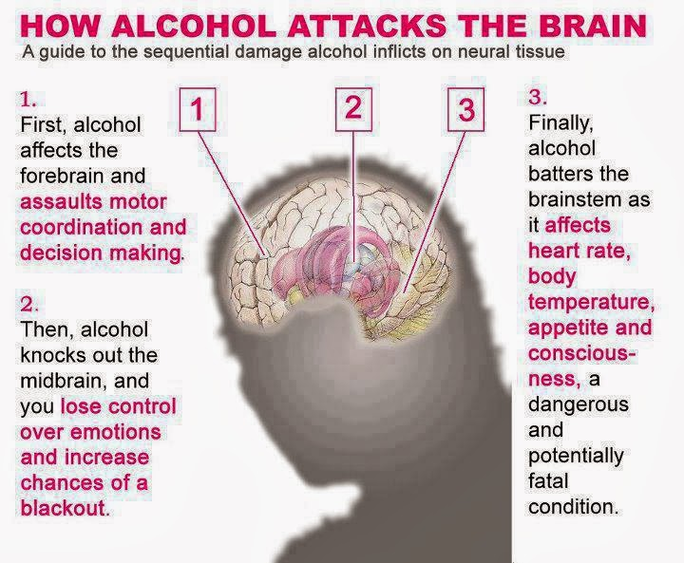
Alcohol

Slide 69
Alcohol
Alcoholism is the continuing/unending abuse of drinking alcohol paired with physiological changes aligned with addiction.
Statistics express that alcohol affects 10 million Americans, it is a leading cause of expensive health problems (car accidents, innocent death victims, property, etc.), accounts for over 200,000 deaths in the United States a year and is responsible for 60-90% of all documented liver disease cases.

Slide 70
Alcohol
Fetal alcohol syndrome (FAS) is a condition assumed by a newborn due to a pregnant woman drinking while pregnant, with characteristics of deformities/defects such as small head, slow growth, and scientifically termed mental retardation.
Cirrhosis a liver disease that is characterized by the destruction of hepatocytes replacing healthy tissue in the liver with fibrous tissue/scar tissue which will lead to liver failure.

Slide 71
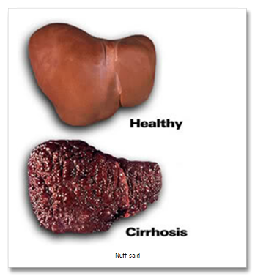
Alcohol
Cirrhosis is a deadly disease. As it progresses it leads to multisystem failure and advanced deterioration of the body.
Rupturing submucosal tissues
Jaundice
Hypertension
Disorientation of the brain function, confusion, or the inability to communicate.

Slide 72
Check On Understanding
Alcohol is not considered a psychoactive drug T/F?
Define alcoholism.
What organ is most affected by cirrhosis?

Slide 73
Nutrition of the Student: Caffeine
Objectives:
Cadets will be able to
List issues and prospective positives caused by caffeine use
Essential Question:
How does caffeine interact with the human body?

Slide 74
Caffeine
Caffeine is a central nervous system (CNS) stimulant, chemical, or drug, and is widely consumed
It is found in coffee, soft drinks/soda, teas, and energy drinks.
It is also available as an over-the-counter medication.
It has a proposed/suggested benefit of improving alertness, energy, ability to concentrate, reaction time, and prolonging endurance.
Through studies, the proven effect was as follows: increased alertness, concentration, elevated mood, but decreased reaction time and fatigue.
Even though it’s widely accessible and not regulated consuming it with risks such as nervousness, restlessness, insomnia, headaches, gastrointestinal problems, & tremors
a withdrawal of intake can result in distress of the gastrointestinal tract, fatigue, and irritability.

Slide 75
Caffeine
Diuretic: speeds up water excretion from the body
Psychotropics: a category of drug known as mood changers. They alter the central nervous system pattern of functioning and change or alter the mental state or mood. They also can be highly addictive agents. Caffeine is a psychotropic drug.
Withdrawal is the physical and psychological suffering symptoms when an individual stops or is prevented from in taking drugs, substances, etc.

Slide 76
Check On Understanding
Caffeine is not considered a drug T/F?
Name 3 proposed benefits of caffeine.
What symptoms result in the withdrawal from caffeine in the body?

Slide 77
Nutrition of the Student: Healthy Brain food for Test Day
Objectives:
Cadets will be able to
List and explain various brain foods for large concentration days or events
Explain with reason why aspartame is possibly dangerous
Define adenosines triphosphate (ATP)
Essential Question:
Does eating a collection of health foods improve performance in concentration?

Slide 78
Heathy Brain Food for Test Day
Eating healthy helps you prepare for any important day, such as test day, academic presentations, and other tasks that take a large amount of concentration.
Science has not proven that the body responds to particular foods, but only that eating healthy can encourage emotional response-control in humans.
Food and a healthy balance of combinations of food are symbolic in traditions, cultures, and special events; birthdays, weddings, funerals, graduations, sporting events, festivals, etc.
In order to remain alert, the brain must metabolize 6 grams of glucose per hour from the blood, in order to not slide into a state of confusion, coma, or death.

Slide 79
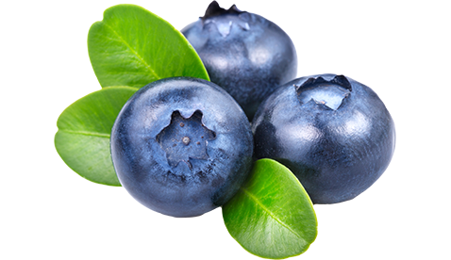
Heathy Brain Food for Test Day
The Blueberry is linked to brain health because it has a high content of anthocyanins.
Anthocyanins are a powerful antioxidant that decreases inflammation.
Adenosine (adenosine triphosphate) (ATP) is a caffeine-like organic compound that provides energy to drive processes in cells. It energizes the brain to function fully in alertness.

Slide 80
Heathy Brain Food for Test Day
Foods for brain health in terms of focus are
Carbohydrates with caloric limits
Digestible carbohydrates
Water
Vitamins
Minerals
Stay away from artificial sweeteners such as aspartame which is possibly linked to brain tumors, autism, emotional disorders, etc.

Slide 81
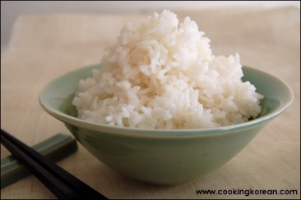
Heathy Brain Food for Test Day
Omega-3 fatty acids and Omega-6 essential fatty acids are a key supplement source found in fish, poultry, and grain-fed animals.
Vitamin C is a supplement that aids in brain health within limits.
White rice contains Thiamin (B₁) a vitamin whose role is to be an energy source and in charge of manufacturing neurotransmitters required for RNA, DNA, and ATP; deficiency in this vitamin can cause brain and heart issues.
Choline is a beneficial compound found in egg yolk, wheat, meat, and fish.
In order to improve brain functionality, the CDC recommendation is to increase fruit and vegetable intake

Slide 82
Check On Understanding
Check on Understanding:
It is scientifically proven that food for the brain has an exact path. (T/F)
_____________ is the antioxidant that the blueberry contains.
The vitamin/supplement ________________ is found in white rice.

Slide 83
Nutrition of the Student: Optimal vs Typical Sample Menus
Objectives:
Cadets will be able to
Discuss optimal vs typical health perspectives or dietary intakes.
Essential Question:
What kind of impact on overall health do different menu types of food products have?

Slide 84
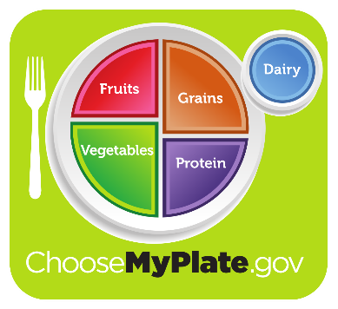
Optimal vs Typical Sample Menus
The important thing about eating healthy/ healthier it is to meet the needs specific to you.
Optimal health perspective choices are based on habitual routines and making intentional food choices
Moderation in eating and in taking nutritional rich foods. This is completed through the following: fill half the plate with vegetables and fruits, one quarter with lean meat/protein, poultry or fish, one quarter with a grain/rice, one serving of dairy

Slide 85
Optimal vs Typical Sample Menus
Typical health perspective is a look at the reality of what many people eat. Some choices are healthy, many are not. No food is forbidden if taken in moderation, but that is not the typical American diet.
The USDA did a longitudinal study spanning from 1970-2005, it tracked what individuals in the United States were consuming over a protracted period.

Slide 86
Typical Food Choices

Slide 87
Optimal Menus
Two weeks of sample healthy menus are in the supplementary information provided with this lesson.

Slide 88
Optimal vs Typical Sample Menus

Slide 89
Optimal vs Typical Sample Menus

Slide 90
Check On Understanding
The typical health perspective represents a nutritious diet ( T/F)
What slogan does the government use for health guidance for planning meals?
Using context clues, what does longitudinal mean?

