Slide 1
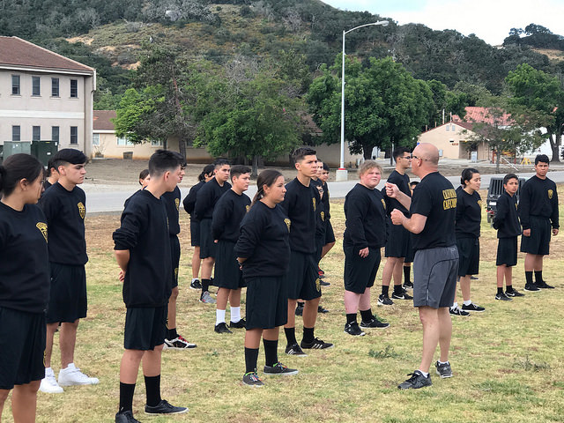
California Cadet Corps Curriculum on Communications
“Think, Listen, Speak, and Write to Influence”
L2/A: Listening & Cooperating

Slide 2
Listening & Cooperating
Agenda
A1. Listening Skills
A2. Communicating with Parents
A3. Communicating with Teachers
A4. Communicating with Peers
A5. Media Literacy

Slide 3
Listening & Cooperating
Objectives
90% of Unit Cadets are able to effectively listen and communicate with parents, teachers, and peers.
Know the six components to the HURIER model for effective listening
Know the five steps to communicating effectively with parents
Know the seven strategies of communicating effectively with teachers
Know the ten rules of communicating effectively with peers
Know the five key questions of media literacy
Essential Question: What are the essential listening skills?

Slide 4
LISTENING SKILLS
A1. Know the six components to the HURIER model for effective listening

Slide 5
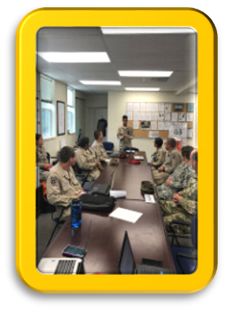
Listening Skills
Listening is not just hearing
Involves receiving, assessing, and analyzing communications
Affects daily life and performance
Interacting with society
Listening to instruction
Receiving and retaining information

Slide 6
Listening & Cooperating
Objectives
90% of Unit Cadets are able to effectively listen and communicate with parents, teachers, and peers.
Know the six components to the HURIER model for effective listening
Know the five steps to communicating effectively with parents
Know the seven strategies of communicating effectively with teachers
Know the ten rules of communicating effectively with peers
Know the five key questions of media literacy
Essential Question:

Slide 7
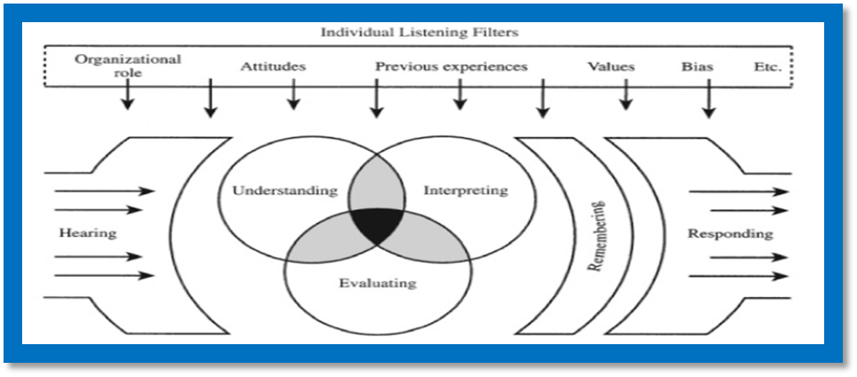
The HURIER model
Six components
Hearing
Understanding
Remembering
Interpreting
Evaluating
Responding

Slide 8
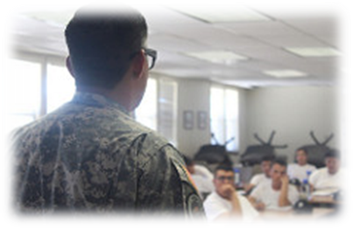
Hearing
Receiving Information
Discrimination between sounds
Focus & Concentration on information

Slide 9
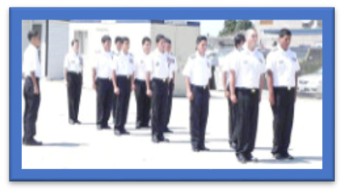
Understanding
Listening Comprehension
Grasping informational points
“Setting the stage” for the rest of the interaction

Slide 10
Remembering
Retain information
for future use
Call on past
experiences

Slide 11
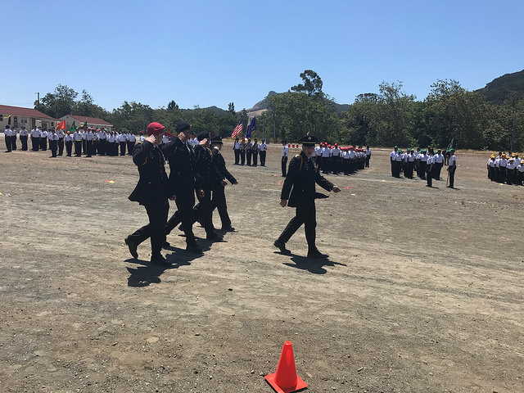
Interpreting
Taking context into account
Letting the speaker know they’ve been understood
Pay attention to nonverbal communication:
Body language
Eye contact
Facial expressions

Slide 12
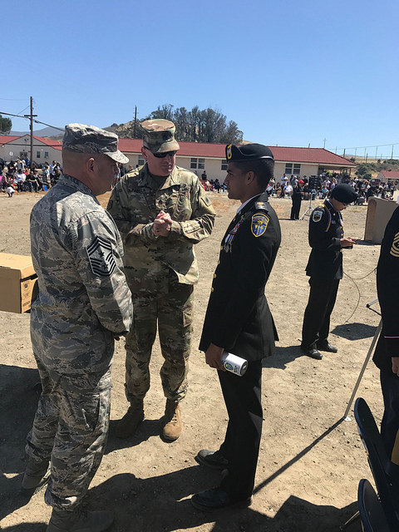
Evaluating
Utilizing your outlook and perceptions
Form or restructure your opinion on the subject
Requires objectivity
Consider and gauge the
information you’re given
Analyze language and
propaganda
Assess credibility

Slide 13
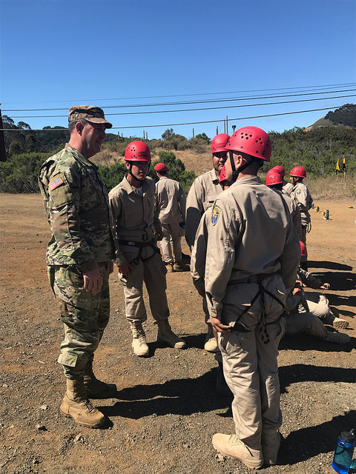
Responding
Consider all participant in the interaction as both speaker and listener
They interpret your listening skills
Your responses affect their attitude and therefore their future points

Slide 14
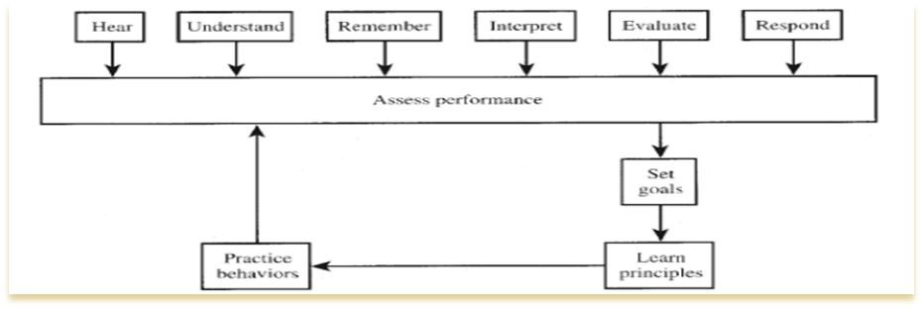
Self-Assessment
1. Assess your performance in each of the six skill areas
2. Set personal goals by identifying the component(s) you would like to improve
3. Learn relevant principles
4. Acquire specific skills by practicing your new listening behaviors
5. Be assessed on exactly what you have listened and practiced

Slide 15
Check on Learning
Name the components of the HURIER Process
2.
4.
3.
1.
6.
5.

Slide 16
Check on Learning
Name the components of the HURIER Process
2.
4.
3.
6.
5.

Slide 17
Check on Learning
Name the components of the HURIER Process
4.
3.
6.
5.

Slide 18
Check on Learning
Name the components of the HURIER Process
4.
6.
5.

Slide 19
Check on Learning
Name the components of the HURIER Process
6.
5.

Slide 20
Check on Learning
Name the components of the HURIER Process
6.

Slide 21
Check on Learning
Name the components of the HURIER Process

Slide 22
Communicating with Parents
A2. Know the five steps to communicating effectively with parents.

Slide 23
Listening & Cooperating
Objectives
90% of Unit Cadets are able to effectively listen and communicate with parents, teachers, and peers.
Know the six components to the HURIER model for effective listening
Know the five steps to communicating effectively with parents
Know the seven strategies of communicating effectively with teachers
Know the ten rules of communicating effectively with peers
Know the five key questions of media literacy
Essential Question: What are the best ways to communicate with parents?

Slide 24
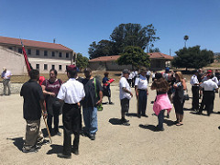
Communicating with Parents
Five Steps
Begin to gain their trust and faith in you in the small things
Try to open up to your parents about the things going on in your life
Ask your parents for advice
Be honest with your parents
Remember that your parents have your best interest in mind

Slide 25
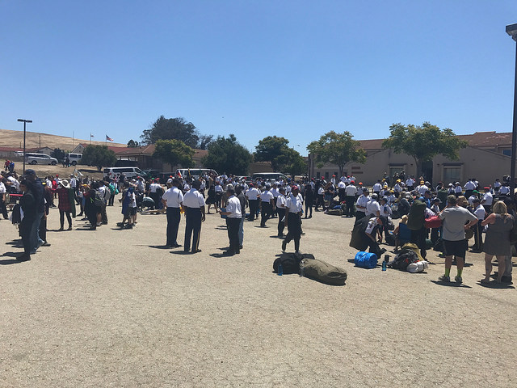
Five Steps
Begin to gain their trust and faith in you in the small things
Personal integrity – keep your word
Dependability – follow through with your actions
Open up about your life
General info about your friends and activities

Slide 26
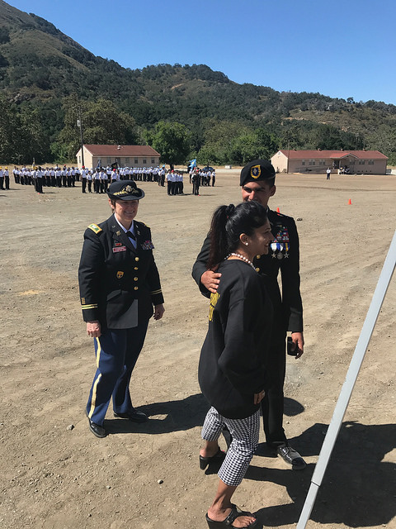
Five Steps
3. Ask for advice
Your parents were teenagers once too! Use their hindsight to your advantage
4. Be honest
Lying cuts off communication
5. Remember that they have your best interest in mind
Your parents are not out to get you!

Slide 27
Check on Learning
T/F? Lying cuts off communication
Gaining your parents’ trust requires ______________ & _____________.
Name three of the five steps of communicating with parents.

Slide 28
Communicating with TEachers
A3. Know the seven strategies of communicating effectively with teachers

Slide 29
Listening & Cooperating
Objectives
90% of Unit Cadets are able to effectively listen and communicate with parents, teachers, and peers.
Know the six components to the HURIER model for effective listening
Know the five steps to communicating effectively with parents
Know the seven strategies of communicating effectively with teachers
Know the ten rules of communicating effectively with peers
Know the five key questions of media literacy
Essential Question: What are the ways I can best communicate with my teachers?

Slide 30
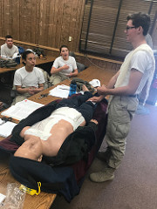
Communicating with Teachers
Seven Strategies
Make eye contact with the teacher as often as possible
Let the teacher know if you are having problems understanding material
Ask questions before assignments are due
Think about your non-verbal communication with the teacher
Admit your mistakes and make sincere apologies
Use “I” statements rather than “you” statements
Be friendly

Slide 31
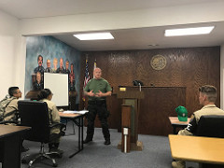
Seven Strategies
Make eye contact with the teacher as often as possible
Show that you’re paying attention
Let the teacher know if you are having problems understanding material
Be specific, so the teacher can pinpoint your struggles and clarify for you

Slide 32
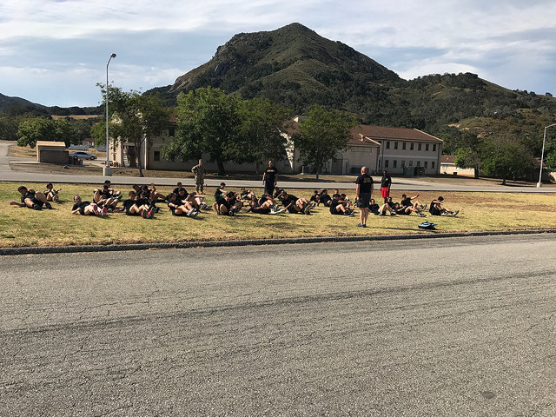
Seven Strategies
Ask questions before assignments are due
Give the teacher time to help you!
Think about your non-verbal communication with the teacher
Body language and facial expressions are important
Admit your mistakes and make sincere apologies
Excuses are a waste of energy, follow through with your promises

Slide 33
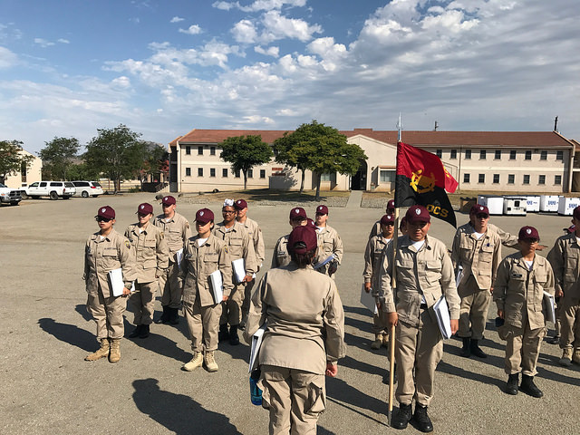
Seven Strategies
Use “I” statements rather than “you” statements
Explain, don’t accuse
Be friendly
Greet your teacher when you see them, and have a positive attitude about their class

Slide 34
Check on Learning
When should you ask the teacher for help with an assignment?
When you turn it in
During the test
Before it’s due
Name at least four ways you should communicate with your teacher.

Slide 35
Communicating with Peers
A4. Know the ten rules of communicating effectively with peers

Slide 36
Listening & Cooperating
Objectives
90% of Unit Cadets are able to effectively listen and communicate with parents, teachers, and peers.
Know the six components to the HURIER model for effective listening
Know the five steps to communicating effectively with parents
Know the seven strategies of communicating effectively with teachers
Know the ten rules of communicating effectively with peers
Know the five key questions of media literacy
Essential Question: How can I best communicate with my peers?

Slide 37
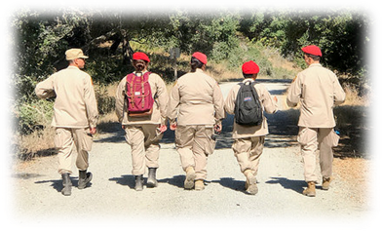
Communicating with Peers
Ten Rules
1. Understand your communication style
2. Reflect on how others react to your communications
3. Share the best way for others to communicate with you
4. Communicate on the other person’s channel
5. Learn how stress impacts communications
6. Deliver messages at the right moments
7. Use the proper tools
8. Recognize others in a way that makes them feel good
9. Be empathetic
10. If the communication falters, don’t let it fester

Slide 38
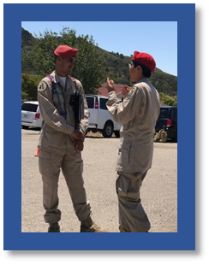
Ten Rules
Understand your communication style
Know yourself and understand your personal approach to communication
Reflect on how others react to your communications
Think about conversational successes and failures
Share the best way for others to communicate with you
Help others communicate with you and avoid misunderstandings

Slide 39
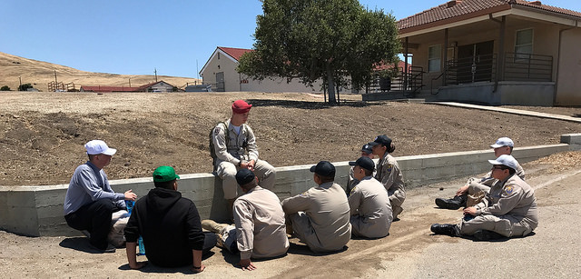
Ten Rules
Communicate on the other person’s channel
Understand and utilize their personal communication style
Learn how stress impacts communications
Stress creates problems with message delivery
Deliver messages at the right moments
Pay attention to how the people around you receive information

Slide 40
Ten Rules
Use the proper tools
Email, phone, meetings, etc.
Recognize others in a way that makes them feel good
Congratulate peers for personal achievement
Be empathetic
Put yourself in their shoes
If the communication falters, don’t let it fester
Admit and fix your miscommunications

Slide 41
Check on Learning
Name three of the ten rules for communicating with peers.
Why is it important to understand your personal communication style?

Slide 42
Media literacy
A5. Know the five key questions of media literacy

Slide 43
Listening & Cooperating
Objectives
90% of Unit Cadets are able to effectively listen and communicate with parents, teachers, and peers.
Know the six components to the HURIER model for effective listening
Know the five steps to communicating effectively with parents
Know the seven strategies of communicating effectively with teachers
Know the ten rules of communicating effectively with peers
Know the five key questions of media literacy
Essential Question: How do I understand the meaning of a media message?

Slide 44
Media Literacy defined
involves all communication media
enables an understanding of the communication media used in society
ensures that people learn how to:
Analyze
identify the sources
interpret the messages and values
select appropriate media for communicating their own messages
gain or demand access to media (UNESCO, 1999, p.273-274 ctd. in Fedorov, 2015).

Slide 45
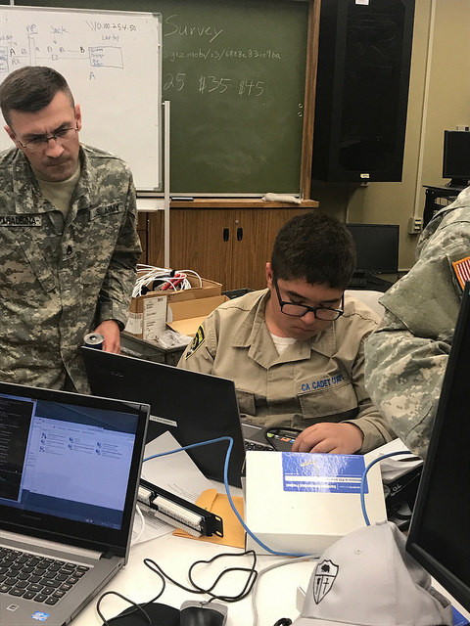
Five Key Questions
“Who created this message?
What creative techniques are used to attract my attention?
How might different people understand this message differently than me?
What values, lifestyles and points of view are represented in, or omitted from, this message?
Why is this message being sent?” (Five Key Questions of Media Literacy).

Slide 46
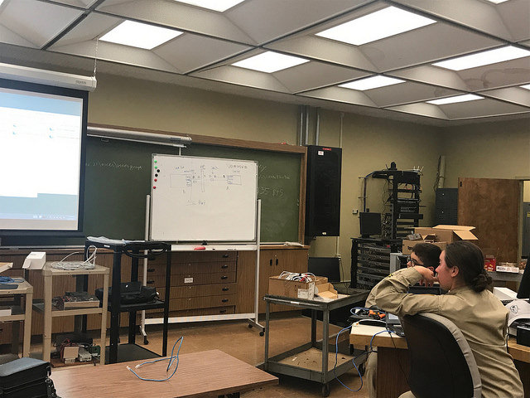
Five Key Questions
Who created this message?
All messages are ‘constructed.’
What creative techniques are used to attract my attention?
Media messages are constructed using a creative language with its own rules.
How might different people understand this message differently than me?
Different people experience the same media message differently.

Slide 47
Five Key Questions
What values, lifestyles and points of view are represented in, or omitted from, this message?
Media have embedded values and points of view.
Why is this message being sent?
Most media messages are organized to gain profit and/or power.

Slide 48
Check on Learning
T/F?: Different people experience the same media message differently.
What is one key question of media literacy?

