Slide 1
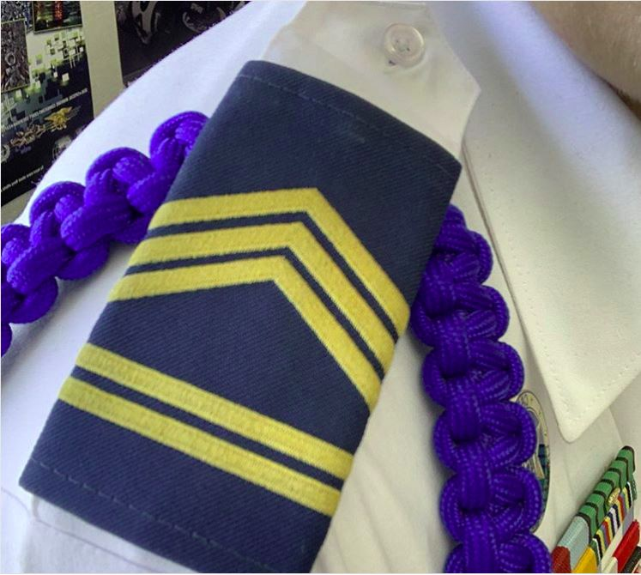
California Cadet Corps Curriculum on Leadership Roles
“Move up through Ranks, Positions, and Experiences”
L3/A: Leadership Roles at the School Level

Slide 2
Agenda
A1. Introduction to Leadership Roles and Responsibilities
A2. Assistant Squad Leader and Guidon Bearer
A3. Squad Leader
A4. Platoon Sergeant
A5. Platoon Leader
A6. First Sergeant

Slide 3
Agenda
A7. Company Executive Officer
A8. Company Commander
A9. S1: Administration and Personnel
A10. S2: Safety and Security
A11. S3: Training and Operations
A12. S4: Supply and Logistics

Slide 4
Agenda
A13. S5: Civic, Public and Military Relations
A14. S6: Communications and IT
A15. Battalion Executive Officer (XO)
A16. Battalion Command Sergeant Major (CSM)
A17. Battalion Commander (CO)

Slide 5
Introduction to Leadership Roles and Responsibilities
A1. Introduction to Leadership Roles and Responsibilities

Slide 6
Leadership Roles at the School Level
OBJECTIVES
Cadets will be prepared to work within the structure of the cadet battalion or brigade, and serve successfully in leadership positions within the California Cadet Corps.
Plan of Action
Describe the role and responsibilities of the cadet leadership position in California Cadet Corps Battalions: Introduction to Leadership Roles and Responsibilities.
Essential Question: How does the CACC develop a leader?

Slide 7
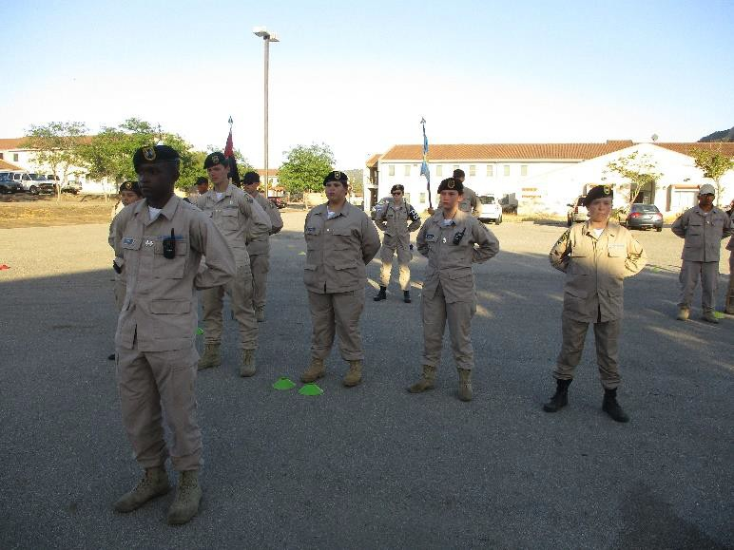
Introduction to Leadership Roles and Responsibilities
CACC’s primary objective: Teaching Leadership
Leadership curriculum standard emphasizes:
Military knowledge
Citizenship and patriotism
Academic Excellence
Health and fitness

Slide 8
Introduction to Leadership Roles and Responsibilities
Leadership is experiential – learn by doing
Foundation to lead after 2 or 3 semesters
Process of learning
Developing skills
Embracing Values
Transform from a TAKER (takes orders, instructions)…
…to a GIVER (give order, tasks, motivates)

Slide 9
Introduction to Leadership Roles and Responsibilities
Academic aspects of leadership introduced
Theories, models
Different styles, types of leadership
Good leaders study the experts
CACC develops leaders by
Serving in leadership/staff positions
Practice leadership skills
May not serve in all positions, but
Be familiar with duties and responsibilities
Helps the Cadet program at your school

Slide 10
Common Staff Procedures
Common Staff procedures to all NCOs:
Visits and inspections
Meetings
Briefings
Reports, and…

Slide 11
Common Staff Procedures
…Staff Coordination – the process of making certain that all pieces of a staff action fit together
Each staff section examines plan
Make adjustments to plan
Ensure adjustments fit with overall plan

Slide 12
Common Staff Procedures
Practical Exercise (20 minutes)
Create a Plan – School Club Fundraiser
In groups of 4, take 15 minutes to develop a plan to raise money for the cadet corps at a school club event. (Student leaders may help students stay on task.)
For the remainder 5 minutes, each group presents their plan to the class.

Slide 13
Common Staff Procedures
Staff officers make visits to
Obtain information for commander
Observe execution of orders
Assist subordinate unit commanders
Examples include
S1 visits a company to assess personnel files
S2 visits a potential bivouac site to assess training
S5 visits a local newspaper for a press release

Slide 14
Common Staff Procedures
Information obtained tells commander
How the units are performing
Give options in planning process
Important part of staff officer’s job
Discover and help subordinates to resolve problems

Slide 15
Common Staff Procedures
Commanders and staff conduct inspections
To determine readiness of unit to accomplish mission
Example: Annual General Inspection (AGI)
AGI is an inspection conducted by Headquarters of the CACC to assess the status of the program throughout the state

Slide 16
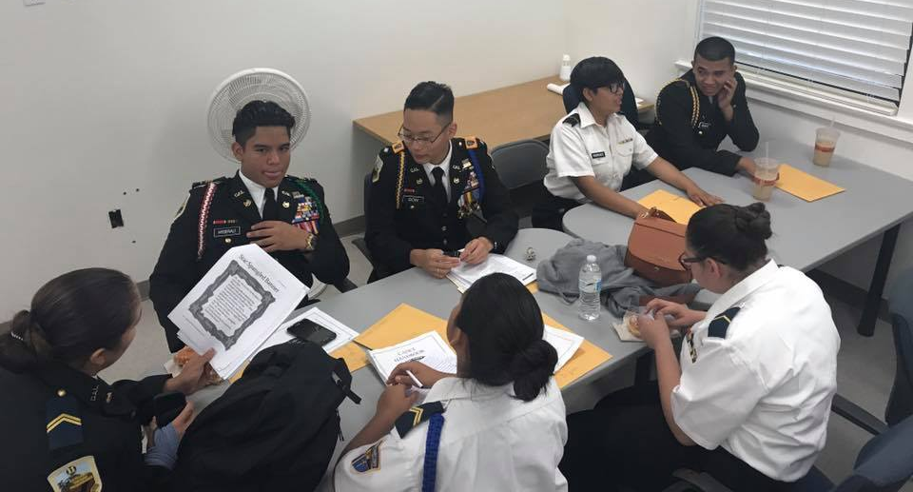
Common Staff Procedures
Commanders and Staff Officers frequently participate in:
Staff Meetings
Determine and evaluate facts
Solve problems
Coordinate actions
Instruct, counsel, advise

Slide 17
Common Staff Procedures
Commanders and Staff Officers frequently participate in:
Staff Briefings
Staff updates commander
XO usually presides
Staff sections provide updated information

Slide 18
Common Staff Procedures
Staff Sections prepare reports, for example:
S1 prepares Strength and Activities Reports (SAR)
S2 prepares Intrusion Reports
S4 prepares Supply Inventory Reports

Slide 19
Common Staff Procedures
Uses CACC Cadet Activity Planning Process in CR3-14
Plan cadet activities
Prepare Warning Orders
Prepare Operations Orders

Slide 20
Check on Learning
What is the Cadet Corps’ primary objective?
T/F: “Staff Coordination” is the process of making certain that all pieces of a staff action fit together.
What does “experiential learning” mean?

Slide 21
Assistant Squad Leader and Guidon Bearer
A2. Assistant Squad Leader and Guidon Bearer

Slide 22
Leadership Roles at the School Level
OBJECTIVES
Cadets will be prepared to work within the structure of the cadet battalion or brigade, and serve successfully in leadership positions within the California Cadet Corps.
Plan of Action
Describe the role and responsibilities of the cadet leadership position in California Cadet Corps Battalions: Assistant Squad Leader and Guidon Bearer.
Essential Question: What are the roles of the Assistant Squad Leader and Guidon Bearer?

Slide 23
Assistant Squad Leader
Entry-level leadership position
Chance to show your leadership qualities
The Assistant Squad Leader:
Sets the example
Leads squad in absence of Squad Leader
Helps squad members when struggling
Hones own skills

Slide 24
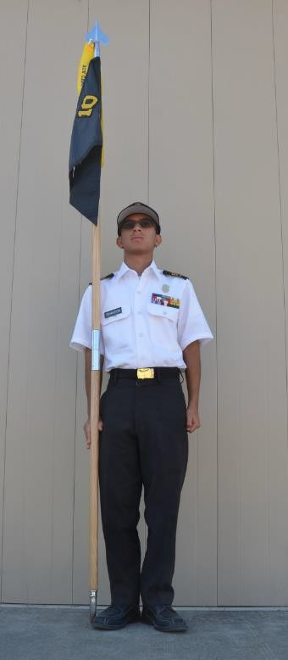
Guidon Bearer
Sharpest junior cadet in the unit
Carries the unit Guidon
Rally point for formation
Leads by example
Drill and Ceremonies: The Guidon Bearer
https://www.youtube.com/watch?v=Uteflg9wPj4

Slide 25
Check on Learning
T/F: The Assistant Squad Leader is an entry level leadership position.
What are two responsibilities of the Guidon Bearer?

Slide 26
Squad Leader
A3. Squad Leader

Slide 27
Leadership Roles at the School Level
OBJECTIVES
Cadets will be prepared to work within the structure of the cadet battalion or brigade, and serve successfully in leadership positions within the California Cadet Corps.
Plan of Action
Describe the role and responsibilities of the cadet leadership position in California Cadet Corps Battalions: Squad Leader.
Essential Question: What is the role of the Squad Leader?

Slide 28
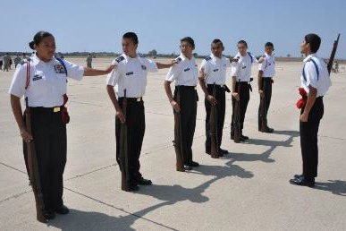
Squad Leader
Reports to Platoon Sergeant
Helps cadets learn to do well on tests and inspections, AGI
Practice drills for squad proficiency
Ensure squad uniforms in order

Slide 29
Squad Leader
A good Squad Leader is responsible for:
Appearance
Conduct
Training
Discipline
Works with Assistant Squad Leader to ensure
Squad members maintain high standards of behavior

Slide 30
Squad Leader
Sets the example
Trains Assistant Squad Leader
Knows names and contact information of assigned squad members
Assists squad members with Cadet Corps matters
Find solutions to issues when possible; refer to the Platoon Sergeant/leader if needed
Forms squad correctly

Slide 31
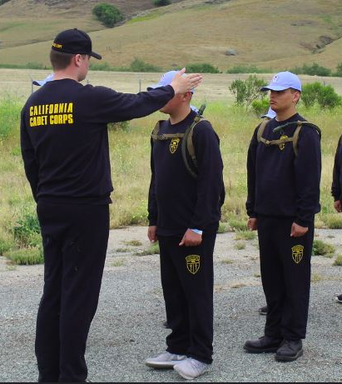
Squad Leader
Accurate report of persons present at activities, company platoon/formations, etc.
Conduct uniform inspection of squad; report uniform needs up chain of command
Thoroughly familiar with individual, squad, platoon drills
Instruct/demonstrate drill movements, allow time for individual performance, supervise squad members for proper performance

Slide 32
Squad Leader
Develop responsibility and leadership in team leaders
Encourage squad members to seek promotion; help prepare for Promotion Task Assessments
Encourage squad members to attend activities, join Color Guard and Flag Detail, participate in Drill Team and Individual Major Awards competitions, and other opportunities
Motivate squad, provide goals and a vision, grow esprit de corps within squad

Slide 33
Check on Learning
Who does the Squad Leader report to?
A good Squad Leader is responsible for which of the following:
Appearance
Conduct
Training
Discipline

Slide 34
Squad Leaders
Practical Exercise (20 minutes)
Train Your Squad
Platoon Sergeants assign your Squad Leaders to train cadets in the following steps from the Manual of the Guidon (CR3-21.5, pg. 79):
1. Order Guidon 4. Raised Guidon
2. Parade Rest 5. Present Guidon
3. Carry Guidon 6. Guidon Bearer’s Salute

Slide 35
PLATOON SERGEANT
A4. Platoon Sergeant

Slide 36
Leadership Roles at the School Level
OBJECTIVES
Cadets will be prepared to work within the structure of the cadet battalion or brigade, and serve successfully in leadership positions within the California Cadet Corps.
Plan of Action
Describe the role and responsibilities of the cadet leadership position in California Cadet Corps Battalions: Platoon Sergeant.
Essential Question: What is the role of the Platoon Sergeant?

Slide 37
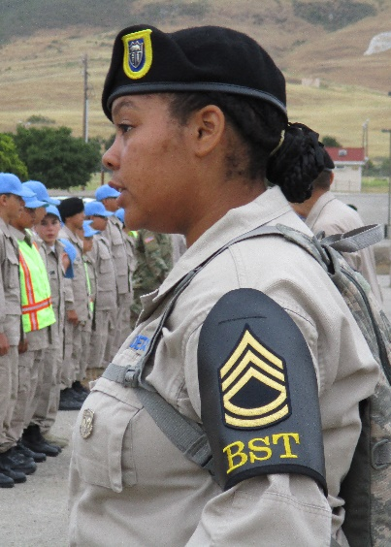
Platoon Sergeant
Primary assistant and advisor to Platoon Leader
Squad Leaders report to Platoon Sergeant
Responsible for training and caring for Cadets
Tasked with platoon readiness, drill and ceremonies, and accountability

Slide 38
Platoon Sergeant
Sets example of discipline and positive attitude
Assist in supervision of the Squad Leaders as they conduct events; ensure safety of Cadets
Develop spirit of teamwork; give Squad Leaders sense of purpose
Submit absentee reports to Company First Sergeant for accurate accountability

Slide 39
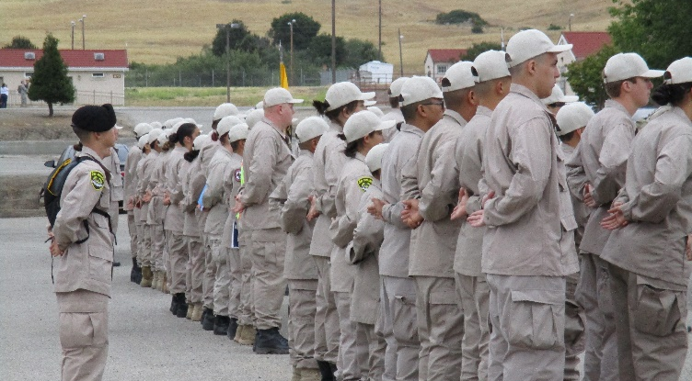
Platoon Sergeant
Assist Platoon Leader in training particularly in military courtesy and uniform wear
Counsel personnel at Squad Leader's request to help teach leadership
Assume control of platoon in Platoon Leader’s absence
Oversee Cadet welfare and safety

Slide 40
Platoon Sergeant
Assign, oversee, mentor Squad Leaders
Manage all tasks and guidance from Platoon Leader
Ensure Cadets comply with success and safety standards
Encourage platoon members to attend activities, march in parades, joining the Color Guard and Flag Detail, participate in the Drill Team and Individual Major Awards competitions, and other opportunities
Motivate platoon, provide goals and vision, grow esprit de corps in platoon

Slide 41
Check on Learning
T/F: The Platoon Sergeant is not responsible for training and caring for cadets.
The primary task of a Platoon Sergeant is:
Platoon readiness, drill/ceremony, accountability
Squad formation
Encourage cadets to attend activities, Color Guard, Flag Detail

Slide 42
PLATOON LEADER
A5. Platoon Leader

Slide 43
Leadership Roles at the School Level
OBJECTIVES
Cadets will be prepared to work within the structure of the cadet battalion or brigade, and serve successfully in leadership positions within the California Cadet Corps.
Plan of Action
Describe the role and responsibilities of the cadet leadership position in California Cadet Corps Battalions: Platoon Leader.
Essential Question: What is the role of the Platoon Leader?

Slide 44
Platoon Leader
Directly responsible for platoon
Primary job – leadership, training, discipline
Opportunity and privilege to be role model, coach, counselor

Slide 45
Platoon Leader
Keep Company Commander apprised of platoon status
Organize and maintain effective chain of command
Work closely with Platoon Sergeant to manage Cadets; knows Cadets’ strengths and weaknesses
Inspect platoon at formations; establish platoon standards
Responsible for Cadet readiness – physical fitness, 201 files, behavior and conduct

Slide 46
Platoon Leader
Know cadet regulations; ensure platoon knows, follows
Enforce orders from superiors
However, if you think an order is wrong, discuss with chain of command or instructor
Develop spirit of teamwork; instill respect, obedience, cooperation
Develop leadership through coaching, training, counseling, and mentorship

Slide 47
Platoon Leader
Know all phases of drill; able to supervise and conduct platoon drill
If the senior officer present in formation, able to conduct company drill
Promote cadet mastery of basic CACC knowledge
Set high standard of personal appearance and conduct

Slide 48
Platoon Leader
Resolve leadership, training, and disciplinary problems
If unable to solve a problem, seek advice and assistance of Company Commander, Company XO, or First Sergeant
Aid or provide counseling to personnel in the platoon as necessary
Know how to receive and give orders

Slide 49
Check on Learning
Who is the Platoon Leader directly responsible for?
T/F: The primary job of a Platoon Leader is leadership, training and discipline.
T/F: It is not important for the Platoon Leader to know how to conduct drill.

Slide 50
Platoon Sergeant Platoon Leader
Practical Exercise (10 minutes)
Evaluate Your Squads
Platoon Sergeant(s) and Platoon Leader:
Select cadets for demonstration of the Manual of the Guidon tasks assigned
Give feedback to Cadets/Squad Leaders

Slide 51
FIRST SERGEANT
A6. First Sergeant

Slide 52
Leadership Roles at the School Level
OBJECTIVES
Cadets will be prepared to work within the structure of the cadet battalion or brigade, and serve successfully in leadership positions within the California Cadet Corps.
Plan of Action
Describe the role and responsibilities of the cadet leadership position in California Cadet Corps Battalions: First Sergeant.
Essential Question: What is the role of the First Sergeant?

Slide 53
First Sergeant
The senior enlisted advisor of a company
Command leadership responsibilities
Handles NCO development of Cadets

Slide 54
First Sergeant
Maintain accountability of all Cadets
Recommend Cadets for special assignments within the unit
Manage promotions
Manages disciplinary issues
Primary time manager for the
company, effecting timeliness
through NCO Chain

Slide 55
First Sergeant
Supervise unit support (admin, safety, supply, communications) operations
Supervise and communicate with Platoon Sergeants
Promote proper use of military courtesies - enforce unit discipline in conduct and uniform
Initiate Company formations

Slide 56
Check on Learning
T/F: The First Sergeant handles leadership of Cadets, specifically NCO development.
Does the First Sergeant initiate company formations?
T/F: It is not the responsibility of the First Sergeant to manage promotions

Slide 57
COMPANY EXECUTIVE OFFICER
A7. Company Executive Officer

Slide 58
Leadership Roles at the School Level
OBJECTIVES
Cadets will be prepared to work within the structure of the cadet battalion or brigade, and serve successfully in leadership positions within the California Cadet Corps.
Plan of Action
Describe the role and responsibilities of the cadet leadership position in California Cadet Corps Battalions: Company Executive Officer.
Essential Question: What is the role of the Company Executive Officer?

Slide 59
Company Executive Officer (XO)
Manage staff
Report to the Commanding Officer
Ensure Commander’s message is communicated clearly and properly to command staff
Typically responsible for management of day-to-day activities

Slide 60
Company XO
Second in command; assume command responsibilities in Company Commander's absence
Assign tasks to company staff NCOs
Supervise company awards program; promote company honor unit point attainment
Ensure dates and times met by platoon leaders
Safety and risk assessment of all company events

Slide 61
Check on Learning
What is the Company XO typically responsible for:
Management of day to day activities
Platoon formation
Safety and risk assessment at company events
T/F: The Company XO ensures the Company Commander’s message is communicated somewhat to the command staff

Slide 62
COMPANY COMMANDER
A8. Company Commander

Slide 63
Leadership Roles at the School Level
OBJECTIVES
Cadets will be prepared to work within the structure of the cadet battalion or brigade, and serve successfully in leadership positions within the California Cadet Corps.
Plan of Action
Describe the role and responsibilities of the cadet leadership position in California Cadet Corps Battalions: Company Commander.
Essential Question: What is the role of the Company Commander?

Slide 64
Company Commander
Considered prestigious assignment
Full command and control over unit; may exercise authority over unit personnel
Ultimately responsible for safety, efficiency, and training of all under their command
Held accountable for actions of their Cadets
Oversee moral leadership of Cadets; present themselves as a positive moral influence

Slide 65
Company Commander
Establish tone and command climate of company
Set priorities for company training and missions
Lead company at battalion formations, ensuring subordinates perform drill properly
Provide instruction and counseling to subordinate commanders concerning command and leadership
Ensure company is prepared for all missions and inspections

Slide 66
Check on Learning
T/F: The Company Commander is held accountable for the actions of their Cadets.
Is the Company Commander ultimately responsible for safety, efficiency, and training of all under their command?

Slide 67
First Sergeant, XO, CO
Practical Exercise (5-15 minutes)
Train the Trainers
The dynamics of leadership within each unit may be different. Have the top class leaders provide a short briefing on the use and importance of the Cadet Regulations.

Slide 68
S1: ADMINISTRATION and PERSONNEL
A9. S1: Administration and Personnel

Slide 69
Leadership Roles at the School Level
OBJECTIVES
Cadets will be prepared to work within the structure of the cadet battalion or brigade, and serve successfully in leadership positions within the California Cadet Corps.
Plan of Action
Describe the role and responsibilities of the cadet leadership position in California Cadet Corps Battalions: S1 – Administration and Personnel.
Essential Question: What is the role of the S1 – Administration and Personnel?

Slide 70
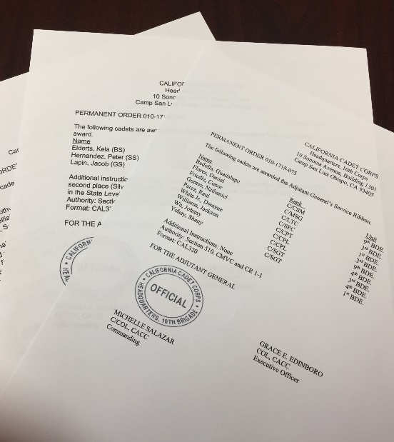
S1: Administration and Personnel
Administrative Office manages personnel and administrative systems
Function as administrative liaison between CACC units and HQ
Handle personnel action: promotions, awards, administration, assignments force structure
Also called the Adjutant
Battalion may have one or more Assistant S1s and Admin NCOs.

Slide 71
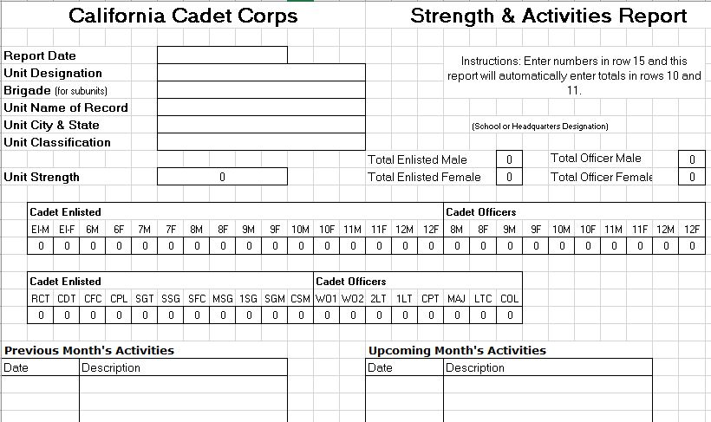
S1: Administration and Personnel
Commander’s primary point of contact for personnel accountability
Submit monthly SAR monthly to HQ
Manage unit’s regulation library
and forms
Organize unit files;
coordinate with all
staff sections

Slide 72
S1: Administration and Personnel
Process Cadet orders and permanent orders
Establish and maintain personnel records
Manage unit’s awards program
Perform duty of Adjutant in battalion formations
In charge of morale activities

Slide 73
Check on Learning
The S1 office handle _____________ and ______________ systems.
T/F: The S1 is also called the Adjutant.
What monthly report does the S1 submit to HQ?

Slide 74
S2: SAFETY and SECURITY
A10. S2: Safety and Security

Slide 75
Leadership Roles at the School Level
OBJECTIVES
Cadets will be prepared to work within the structure of the cadet battalion or brigade, and serve successfully in leadership positions within the California Cadet Corps.
Plan of Action
Describe the role and responsibilities of the cadet leadership position in California Cadet Corps Battalions: S2 – Safety and Security.
Essential Question: What is the role of the S2 – Safety and Security?

Slide 76
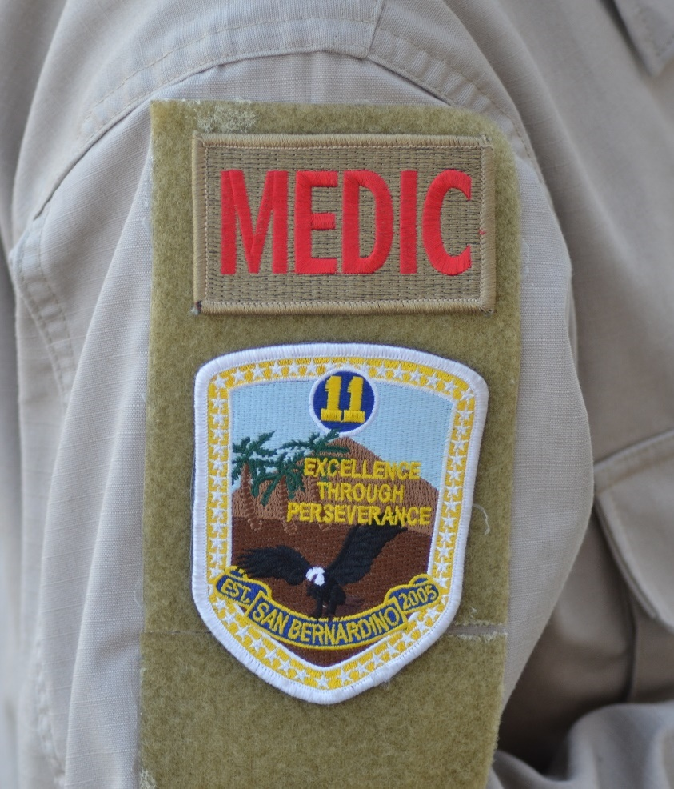
S2: Safety and Security
Cadet Corps S2 is different from the Army
Changed from traditional security and intelligence to medical services and safety of Cadets

Slide 77
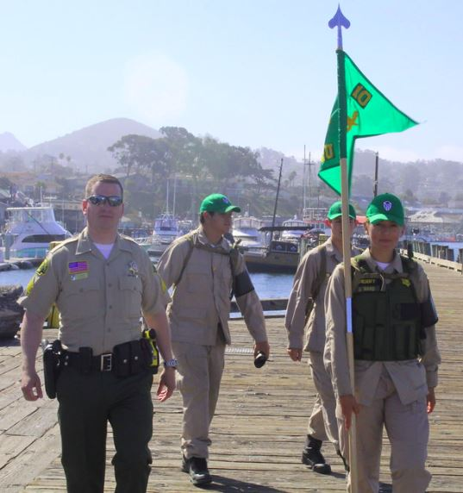
S2: Safety and Security
Supervise unit physical security
Provide risk assessments and safety briefings
Plan and conduct unit training
Develop and implement medical service plans for Cadets at events
Sick call procedures
Medication management and administration protocols
Treatment of minor and major injuries and illnesses (with adult supervision)

Slide 78
Check on Learning
T/F: The S2 in the CACC provides medical services and safety of Cadets.
Does the S2 provide risk assessments and safety briefings?

Slide 79
S3: TRAINING AND OPERATIONS
A11. S3: Training and Operations

Slide 80
Leadership Roles at the School Level
OBJECTIVES
Cadets will be prepared to work within the structure of the cadet battalion or brigade, and serve successfully in leadership positions within the California Cadet Corps.
Plan of Action
Describe the role and responsibilities of the cadet leadership position in California Cadet Corps Battalions: S3 – Training and Operations.
Essential Question: What is the role of the S3 – Training and Operations?

Slide 81
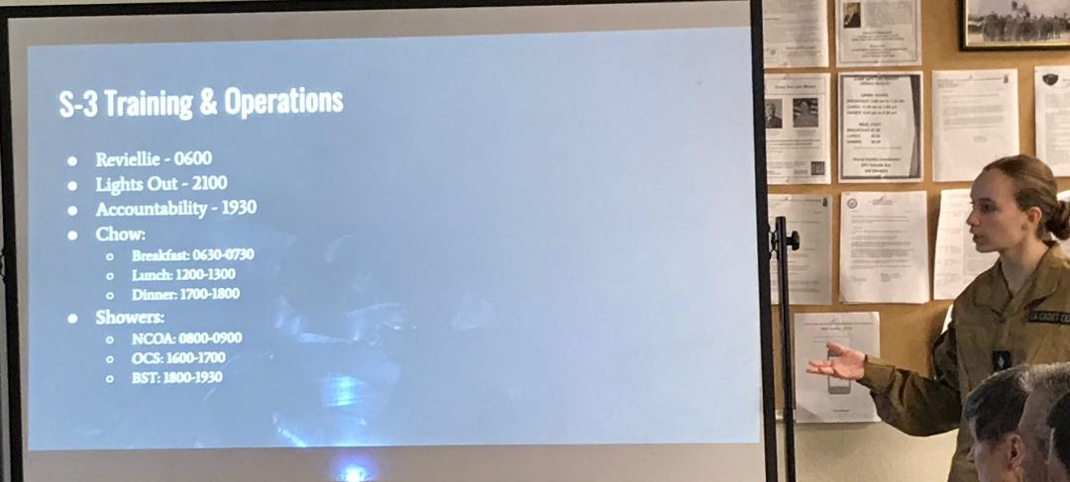
S3: Training and Operations
Training and Operations Officers identify training needs, planning, organizing, and oversight of training
Training Officer ensures ongoing military education of Cadets.

Slide 82
S3: Training and Operations
Create operational plans implemented by all unit leaders and staff
Coordinate activities and operations with staff
Advise Commander concerning training and other matters that can affect the unit’s status
Publish and maintain training schedules and files

Slide 83
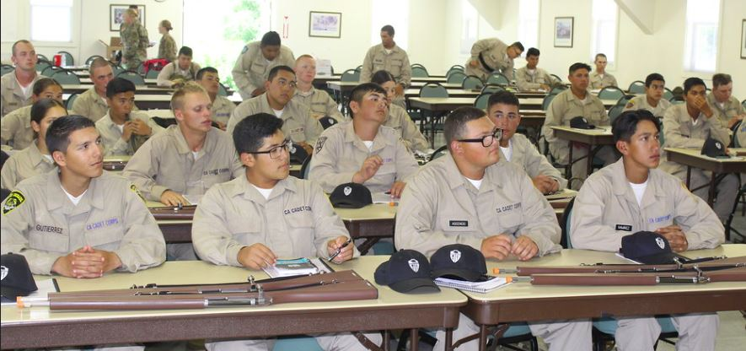
S3: Training and Operations
Manage unit training resources
Visit smaller battalion units to assess leadership readiness
Produce AARs for unit events

Slide 84
Check on Learning
The _________ Officer identifies ensures ongoing military education of Cadets.
T/F: The S3 creates operational plans implemented by all unit leaders and staff.

Slide 85
S4: SUPPLY AND LOGISTICS
A12. S4: Supply and Logistics

Slide 86
Leadership Roles at the School Level
OBJECTIVES
Cadets will be prepared to work within the structure of the cadet battalion or brigade, and serve successfully in leadership positions within the California Cadet Corps.
Plan of Action
Describe the role and responsibilities of the cadet leadership position in California Cadet Corps Battalions: S4 – Supply and Logistics.
Essential Question: What is the role of the S4 – Supply and Logistics?

Slide 87
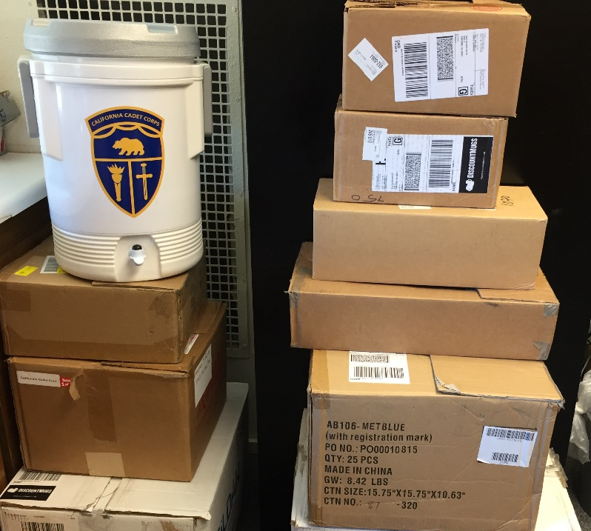
S4: Supply and Logistics
Supply Officer manages ALL supplies and equipment
Usually at battalion level
Supervise Supply Sergeants at company level
Manage storage of unit supplies, accountability of property, and logistics support of unit activities

Slide 88
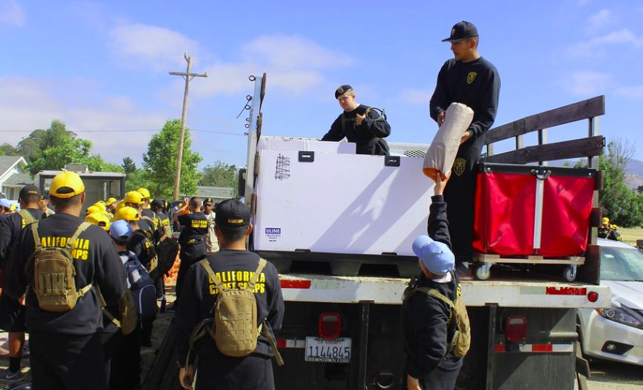
S4: Supply and Logistics
Conduct periodic inventory of property
Requisition, receive, and store supplies issued
Prepare lateral supply transfer from unit to unit
Requisition and stock awards

Slide 89
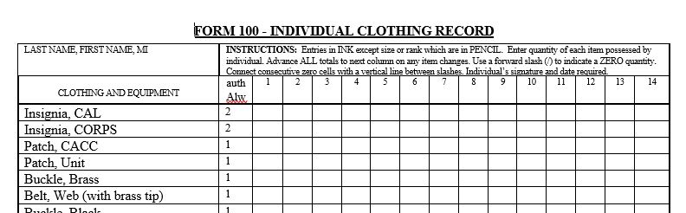
S4: Supply and Logistics
Maintain individual clothing records
Maintain unit property book stock records
Maintain Temporary Hand Receipts
Plan, coordinate, and execute logistics support necessary for unit activities

Slide 90
Check on Learning
The S4 manages ALL of what?
The S4 maintains which of the following:
Individual clothing records
Unit property book stock records
Temporary Hand Receipts

Slide 91
S5: CIVIC, PUBLIC AND MILITARY RELATIONS
A13. S5: Civic, Public and Military Relations

Slide 92
Leadership Roles at the School Level
OBJECTIVES
Cadets will be prepared to work within the structure of the cadet battalion or brigade, and serve successfully in leadership positions within the California Cadet Corps.
Plan of Action
Describe the role and responsibilities of the cadet leadership position in California Cadet Corps Battalions: S5 – Civic, Public and Military Relations.
Essential Question: What is the role of the S5 – Civic, Public and Military Relations?

Slide 93
S5: Civic, Public and Military Relations
Responsible for public outreach, engagement, and relationship management with:
Cadets
Parents and families
Local communities
Legislative offices
Tell the unit and Cadet Corps story
Manage unit social media presence
Facebook, Twitter, YouTube, etc.

Slide 94
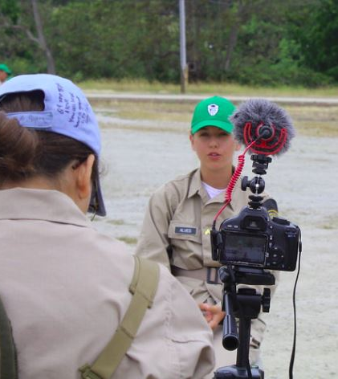
S5: Civic, Public and Military Relations
Prepare and release information bulletins
Coordinate community service activities support
Communicate with media outlets (under adult supervision)

Slide 95
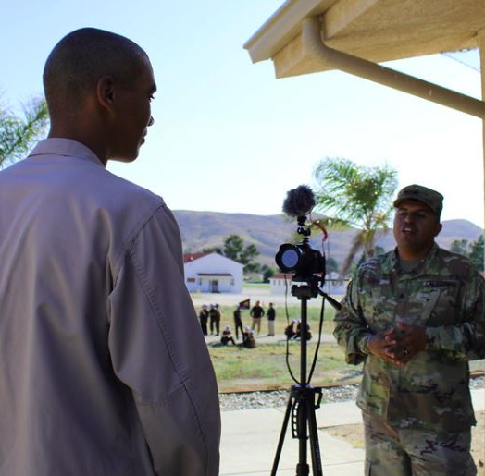
S5: Civic, Public and Military Relations
Maintain list of local press, media and community contacts
Invite distinguished guests and press to unit activities
Escort visitors and VIPs when visiting the unit

Slide 96
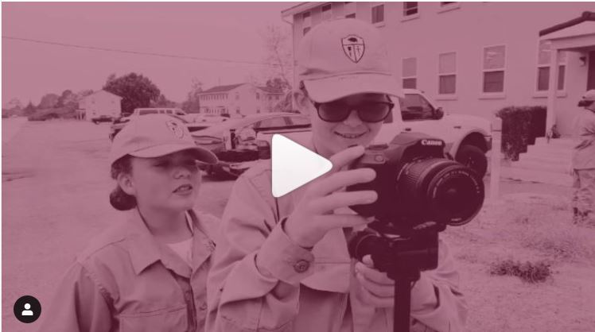
S5: Civic, Public and Military Relations
https://www.instagram.com/p/BzZDgyABt9f/

Slide 97
Check on Learning
The S5 is responsible for public outreach, engagement, and relationship management with who?
T/F: It is the S5 officer that tells the unit and Cadet Corps story.

Slide 98
S6: COMMUNICATIONS AND IT
A14. S6: Communications and IT

Slide 99
Leadership Roles at the School Level
OBJECTIVES
Cadets will be prepared to work within the structure of the cadet battalion or brigade, and serve successfully in leadership positions within the California Cadet Corps.
Plan of Action
Describe the role and responsibilities of the cadet leadership position in California Cadet Corps Battalions: S6 – Communications and IT.
Essential Question: What is the role of the S6 – Communications and IT?

Slide 100
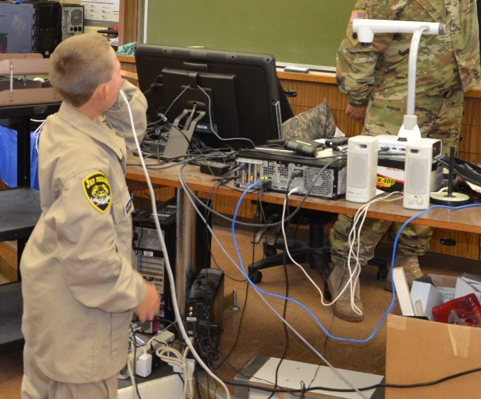
S6: Communications and IT
Responsible for the entire communication system
Plan for all facets of communication and technology

Slide 101
S6: Communications and IT
Advise commander on information technology, communication electronics and computers
Develop and implement radio communication protocols
Serve as the staff “expert” on computer hardware, software, and peripherals

Slide 102
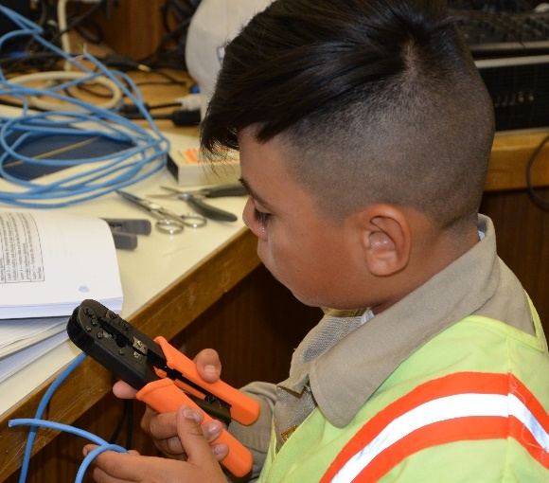
S6: Communications and IT
Maintain unit website
Ensure security of data maintained on computers
Maintain and manage other electronic equipment
Copiers, camcorders, cameras, etc.

Slide 103
Check on Learning
T/F: Is it not the responsibility of the S6 to plan for all areas of communication and technology
The S6 is responsible for which of the following:
Maintain unit social media
Maintain unit website
Maintain electronic equipment

Slide 104
Staff Units
Practical Exercise (10 minutes)
Play a Game
Divide class into two groups
Have each group assign a spokesperson
Each group calls out which S unit is responsible for that item
The group that calls out the most correct answers wins!

Slide 105
Staff Units
Form 13
Report of Survey
Set up Bivouac
Permanent Orders
Color Guard Roster
Risk Assessment
Charging Radios
Provide Extension Cords
Interview a Veteran
Storing Rifles
Class on Tying Knots
Ribbon Chart
Attend District Meeting
Post Articles on Unit Website
Establish First-Aid Station

Slide 106
BATTALION EXECUTIVE OFFICER (XO)
A15. Battalion Executive Officer (XO)

Slide 107
Leadership Roles at the School Level
OBJECTIVES
Cadets will be prepared to work within the structure of the cadet battalion or brigade, and serve successfully in leadership positions within the California Cadet Corps.
Plan of Action
Describe the role and responsibilities of the cadet leadership position in California Cadet Corps Battalions: Battalion Executive Officer (XO).
Essential Question: What is the role of the Battalion Executive Officer (XO)?

Slide 108
Battalion Executive Officer (XO)
Primary duties:
Supervise Battalion staff
Ensure directives of Battalion Commander are carried out
Plan and provide battalion support
Second in command of the Battalion

Slide 109
Battalion XO
Prepared to assume command of unit when Commander or Deputy Commander is absent
Supervise staff operations and activities
Supervise preparation and submission of required reports
Provide instruction and counseling to staff officers regarding staff function and effective communication

Slide 110
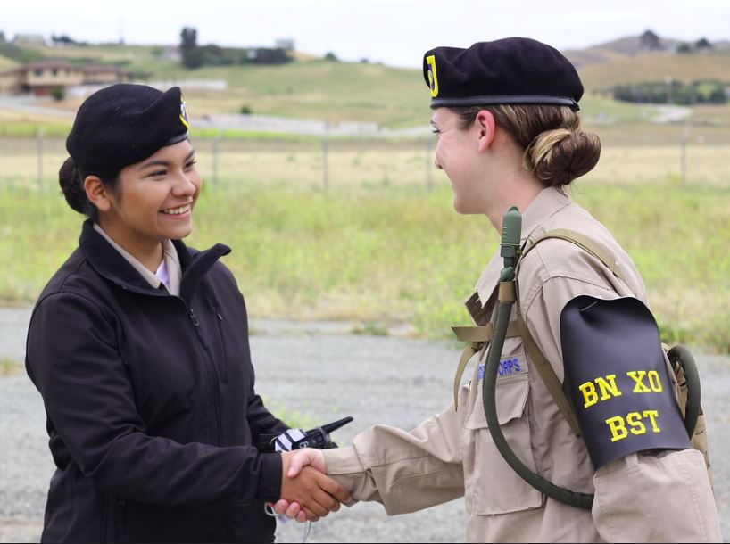
Battalion XO
Ensure proper lateral staff coordination and communications
Designate appropriate staff section to:
Conduct project planning
Coordinate actions of subordinate units

Slide 111
Battalion XO
Make recommendations to unit commander for officer appointment and retention
Coordinate recommendations for promotions and awards; submit to Battalion Commander for approval
Coordinate command inspection program (including AGI)

Slide 112
Battalion XO
Supervise preparation and delivery of command briefings to visitors and inspectors
Assist unit commander as required
Serve as Commander of Troops at Pass in Review ceremonies

Slide 113
Check on Learning
Battalion XO is responsible for which of the following:
Supervise Battalion staff
Ensure directives of Battalion Commander are carried out
Serves as Commander of Troops at Pass in Review ceremonies
T/F: The Battalion XO coordinates command inspection program (AGI).

Slide 114
BATTALION COMMAND SERGEANT MAJOR (CSM)
A16. Battalion Command Sergeant Major (CSM)

Slide 115
Leadership Roles at the School Level
OBJECTIVES
Cadets will be prepared to work within the structure of the cadet battalion or brigade, and serve successfully in leadership positions within the California Cadet Corps.
Plan of Action
Describe the role and responsibilities of the cadet leadership position in California Cadet Corps Battalions: Battalion Command Sergeant Major (CSM).
Essential Question: What is the role of the Battalion Command Sergeant Major (CSM)?

Slide 116
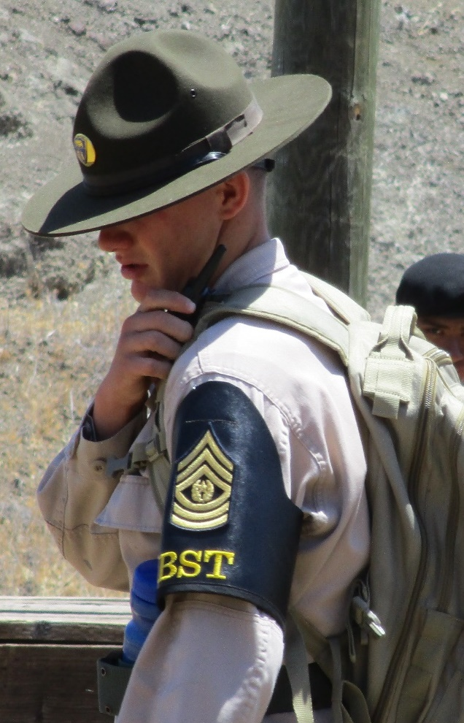
Battalion Command Sergeant Major (CSM)
Senior enlisted member of the Battalion.
Supervise NCOs and enlisted Cadets
Advise Battalion Commander on all matters regarding Cadets and NCOs

Slide 117
Battalion CSM
Senior non-commissioned officer representative
Advisor to commander, especially in matters of training and discipline
Design and implement unit NCO development programs
Management of battalion headquarters (staff NCOs) along with XO

Slide 118
Battalion CSM
Keep high standards of cadet uniform wear and military courtesies
Assist S-2 in proper implementation of safety program
Help train and counsel NCOs and enlisted cadets regarding attitude, appearance, military courtesy, and discipline; reports serious cases to Battalion Commander
Supervise Color Guard, flag detail and teams to the highest standards of training and appearance

Slide 119
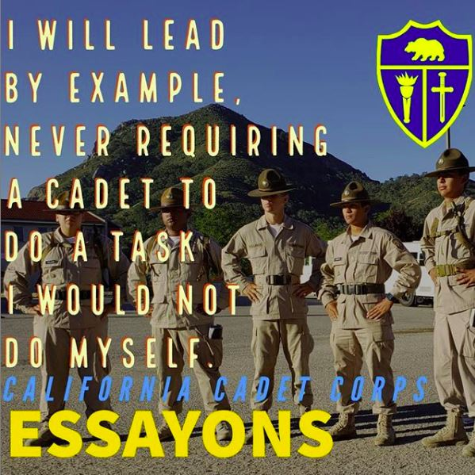
Battalion CSM
Conduct periodic inspection of the CACC area for cleanness
Manage accountability activities
Manage formations and ceremonies

Slide 120
Check on Learning
T/F: The Command Sergeant Major the senior NCO member of the Battalion
The CSM is responsible for which of the following:
Design unit NCO development programs
Supervisor Color Guard and flag detail
Manage formations and ceremonies
Gives command briefings to visitors and inspectors

Slide 121
BATTALION COMMANDER (CO)
A17. Battalion Commander (CO)

Slide 122
Leadership Roles at the School Level
OBJECTIVES
Cadets will be prepared to work within the structure of the cadet battalion or brigade, and serve successfully in leadership positions within the California Cadet Corps.
Plan of Action
Describe the role and responsibilities of the cadet leadership position in California Cadet Corps Battalions: Battalion Commander (CO).
Essential Question: What is the role of the Battalion Commander (CO)?

Slide 123
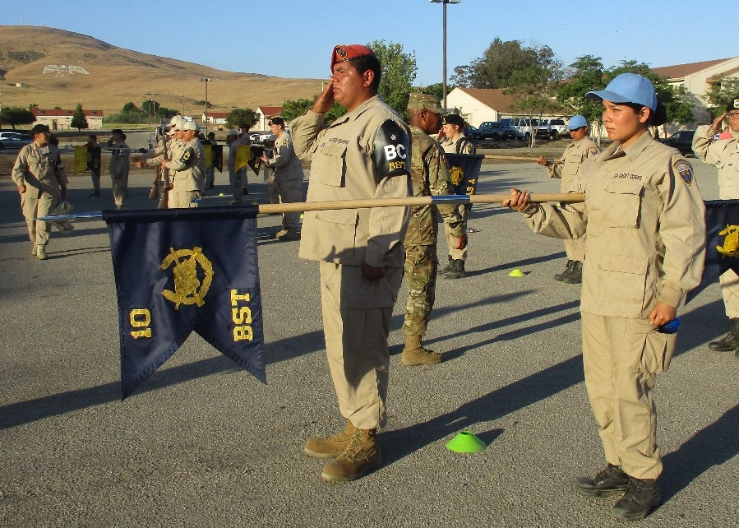
Battalion Commander
Responsible for everything that the Battalion does or fails to do
Directs subordinate units through Company Commanders, and
staff through the
Executive Officer
Provide unit vision
and goals

Slide 124
Battalion Commander
Command the Battalion at parades and ceremonies
Set the vision and goals for the unit
Lead unit in accomplishment of missions and projects
Establish a climate that promotes mutual respect and confidence

Slide 125
Battalion Commander
Supervise the Battalion Executive Officer, Company Commanders, and Battalion Command Sergeant Major
Ensure fully trained to perform duties
Ensure high morale throughout the unit
Determine scope of unit command inspection programs; conduct command inspections

Slide 126
Battalion Commander
Implement unit discipline policy and program
Make recommendations to the Commandant on matters affecting the battalion
Staffing, promotions, awards and operations
Provide instruction and counseling to subordinate commanders concerning command and leadership

Slide 127
Check on Learning
T/F: The Battalion Commander is responsible for everything the Battalion does or fails to do.
Is the BC responsible for promoting mutual respect and confidence in the Battalion?
The BC directly supervisors which of the following:
Executive Officer
Company Commanders
Sergeant Major

Slide 128
